Slide 1
ICC 2026
Relationship between post-treatment mPAP and Peak VO₂ in CTEPH patients

Slide 2

Relationship between post-treatment mPAP and Peak VO₂ in CTEPH patients
・
Kuniyoshi Fukai ,MD ,Ph.D.
Omihachiman community medical center
Omihachiman, Shiga, Japan

Slide 3
Introduction
The goal of treatment for chronic thromboembolic pulmonary hypertension (CTEPH) has shifted from improving prognosis to improving quality of life₁₎.
However, the degree of improvement in quality of life varies widely, and there is no set standard for post-treatment assessment, including symptom improvement, oxygen discontinuation, and the presence or absence of exercise-induced pulmonary hypertension₂₎.
In this study, we analyzed our own institution's data based on previously reported cardiopulmonary exercise testing (CPX) data₃₎ and evaluated the efficacy of CPX and the patient population in which normalization occurred.
Circ Cardiovasc Qual Outcome.2017 Nov:10(11): e004029
Eur Respir J 2020; 56: 1901982
Heart 2016 Sep ;102(17):1403-9

Slide 4
Methods
A single-center retrospective analysis was conducted on 42 consecutive cases of CTEPH treated with balloon pulmonary angioplasty (BPA) at our hospital between January 2020 and February 2025.
Exclusion criteria: Lack of CPX data after BPA
We analyzed 17 cases with CPX before and after BPA
Normalization was defined as reaching Peak VO₂ 80% or higher.
・

Slide 5
Patient Characteristics
 | Overall (n=17)
Age at diagnosis, yrs | 64.2±13.4
Female | 15 (88.2%)
NYHA Ⅱ | 9 (52.9%)
Ⅲ | 7 (41.1%)
Ⅳ | 1 (5.8%)
Hypertension | 8 (47.0%)
Diabetes | 2 (11.8%)
Dyslipidemia | 6 (35.3%)
Smoker history | 1 (5.8%)
HFpEF | 7 (41.1%)
Obesity | 3 (17.6%)
Mental illness | 3 (17.6%)
 | Overall (n=17)
PH Medication none | 7 (41.1%)
Riociguat | 6 (35.3%)
Selexipag | 4 (23.5%)
DOAC | 16 (94.2%)
Warfarin | 1 (5.8%)
Pre mPAP | 39.1±13.6
Post mPAP | 20.6±3.6

Slide 6
Results
Mean age 68±8.0 yrs
CI 2.58±0.52
mPAP 39.0±11.3➡24.5±5.3mmHg
Mean age 64.2±13.4 yrs
CI 2.52±0.41
mPAP 39.1±13.6➡20.6±3.6mmHg
Heart 2016;102:1403-1409
Our data
・
<Peak VO₂ % predicted (%)>
Pre 61.3±11.9 ➡ 53.3±10.3
Post 70.7±9.4 ➡ 69.6±18.5
<VO₂ at AT % predicted (%)>
Post 61.7±65.6 ➡ 66.6±13.2
<VE-VCO₂ slope>
Post 42.1±10.2 ➡ 36.2±6.9
Improvement in pulmonary artery pressure is not the only factor affecting Peak VO2.
・
Heart 2016;102:1403-1409
Our data
OCMC data

Slide 7
Results
✓All normalized cases had mPAP of 20mmHg or less at rest (n=6)
Inhibitory factors for improving exercise tolerance
 | Relative risk | 95% Confidence interval | p-Value
HFpEF | 0.4 | 0.18-0.85 | <0.035
Obesity | 0.57 | 0.36-0.89 | 0.51
Respiratory disease | 0.62 | 0.42-0.91 | 0.69
Mental illness | 0.96 | 0.39-2.35 | 0.75
Anemia | ー | ー | 0.35
Hypertension | 0.51 | 0.23-1.10 | 0.13
Diabetes | 0.6 | 0.39-0.9 | 0.51
Female PH medication Age at diagnosis | 0.75 1.4 ー | 0.18-3.13 0.35-5.65 ー | 0.88 0.51 0.06
Logistic statistics, p<0.05
OCMC data

Slide 8
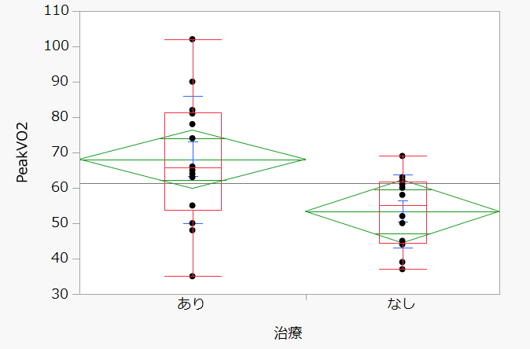
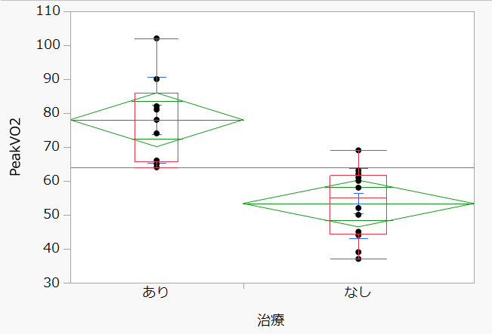
Results
＜Without HFpEF cases＞
p=0.018
p<0.001
Peak VO₂
Peak VO₂
110
90
70
50
30
110
90
70
50
30
Pre
Post
Pre
Post
・
・
Peak VO₂(%) 53.3±10.3➡ 69.6±18.5
Peak VO₂(%) 55.5±10.4➡ 78.0±12.6

Slide 9
Discussion
Only 17 of the 42 patients were able to be evaluated with CPX. Many of them could not be evaluated due to elderly, oxygen therapy, or frailty
Cardiac rehabilitation is very important. It has the therapeutic effect of increasing Peak VO₂ by 5-10%.
This study was conducted with a small population size and the results should be interpreted with caution.
・

Slide 10
Conclusion
Only patients with normalized resting mPAP can achieve Peak VO2 of 80% or higher.
HFpEF is the most influential factor affecting exercise tolerance.
・

