Slide 1
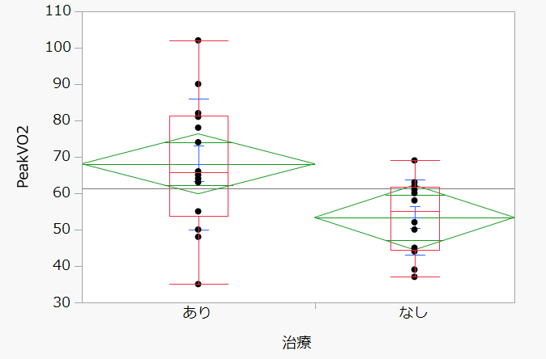
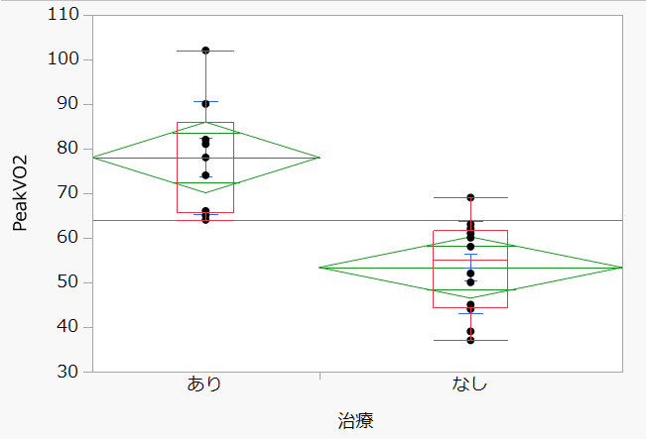









Relationship between post-treatment mPAP and Peak VO₂ in CTEPH patients
Kuniyoshi Fukai ,MD ,Ph.D. Omihachiman community medical center, Omihachiman, Shiga, Japan
Introduction
• The goal of treatment for chronic thromboembolic pulmonary hypertension (CTEPH) has shifted from improving prognosis to improving quality of life₁₎.
• However, the degree of improvement in quality of life varies widely, and there is no set standard for post-treatment assessment, including symptom improvement, oxygen discontinuation, and the presence or absence of exercise-induced pulmonary hypertension₂₎.
• In this study, we analyzed our own institution's data based on previously reported cardiopulmonary exercise testing (CPX) data₃₎ and evaluated the efficacy of CPX and the patient population in which normalization occurred.
Circ Cardiovasc Qual Outcome.2017 Nov:10(11): e004029
Eur Respir J 2020; 56: 1901982
Heart 2016 Sep ;102(17):1403-9
Methods
• A single-center retrospective analysis was conducted on 42 consecutive cases of CTEPH treated with balloon pulmonary angioplasty (BPA) at our hospital between January 2020 and February 2025.
• Exclusion criteria: Lack of CPX data after BPA
• We analyzed 17 cases with CPX before and after BPA
Normalization was defined as reaching Peak VO₂ 80% or higher.
Patient Characteristics
 | Overall (n=17)
Age at diagnosis, yrs | 64.2±13.4
Female | 15 (88.2%)
NYHA Ⅱ | 9 (52.9%)
Ⅲ | 7 (41.1%)
Ⅳ | 1 (5.8%)
Hypertension | 8 (47.0%)
Diabetes | 2 (11.8%)
Dyslipidemia | 6 (35.3%)
Smoker history | 1 (5.8%)
HFpEF | 7 (41.1%)
Obesity | 3 (17.6%)
Mental illness | 3 (17.6%)
 | Overall (n=17)
PH Medication none | 7 (41.1%)
Riociguat | 6 (35.3%)
Selexipag | 4 (23.5%)
DOAC | 16 (94.2%)
Warfarin | 1 (5.8%)
Pre mPAP | 39.1±13.6
Post mPAP | 20.6±3.6
Results
Results
Discussion
• Only 17 of the 42 patients were able to be evaluated with CPX. Many of them could not be evaluated due to elderly, oxygen therapy, or frailty
• Cardiac rehabilitation is very important.
It has the therapeutic effect of increasing Peak VO₂ by 5-10%.
• This study was conducted with a small population size and the results should be interpreted with caution.
Conclusions
• Only patients with normalized resting mPAP can achieve Peak VO2 of 80% or higher.
• HFpEF is the most influential factor affecting exercise tolerance.
Contact / QR
• E-mail: ku2fukai@koto.kpu-m.ac.jp
Mean age 68±8.0 yrs
CI 2.58±0.52
mPAP 39.0±11.3➡24.5±5.3mmHg
Mean age 64.2±13.4 yrs
CI 2.52±0.41
mPAP 39.1±13.6➡20.6±3.6mmHg
✓All normalized cases had mPAP of 20mmHg or less at rest (n=6)
< Inhibitory factors for improving exercise tolerance >
 | Relative risk | 95% Confidence interval | p-Value
HFpEF | 0.4 | 0.18-0.85 | <0.035
Obesity | 0.57 | 0.36-0.89 | 0.51
Respiratory disease | 0.62 | 0.42-0.91 | 0.69
Mental illness | 0.96 | 0.39-2.35 | 0.75
Anemia | ー | ー | 0.35
Hypertension | 0.51 | 0.23-1.10 | 0.13
Diabetes | 0.6 | 0.39-0.9 | 0.51
Female PH medication Age at diagnosis | 0.75 1.4 ー | 0.18-3.13 0.35-5.65 ー | 0.88 0.51 0.06
Heart 2016;102:1403-1409
Our data
<Peak VO₂ % predicted (%)>
3
Pre 61.3±11.9 ➡ 53.3±10.3
Post 70.7±9.4 ➡ 69.6±18.5
<VO₂ at AT % predicted (%)>
Post 61.7±65.6 ➡ 66.6±13.2
<VE-VCO₂ slope>
Post 42.1±10.2 ➡ 36.2±6.9
Logistic statistics, p<0.05
・
＜All cases＞
＜Without HFpEF cases＞
Improvement in mPAP is not the only factor affecting Peak VO2.
Peak VO₂
p=0.018
Peak VO₂
p<0.001
・
110
90
70
50
30
110
90
70
50
30
?
Heart 2016;102:1403-1409
Our data
・
Pre
Post
・
Pre
Post
Peak VO₂(%) 53.3±10.3➡ 69.6±18.5
Peak VO₂(%) 55.5±10.4➡ 78.0±12.6

