Slide 1
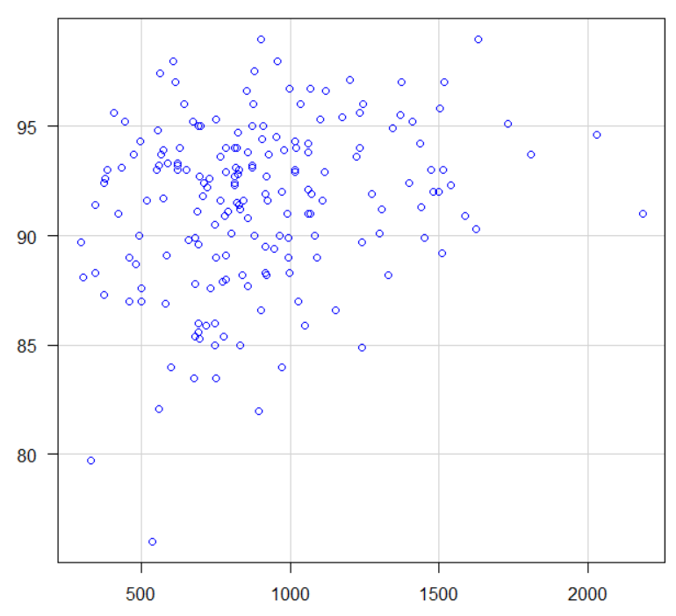








Determinants of Exercise Oxygen Desaturation After Balloon Pulmonary Angioplasty in CTEPH
Yohei Ishibashi^{1,2}, Takumi Inami¹.
1. Kyorin University Hospital, Department of Cardiology, Tokyo, Japan. 2. Gunma University Hospital, Department of Cardiology, Gunma, Japan
Introduction
・ Balloon pulmonary angioplasty (BPA) improves pulmonary hemodynamics in chronic thromboembolic pulmonary hypertension (CTEPH).
・ However, exercise-induced oxygen desaturation may persist despite successful treatment.
・ Some patients remain dependent on long-term oxygen therapy even after BPA.
・ The physiological determinants of impaired oxygenation after BPA remain unclear.
・ We investigated exercise oxygenation using exercise right heart catheterization data.
Results
Figure 2. Association of Peak Exercise SaO₂ and Peak VO₂
Table 1. Baseline characteristics
Table 2. Hemodynamic characteristics
Age | 63 ± 13
Female | 133 (70.7%)
BMI, kg/m² | 22.8 ± 3.6
Onset to Diagnosis, months | 12 (5-24)
PEA | 12 (6.4%)
APE | 93 (49.5%)
DVT | 44 (23.4%)
Smoking | 59 (31.4%)
WHO functional class (I/Ⅱ/Ⅲ/Ⅳ) | 2/58/120/8
BNP, pg/mL | 53 (25-168)
6-minute walk, m | 380 (325-440)
Oxygen therapy | 123 (65.4%)
 | RHC (before BPA) | RHC, rest (follow-up) | RHC, Peak Exercise
RA, ｍｍHg | 5 (3-6) | 3 (2-4)
RVEDP, mmHg | 8 (6-11) | 2 (-1-2)
PA, systolic, mmHg | 65 (49-77) | 32 (28-37) | 65 (56-74)
PA, diastolic, mmHg | 17 (12-22) | 8 (5-11) | 17 (13-21)
PA, mean, mmHg | 35 (27-42) | 23 (18-27) | 39 (33-45)
PCW, mmHg | 8 (6-11) | 11 (9-14) | 16 (12-21)
CO, L/min | 4.7 (3.9-5.7) | 5.5 (4.3-6.9) | 10.7 (8.5-13.0)
PVR, wood unit | 6.3 (4.3-9.6) | 2.0 (1.4-2.8) | 2.2 (1.4-2.8)
SaO₂, % | 93 (90-95) | 95 (93-97) | 92 (89-94)
Aa-DO₂, mmHg | 45 (34-54) | 27 (16-36) | 47 (40-54)
SaO₂, %
Methods
Figure 1. Study Flow
VO₂, mL/min
Consecutive CTEPH patients who underwent BPA at our center
(February 2009 – May 2024)
n = 385
Table 3. Multivariable Analysis of Peak Exercise SaO₂
Variable | β coefficient | 95% CI | p value
mPAP/CO slope | -0.0013 | -0.0032 – 0.0005 | 0.160
VE/VCO₂ slope | -0.062 | -0.139 – 0.015 | 0.110
Peak VO₂ | 0.0020 | 0.00025 – 0.00379 | 0.026
Excluded (n = 197)
No follow-up exercise right heart
catheterization within 1 year after
the final BPA session
Study population
Patients with follow-up exercise right heart catheterization
within 1 year after the final BPA session
n = 188
Discussion
・ Peak VO₂ was independently associated with peak SaO₂.
・ VE/VCO₂ slope showed a negative trend toward lower oxygenation.
mPAP/CO slope was not independently associated.
・ Exercise oxygenation is not determined solely by pulmonary hemodynamics.
・ Even after normalization of resting pulmonary pressures, impaired oxygenation during exercise may persist.
・ Exercise capacity and ventilatory efficiency play important roles in maintaining oxygenation.
・ These findings suggest that peripheral conditioning, ventilatory inefficiency, and ventilation–perfusion mismatch contribute to exercise desaturation.
・ Residual physiological limitation persists despite successful BPA and may explain ongoing functional impairment and oxygen therapy dependence.
Conclusions
Residual physiological limitation persists after BPA, and exercise capacity and ventilatory efficiency play key roles in exercise oxygenation.
Variables evaluated
• Peak exercise SaO₂
• Cardiopulmonary exercise variables
• Hemodynamic variables
Contact
Yohei Ishibashi, M.D. Ph.D.
E-mail: yishibashi.oct13@gmail.com
Disclosures
The authors declare no conflict of interest.
No external funding was received for this work.
Multivariable linear regression analysis
to identify determinants of peak exercise SaO₂
APE: Acute pulmonary embolism, BNP: B-type natriuretic peptide, BPA: Balloon pulmonary angioplasty, CTEPH: Chronic thromboembolic pulmonary hypertension, DVT: Deep vein thrombosis, PA: Pulmonary artery, PCW: Pulmonary capillary wedge, PEA: Pulmonary endarterectomy, PVR: Pulmonary vascular resistance, RA: Right atrium, RHC: Right heart catheterization, RVEDP: Right ventricular end-diastolic pressure, WHO: World Health Organization

