Slide 1
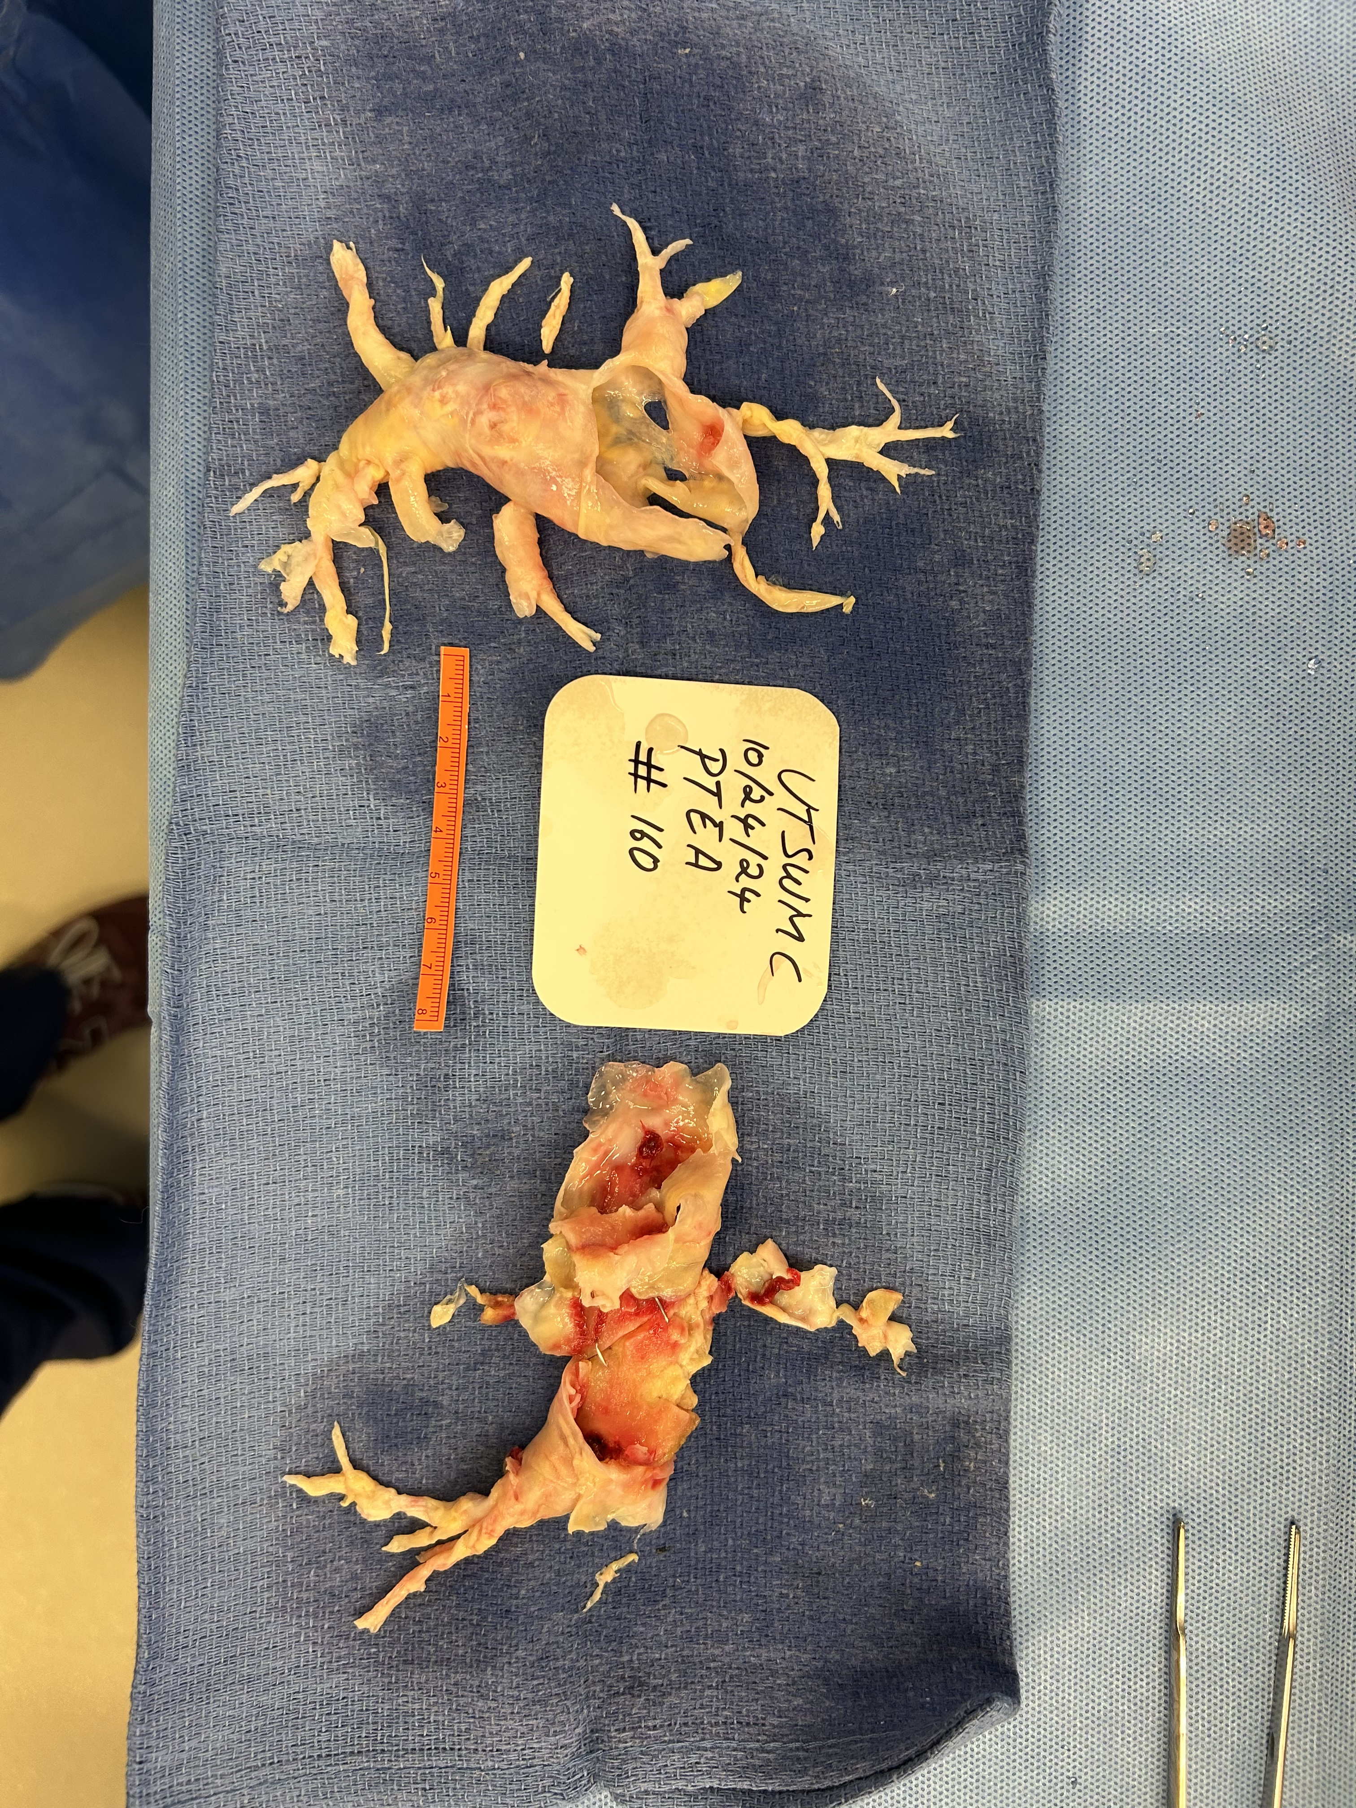
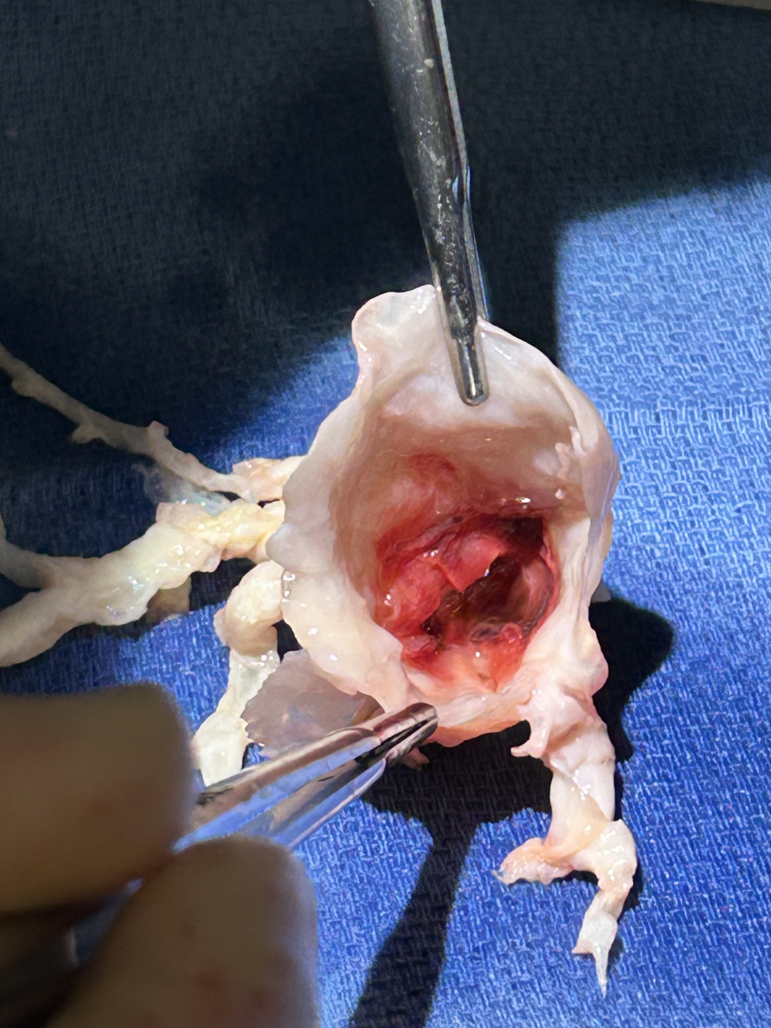
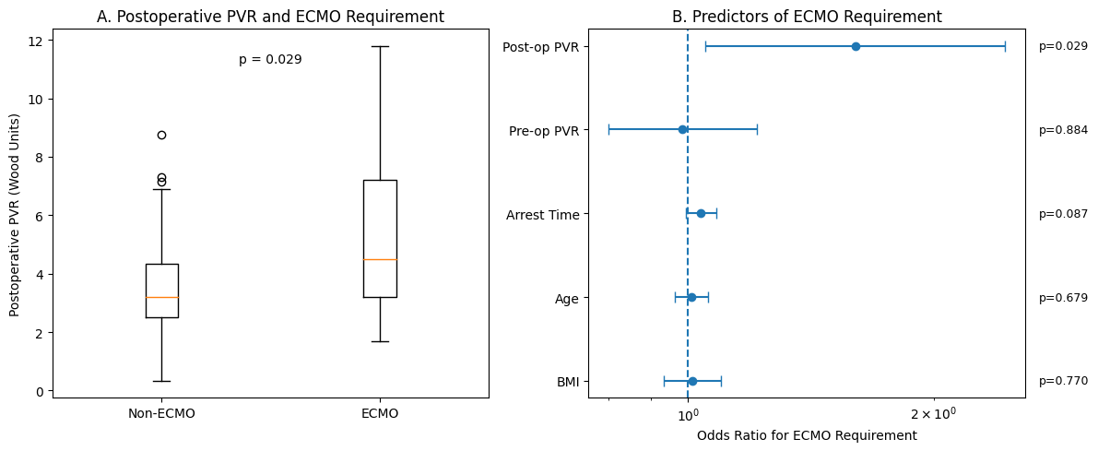








Predictors of ECMO Utilization After Pulmonary Thromboendarterectomy
Richard Whitlock MD¹, Lauryn Spinetta BS¹, Erin Hoover MD¹, Brandon Jakubowski MD², Elizabeth Hardin MD², Kara Goss MD², Grace Malampalli MD¹, Kelly Chin MD², Sonja Bartolome MD², Christopher Heid MD¹
1 University of Texas Southwestern Department of Cardiovascular and Thoracic Surgery
2 University of Texas Southwestern Department of Internal Medicine, Pulmonary and Critical Care Medicine,
Introduction
Pulmonary thromboendarterectomy (PTE) is the definitive surgical treatment for chronic thromboembolic pulmonary hypertension (CTEPH).
A subset of patients require extracorporeal membrane oxygenation (ECMO) support due to persistent pulmonary hypertension or right ventricular failure
Patients requiring ECMO after PTE often represent a particularly high-risk subgroup with severe preoperative pulmonary hypertension, persistent postoperative pulmonary vascular dysfunction, reperfusion injury, or right ventricular failure
ECMO may be required for circulatory support, severe hypoxemia, or refractory cardiopulmonary failure during the perioperative period
Patients requiring postoperative mechanical circulatory support frequently experience prolonged ICU stays, increased resource utilization, and higher mortality.
Predictors of ECMO requirement following PTE remain incompletely characterized
This study evaluated predictors of ECMO utilization following PTE.
Methods
Retrospective analysis was performed of a prospectively maintained institutional database
Patients undergoing PTE for CTEPH between October 2017 and May 2025
Patients supported with preoperative ECMO were excluded.
Demographic, preoperative hemodynamic, and operative variables were analyzed
Primary outcome was postoperative ECMO requirement.
Univariate analysis and multivariable logistic regression were used to identify predictors of ECMO utilization.
Results
A total of 191 patients underwent pulmonary thromboendarterectomy during the study period
ECMO support was required in 7.3% of patients (14/191)
  One patient required preoperative ECMO and was excluded from the predictors analysis
  ECMO support configuration was VV in 8 (57.1%), VA in 3 (21.4%), and VAV in 3 (21.4%) patients
Mean preoperative pulmonary vascular resistance was 7.9 ± 3.9 Wood units and decreased to 3.7 ± 2.2 Wood units postoperatively
Thirty-day mortality was 1.6% (3/191)
Postoperative ECMO support was required in 7.3% of patients (14/191).
Among patients requiring ECMO, 30-day mortality was 14.3% (2/14) compared to 0.6% (1/177) of patients not requiring postoperative ECMO
Higher postoperative pulmonary vascular resistance was independently associated with ECMO requirement on multivariable logistic regression (OR 1.63 per Wood unit increase, p = 0.029)
Total circulatory arrest time demonstrated a trend toward increased ECMO utilization (OR 1.04 per minute increase, p = 0.055) on univariable analysis.
Age, body mass index, and preoperative PVR were not significantly associated with ECMO use.
Discussion/Results
Conclusions
ECMO support following pulmonary thromboendarterectomy is uncommon but remains an important adjunct for patients with persistent postoperative pulmonary hypertension
Higher residual postoperative pulmonary vascular resistance after PTE is strongly associated with need for post-operative ECMO support needs
Our findings suggest incomplete hemodynamic recovery is a major driver of postoperative mechanical support
Contact / QR
• Corresponding Author: Richard Whitlock
Richard.whitlock@utsouthwestern.edu
Box plot demonstrating postoperative pulmonary vascular resistance (PVR) among patients requiring postoperative extracorporeal membrane oxygenation (ECMO) compared with patients not requiring ECMO support.
Forest plot demonstrating multivariable logistic regression analysis evaluating predictors of postoperative ECMO utilization following pulmonary thromboendarterectomy. Error bars represent 95% confidence intervals for odds ratios

