Slide 1
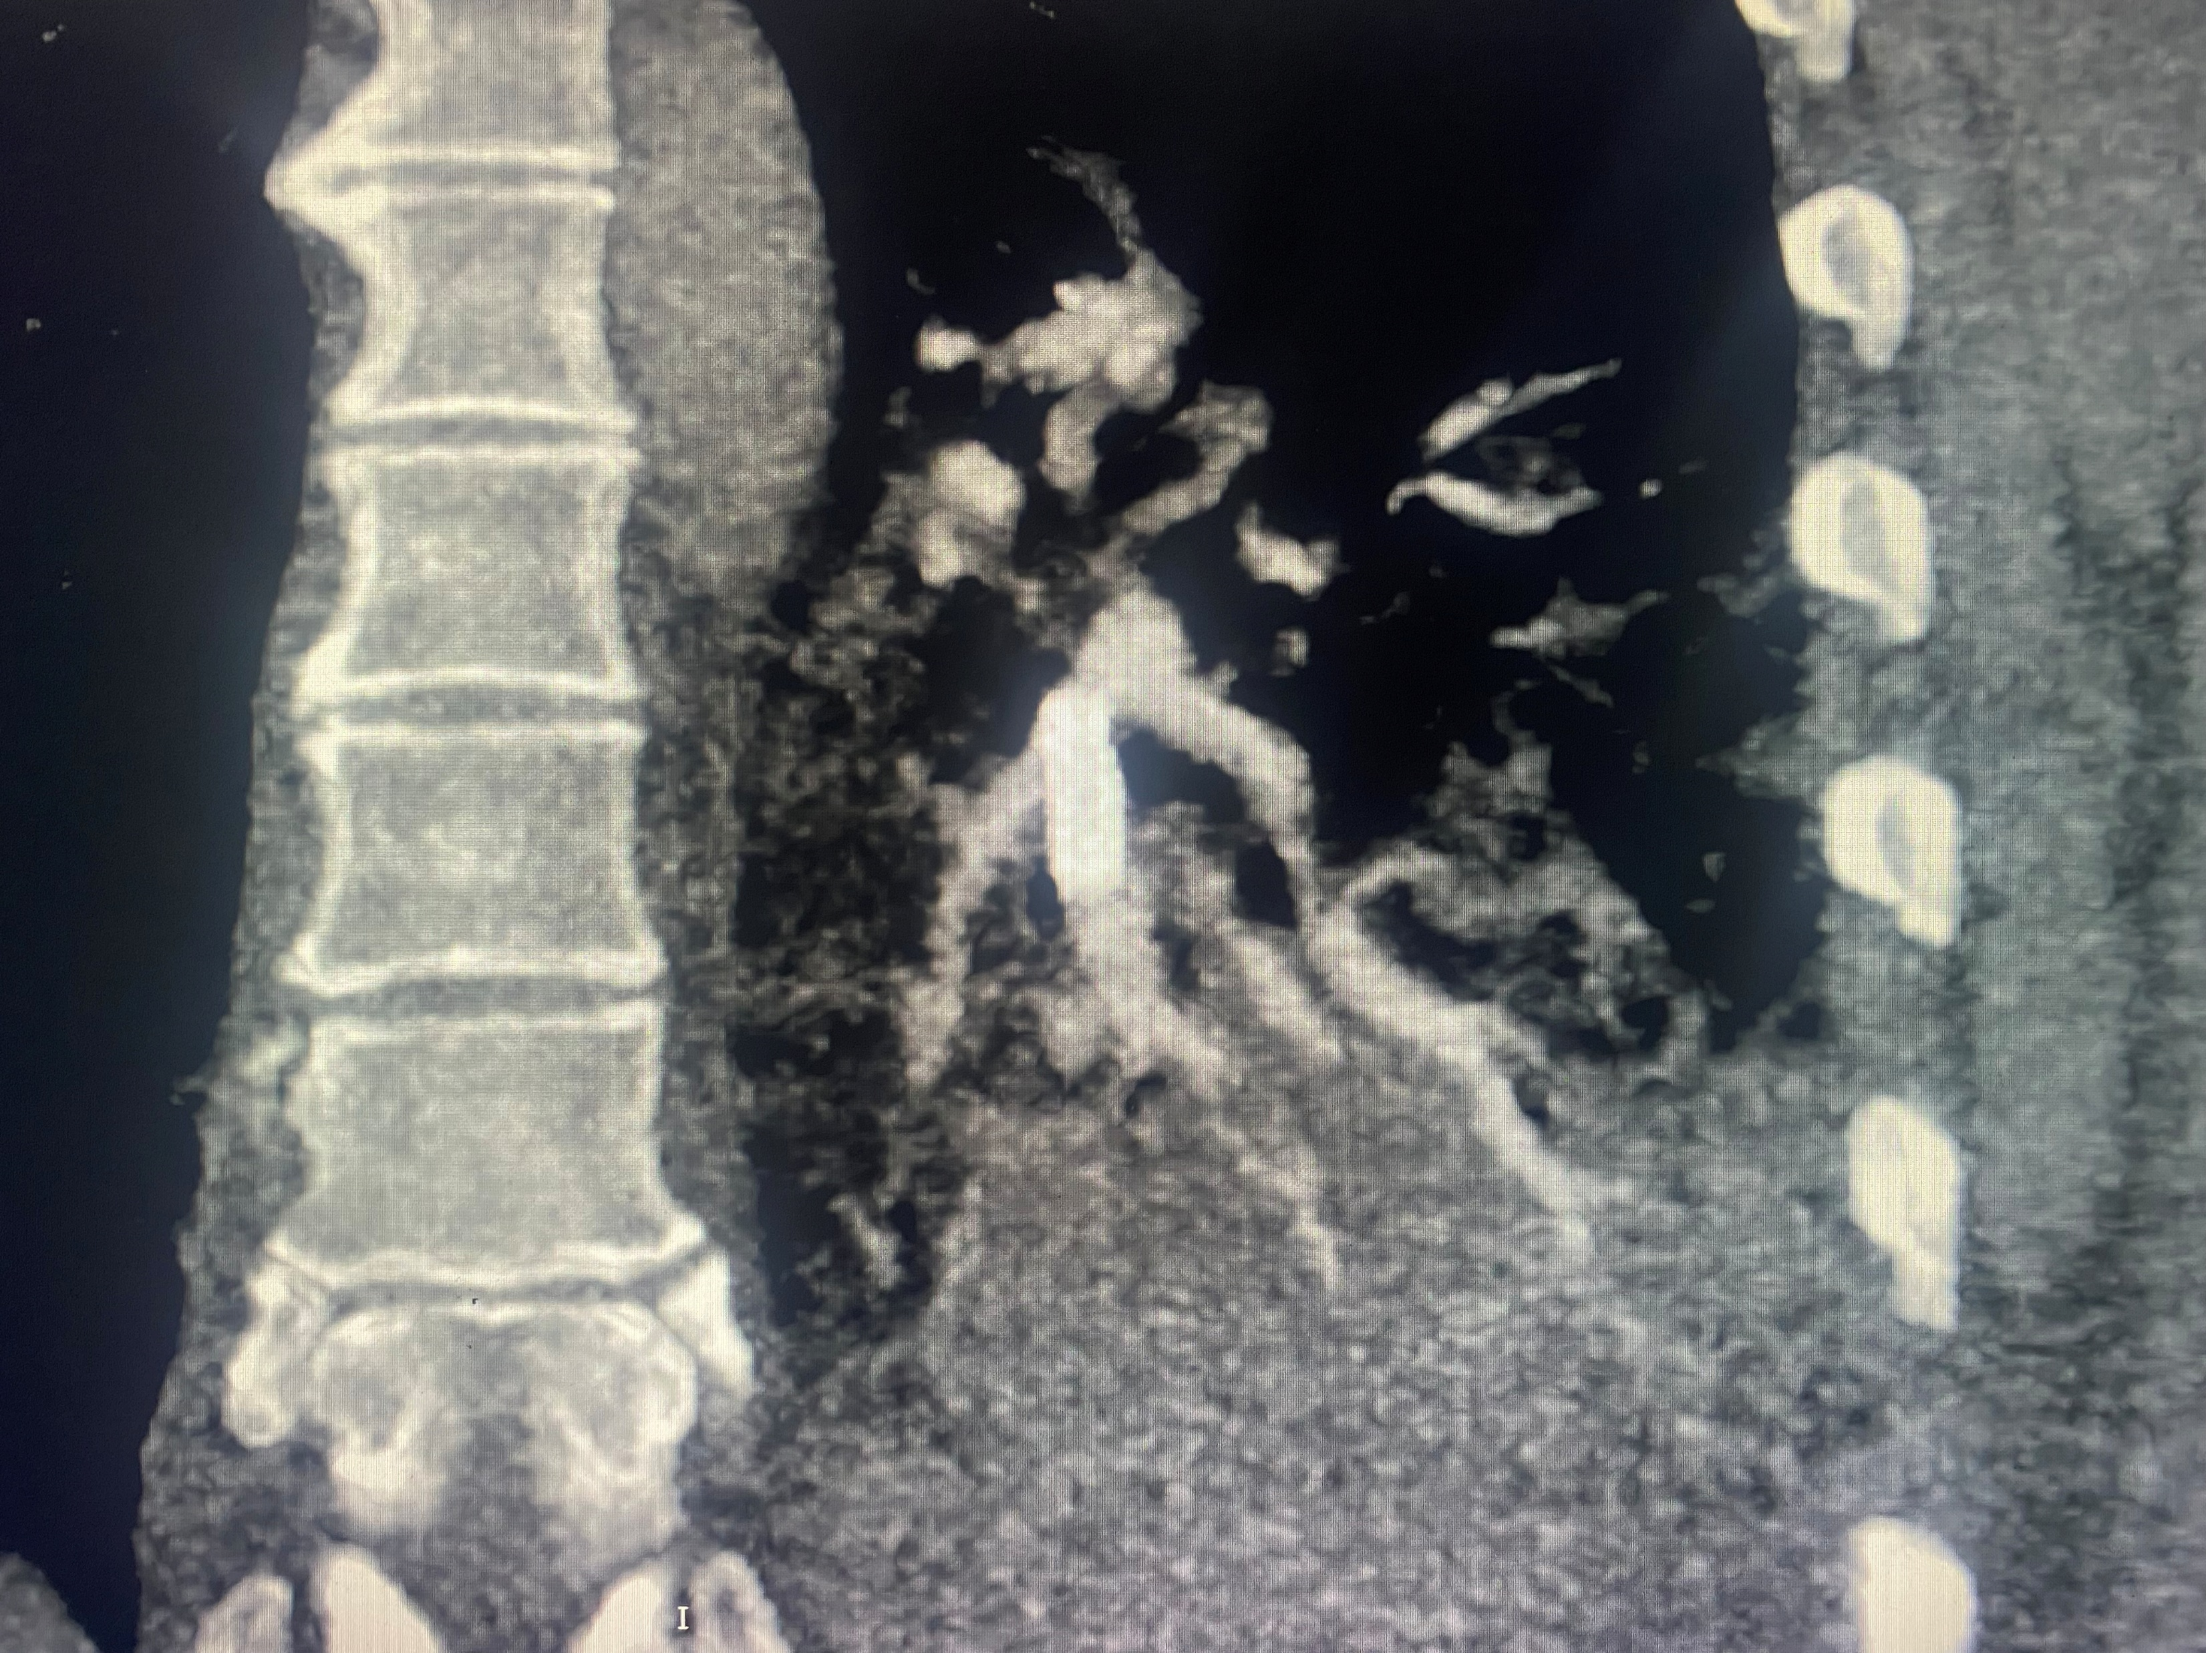
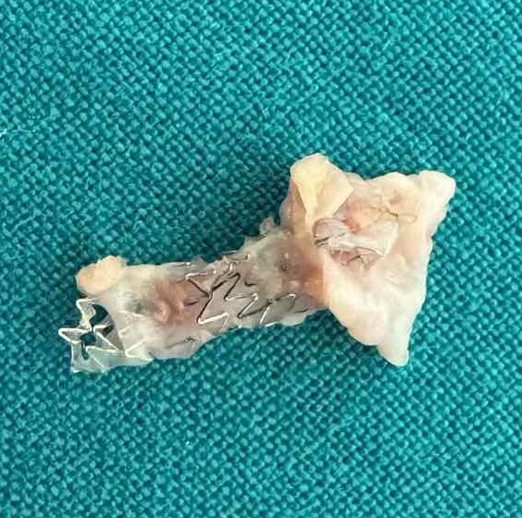
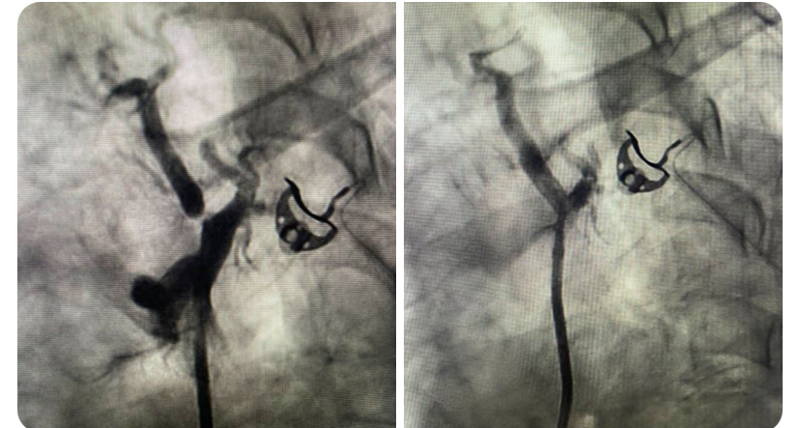
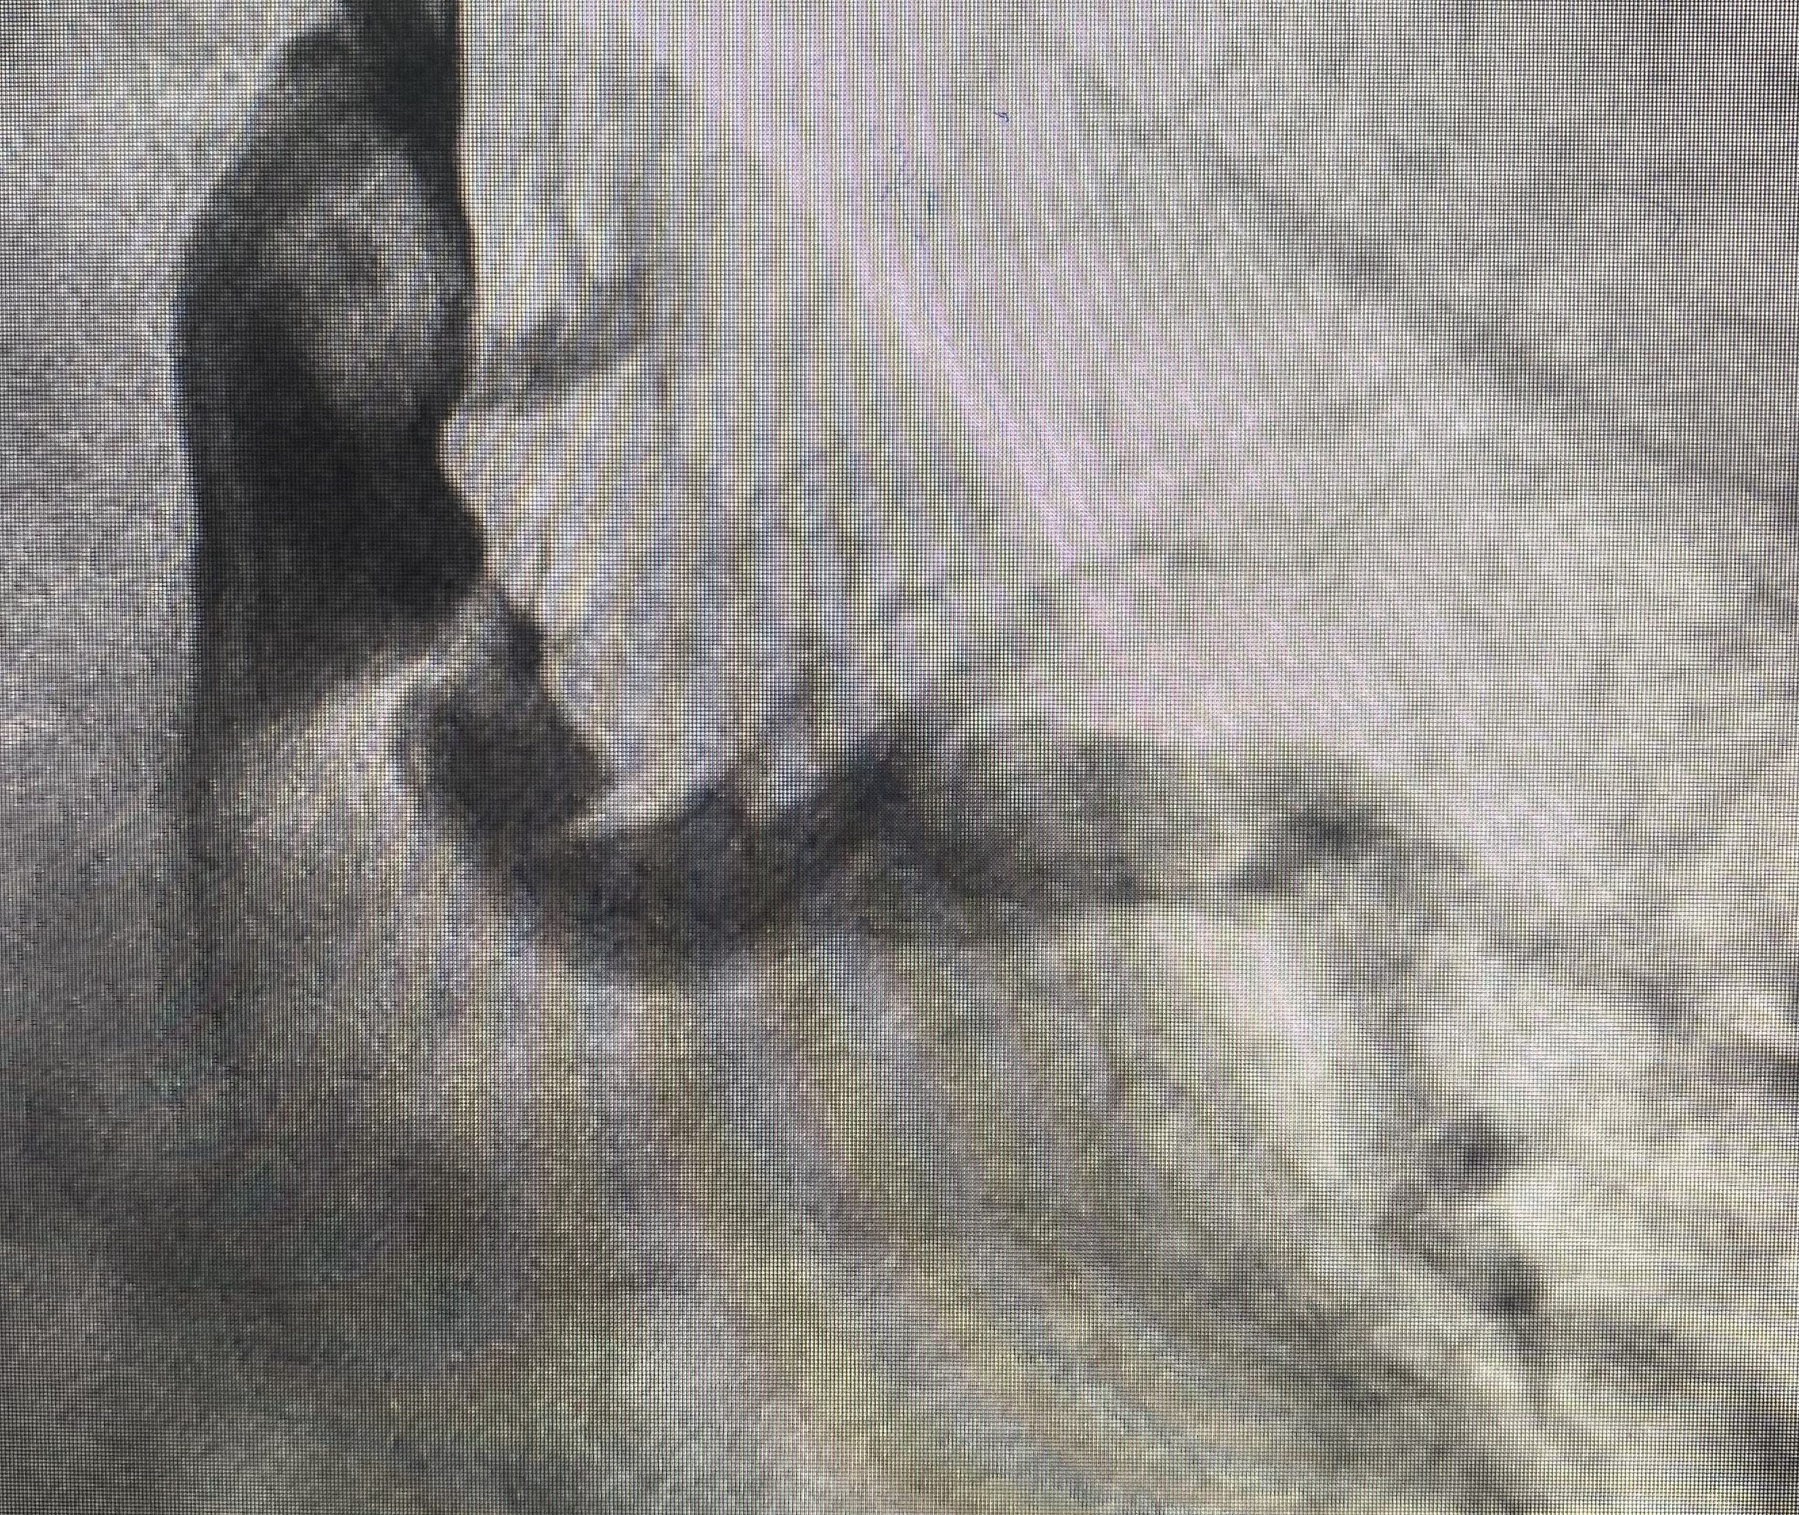
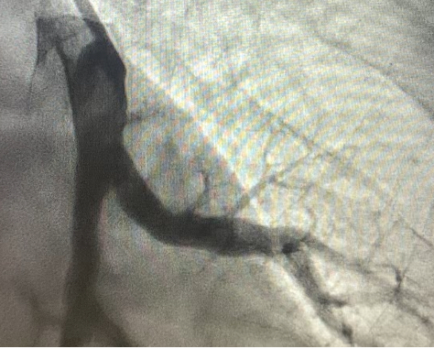








Indication for stenting pulmonary arteries in patients with CTEPH with coronary stents and long-term perfusion follow-up
Obradovic S¹, Dzudovic B¹, Matijasevic J², Kafedzic S³, Ristic A⁴, Lozo M⁵, Zivanovic Z⁶, Dragnic S⁷, Begic A⁸, Begic E⁹. ¹Clinic of Cardiology MMA, Belgrade, Institute of Pulmonary Diseases Vojvodine, Clinic of Cardiology Clinical Center Zemun, Clinic of Cardiology Clinical Ceter Srbija, Clinic of Cardiology University Hospital Split, Clinic of Cardiology Podgorica, Clinic of Cardiology Sarajevo
Introduction
•Although balloon pulmonary angioplasty has become the standard therapy for distal chronic thromboembolic pulmonary hypertension (CTEPH), the possibility that stents could improve the results of this procedure was not investigated.
Methods
From 2016 til March 2026, our multicenter team (Registry from the Balkan western countres – Serbia, Bosnia and Herzegovina, Croatia and Montenegro) performed 260 sessions of balloon pulmonary angioplasties (BPA) in 62 patients. In 22 patients, we implanted 32 coronary stents (1-3 per patient) after several attempts of BPA, where we did not achieve good peripheral blush with significant residual obstruction either by organized, firm thrombus or possible dissection of an old thrombotic mass.
After treating about 1100 lesions, we decided to implant stents in 32 of them, and the success of the procedure was 100% (success of coronary stent implantation into the culprit lesion) with an excellent flow after stenting, full blush of the irrigated pulmonary (sub)segments, and clear visible venous return. In 4/32 patients, transient lung perfusion injury was detected,
A. Reperfusion injury after stenting.
B. Extracted stent during PEA.
Result
Since we treated patients with multiple sessions, we always check the patency of the stents in the following sessions (the stents were always patent with excellent distal flow), and we found a restenosis-like lesion (hard, high-grade re-stenotic lesion) only once and treated it successfully with BPA. In 20 patients, angiography follow-up was between 3-96 months (median time 22 months). In six patients, we performed SPECT-CT imaging, and the perfusion of the stented segments was excellent compared to many segments that were treated only with BPA.
Conclusions
The implantation of coronary stents after suboptimal results of BPA in CTEPH patients is feasible and safe (reperfusion injury could be more often present). Coronary stents could achieve long-term full patency of the suboptimally BPA-treated pulmonary vessels without late complications. For the precise indications for stenting and possible use of dedicated stents in patients with CTEPH, further investigations are needed.
Contact
• Western Balkan CTEPH Regestry
Prof. Slobodan Obradovic, e-mail: sloba.d.obradovic@gmail.com
Docent Boris Dzudovic, e-mail> dzuda1977@gmail.com
Subtotal stenosis after repeated BPA, and angiography after stenting.

