Slide 1
Building a Romanian National CTEPH Referral Center: The Experience of the Târgu Mureș Pulmonary Hypertension Center
Prof. habil. Ioan TILEA, MD, PhD, FESC
Internal Medicine Clinic II – Cardiology
Head, Pulmonary Hypertension Center
County Emergency Clinical Hospital
“G.E. Palade” University of Medicine, Pharmacy, Science and Technology
Targu Mures, Romania
ioan.tilea@umfst.ro
ICC 2026

Slide 2
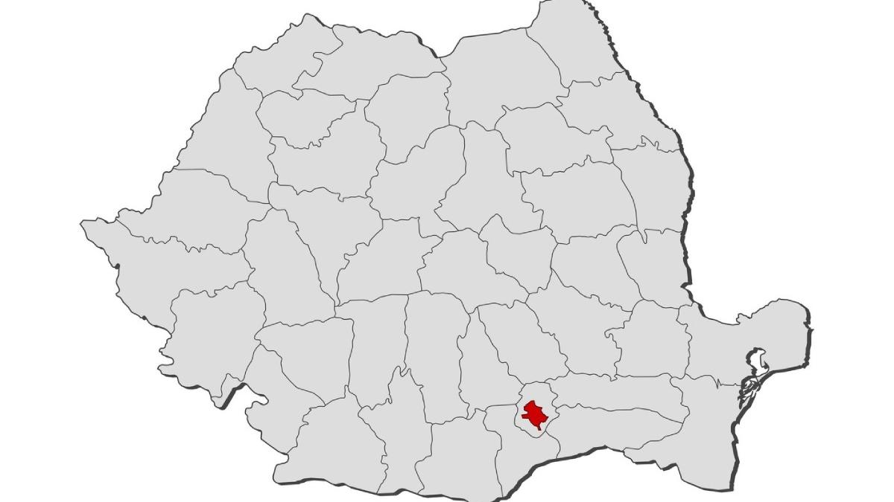
PH centers in Romania
- 9 adult centers for PH
Iași
- 5 children centers for PH
Oradea
Cluj-Napoca
Târgu Mureș
A regional and a national reference PH center can successfully build a CTEPH program even in a resource-limited healthcare system through networking with European expert centers.
Romania population: ~19 million
Timișoara
București

Slide 3
Târgu Mureș Pulmonary Hypertension Center – Program Overview
Established: April 2015, 20 beds
Location: Internal Medicine Clinic II – Cardiology
Institutional Affiliation:
  County Emergency Clinical Hospital, Târgu Mureș, Romania
  “G.E. Palade” University of Medicine, Pharmacy, Science and Technology, Târgu Mureș, Romania
Patient Communication and Support:
  24/7/365 Call Center (three dedicated phone lines)
  Dedicated Email Contact: compartimentcardiologie@gmail.com
  Website: www.chtpms.ro, www.mures-phacademy.org

Slide 4
Pulmonary Hypertension Center - Healthcare workers
Head: Prof. habil. Ioan TILEA, MD, PhD, FESC
Consultants (2): Prof. habil. Andreea VARGA, MD, PhD, FESC, Codruta Maria GAL, MD
Cardiologists, PH focused (2): Lecturer Razvan Gheorghita MARES, Assist. Prof. Liviu Cristescu
PhD students, research focused on PH (3): Assist. Prof. Dragos-Gabriel IANCU, Assist. Prof. Andreea Diana MOLDOVAN, Assist. Prof. Radu-Adrian SUTEU
Reference/admission office
Nurse trained in subcutaneous pump placement
Dedicated qualified nurses (7)
Clinical Psychologist
Support Staff

Slide 5
Targu Mures PH Center – Facilities
Infrastructure
  20 monitored inpatient beds with centralized oxygen supply
  Continuous monitoring: ECG, SpO₂, non-invasive blood pressure
  Dedicated 30 m corridor for 6-Minute Walk Test (6MWT)
Functional Assessment
  Integrated BTL CardioPoint platform:
  12-lead ECG • Wireless ECG • Holter • ABPM • Spirometry
  Cardiopulmonary Exercise Testing (CPET)
  BTL system with GE eBike Comfort Ergometer

Slide 6
Targu Mures PH Center – Facilities
Advanced Imaging
  CT imaging including pulmonary and coronary CT angiography
  Cardiac MRI
Ultrasound
  Comprehensive echocardiography (TTE/TOE)
  Vascular and abdominal ultrasound
  Platforms: Philips, GE, Samsung
Ventilation–perfusion (V/Q) scanning currently not available in Romania.

Slide 7
Targu Mures PH Center – Facilities
ISO-15189 laboratory:
  routine blood tests, NT-proBNP, ferritin, transferrin, TSAT, CRP, D-dimer, ABG
  supplementary POC for NT-proBNP, electrolytes
Genetic testing laboratory (gene panel): analysis of 23 genes
  Blueprint Genetics, Finland (national contact point in Romania)
  G.E. Palade” University of Medicine, Pharmacy, Science and Technology, Târgu Mureș, Romania
Cardiac Catheterization Laboratory – GE platform

Slide 8
Patient volume
77 PAH
114 PH all-time
in local registry
Currently 26 under follow-up
37 CTEPH
3 lost follow-up
8 deceased

Slide 9
Current CTEPH Cohort Characteristics
Age (years, mean±SD) | 62.11 (51.12±18.36)
Female (n, %) | 14 (53.84%)
Distribution (2022 ESC/ERS classification)
4.1 CTEPH | 25 (96.15%)
4.2 Other pulmonary obstructions – Takayasu arteritis | 1 (3.84%)
QoL: EmPHasis-10 questionnaire (points, mean, IQR) | 10 (3-19.5)

Slide 10
Current CTEPH Cohort Characteristics
 | Baseline | Last follow-up
6MWD (meters, mean, IQR) | 343 (163.5-390) | 345 (272-426)
NT-proBNP (pg/mL, mean, IQR) | 1212 (301-2073) | 1170 (687.5-2312)
WHO functional class (n)
I | 2 | 3
II | 14 | 18
III | 9 | 4
IV | 1 | 1
Four-strata risk assessment (n)
Low risk | 3 | 5
Intermediate-low risk | 14 | 10
Intermediate-high risk | 5 | 9
High risk | 4 | 2
Overall, clinical stability and modest functional improvement were observed during follow-up

Slide 11
Pharmacological treatment – 23 pts.
Treatment | No. of cases
Without specific therapy, under follow-up (after PEA, performed in 2023) | 1
Targeted Pharmacological Treatment in the Current CTEPH Cohort
Sildenafil + Bosentan | 1
Riociguat | 23
Riociguat + Treprostinil s.c. | 1
Anticoagulation: Acenocumarol, DOACs

Slide 12
Pulmonary endarterectomy
Started in 23, 4 male patients underwent PEA
PEA indication: after multidisciplinary team evaluation (prof. Lang – Vienna, Austria, prof. Kurzyna - Otwock, Poland, prof. D’Armini – Pavia, Italy)
 | Before PEA |  | After PEA
Patient | mPAP (mmHg) | PVR (WU) | mPAP (mmHg) | PVR (WU)
Male, 51 y.o. performed in 2023 | 36 | 5.24 | 13 | 1.11
Male, 62 y.o. performed in 2023 | 68 | 23.25 | 27 | 3.45
Male, 55 y.o. performed in 2024 | 44 | 7.21 | 22 | 1.41
Male, 34 y.o. performed in 2024 | lost-follow up
Significant haemodynamic improvement after PEA was observed

Slide 13
Balloon Pulmonary Angioplasty - The First and Single Center in Romania
Started in 2018, 4 patients (2 male) underwent BPA, with a median of 3 procedures
BPA indication: after multidisciplinary team evaluation (prof. Lang – Vienna, Austria, prof. Kurzyna, Otwock, Poland)
 | Before BPA |  | After last BPA *
Patient | mPAP (mmHg) | PVR (WU) | mPAP (mmHg) | PVR (WU)
Female heterozygous MTHFR A1298C mutation | 41 | 12.7 | 24 | 6.12
Female | 53 | 15.5 | 35 | 10.28
Male, heterozygous MTHFR A1298C mutation | 42 | 6.01 | 36 | 5.84
Male | 33 | 4.8 | 25 | 3.91
*RHC presented values were recorded after 6-12 months post BPA.

Slide 14
Regular Follow-up at 3 months (national regulations)
Standardized, local regulations, V/Q scan not available
Functional capacity:
  WHO functional class
  6MWD
  CPET (if considered)
Imaging:
  Cardiac ultrasound
  If considered: abdominal ultrasound, plain chest X-ray, lung CT, PFT, DLCO
Lab tests: NT-proBNP, iron deficiency anemia, electrolytes, other (if considered)
Electrocardiogram: rest ECG, Holter (if considered)
Risk assessment – 4-strata risk assessment tool
QoL questionnaires:
  emPHasis-10
  EQ-5D

Slide 15
Waiting list for PEA and BPA
Currently:
  8 patients for BPA (4 new)
  2 new patients for PEA
High refusal rate for PEA and BPA

Slide 16
Future Directions for CTEPH Care in Romania
Continuing BPA programme in Targu Mures with surgical back-up – networking with Romanian&European Expert Centers
PEA ? Doubtfully, experienced cardiac surgeons and intensive care teams must be involved, at least one high-volume center is needed
CTEPH oupatient services
CTEPH awareness and screening
Follow-up patients (including self-monitoring INR)

Slide 17
Academic and Educational Activity
Supervision of PhD research projects
Organisation of 4 international conferences under the auspices of “G.E. Palade” University of Medicine, Pharmacy, Science and Technology Târgu Mureș, Romania (2016, 2021, 2022, 2025)
Participation in national scientific meetings, including the PHADER Symposium and the Romanian Society of Cardiology Congress
Presentation of scientific work at international conferences
Participation in international expert meetings and training programs in PAH and CTEPH
Teaching activities for medical students at “G.E. Palade” University of Medicine, Pharmacy, Science and Technology, Târgu Mureș, Romania and UMCH - Universitätsmedizin Neumarkt a. M. Campus Hamburg, Germany
Accredited postgraduate courses with CME credits

Slide 18
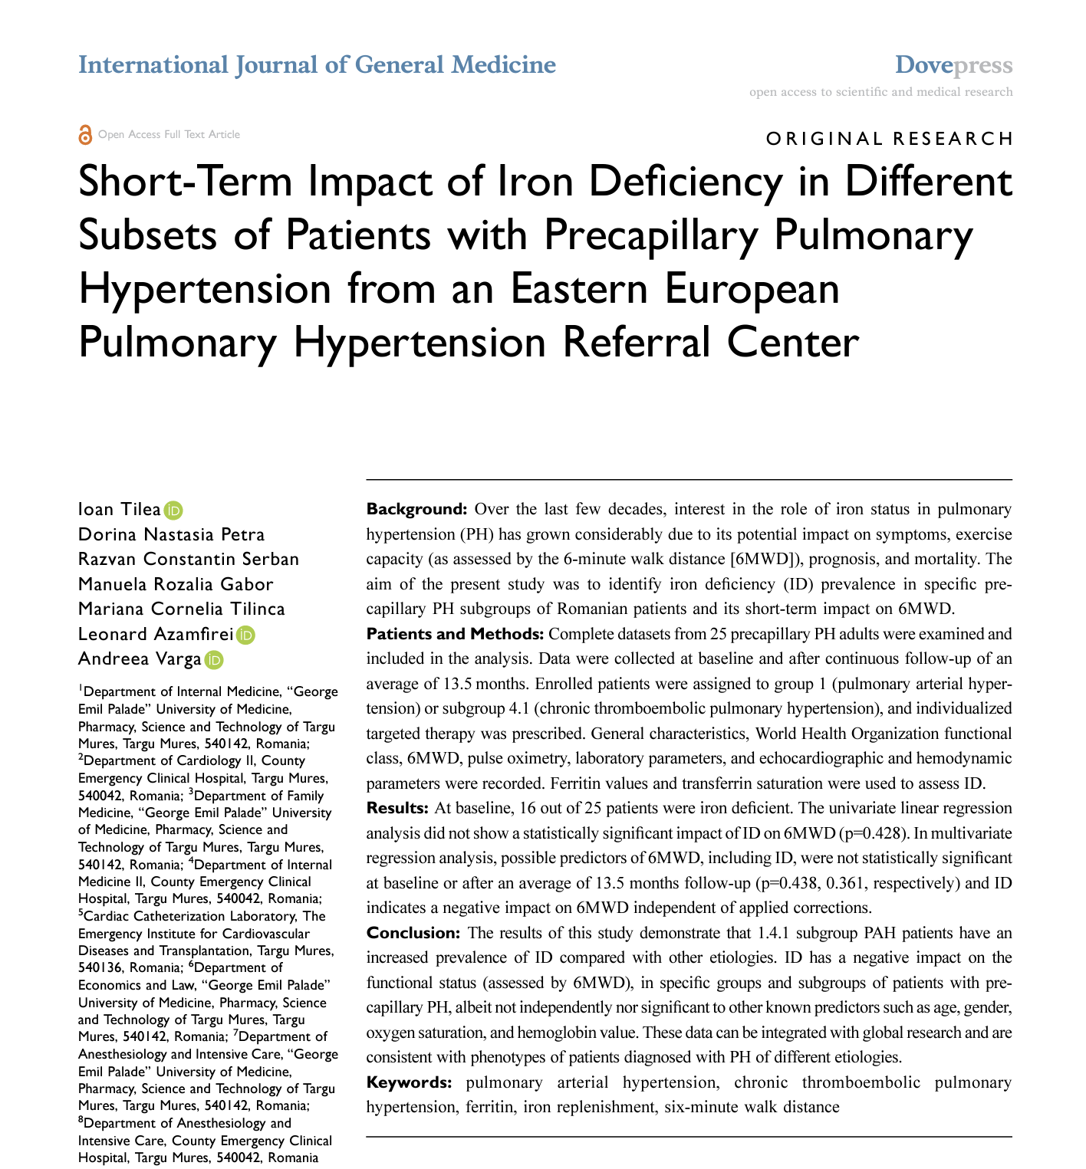
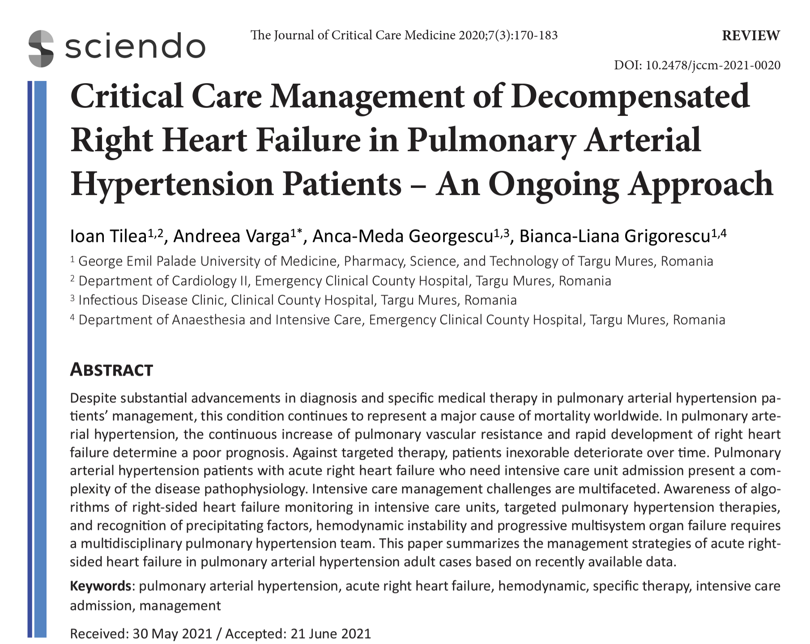
Few Publications in ISI-Indexed and International Databases

Slide 19
Take-home messages
The Târgu Mureș PH Center has developed a comprehensive CTEPH program integrating diagnosis, pharmacotherapy, and interventional management.
Despite national limitations (including the absence of V/Q scanning), a structured multidisciplinary approach allows effective identification and management of CTEPH patients.
The center established the first Balloon Pulmonary Angioplasty (BPA) program in Romania, with encouraging haemodynamic outcomes.
Further development of national referral pathways and surgical expertise is essential to improve access to PEA and BPA for Romanian CTEPH patients.

Slide 20
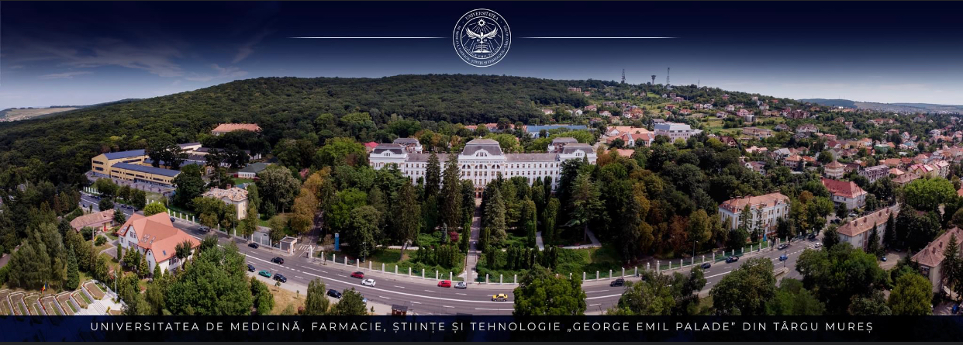
The development of the Târgu Mureș PH Center demonstrates that building a comprehensive CTEPH program is feasible in emerging healthcare systems through international collaboration and multidisciplinary expertise.

