Slide 1
ICC 2026

Slide 2

Influence of Preoperative Pulmonary Vascular Resistance on Postoperative Functional Class in Patients Undergoing Pulmonary Thromboendarterectomy: A Single-Center Analysis
Orival de Freitas Filho
Thoracic Surgery Department of the Heart Institute
University of São Paulo, São Paulo, São Paulo, Brazil

Slide 3
Introduction
The aim of this study was to demonstrate the clinical benefits observed in patients undergoing pulmonary endarterectomy (PEA) who presented with more severe pre-operative haemodynamic impairment, by analysing changes in their modified New York Heart Association (NYHA) functional class before and after surgery.

Slide 4

Methods
For this analysis, 183 patients were selected and divided into two groups according to pre-operative haemodynamic severity, based on pulmonary vascular resistance (PVR) values:PVR < 800 dyn·s·cm⁻⁵PVR ≥ 800 dyn·s·cm⁻⁵
Functional class (according to the modified New York Heart Association classification) was compared between the two groups during the pre-operative period and at the first post-operative follow-up visit.The PVR < 800 dyn·s·cm⁻⁵ group comprised 113 patients, while the PVR ≥ 800 dyn·s·cm⁻⁵ group included 70 patients.

Slide 5
Results
At the post-operative evaluation, both groups demonstrated a marked improvement in modified NYHA functional class following PEA, with more than 95% of patients achieving functional class I or II.
There was no statistically significant difference between the groups (p = 0.67), indicating a similar degree of functional recovery regardless of pre-operative PVR.
However, when analysing the change in modified NYHA functional class between pre-operative and post-operative assessments, patients with PVR ≥ 800 dyn·s·cm⁻⁵ exhibited greater functional improvement compared with those with lower PVR (93.8% vs 86.1%), reaching statistical significance (p = 0.04).

Slide 6
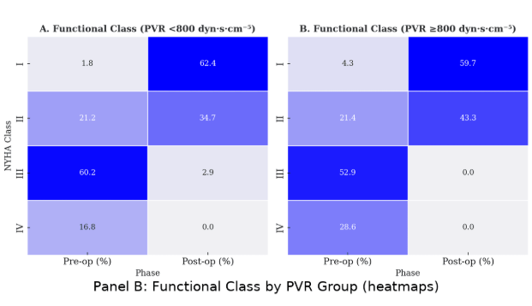
Results

Slide 7
Discussion
Chronic thromboembolic pulmonary hypertension (CTEPH) is a debilitating condition that progressively limits patients’ functional capacity and quality of life. Pulmonary endarterectomy has been shown to significantly improve outcomes and quality of life in affected individuals (1,2).In the search for factors influencing outcomes in this patient population, pulmonary vascular resistance, which reflects disease burden and haemodynamic severity (3), was selected as the primary variable of interest in this study.

Slide 8
Discussion
The aim was to compare outcomes between patients with more advanced haemodynamic impairment and those with less severe disease, both undergoing PEA.Our findings demonstrate that patients with PVR ≥ 800 dyn·s·cm⁻⁵, representing more severe clinical presentations, experienced substantial functional improvement following surgery. These results highlight that PEA should be considered across all levels of disease severity, as it provides meaningful clinical benefit even in patients with marked haemodynamic compromise.

Slide 9
Conclusion
Pulmonary endarterectomy provides substantial clinical benefit even in patients with severe pulmonary hypertension, reinforcing the importance of timely surgical intervention in this high-risk population.
References:
1-Kallonen J, et al. Quality of life and functional status after pulmonary endarterectomy for chronic thromboembolic pulmonary hypertension: A Swedish single-center study. Pulm Circ. 2023 Apr 1;13(2):e12219.
2-H. Kim, et al. Functional Outcomes of Pulmonary Endarterectomy for Chronic Thromboembolic Pulmonary Hypertension, The Journal of Heart and Lung Transplantation, Volume 41, Issue 4, Supplement, 2022, Pages S391-S392
3-Tsutsumi Y, et al. Assessment of Severity in Chronic Thromboembolic Pulmonary Hypertension by Quantitative Parameters of Dual-Energy Computed Tomography. J Comput Assist Tomogr. 2020 Jul/Aug;44(4):578-585

