Slide 1


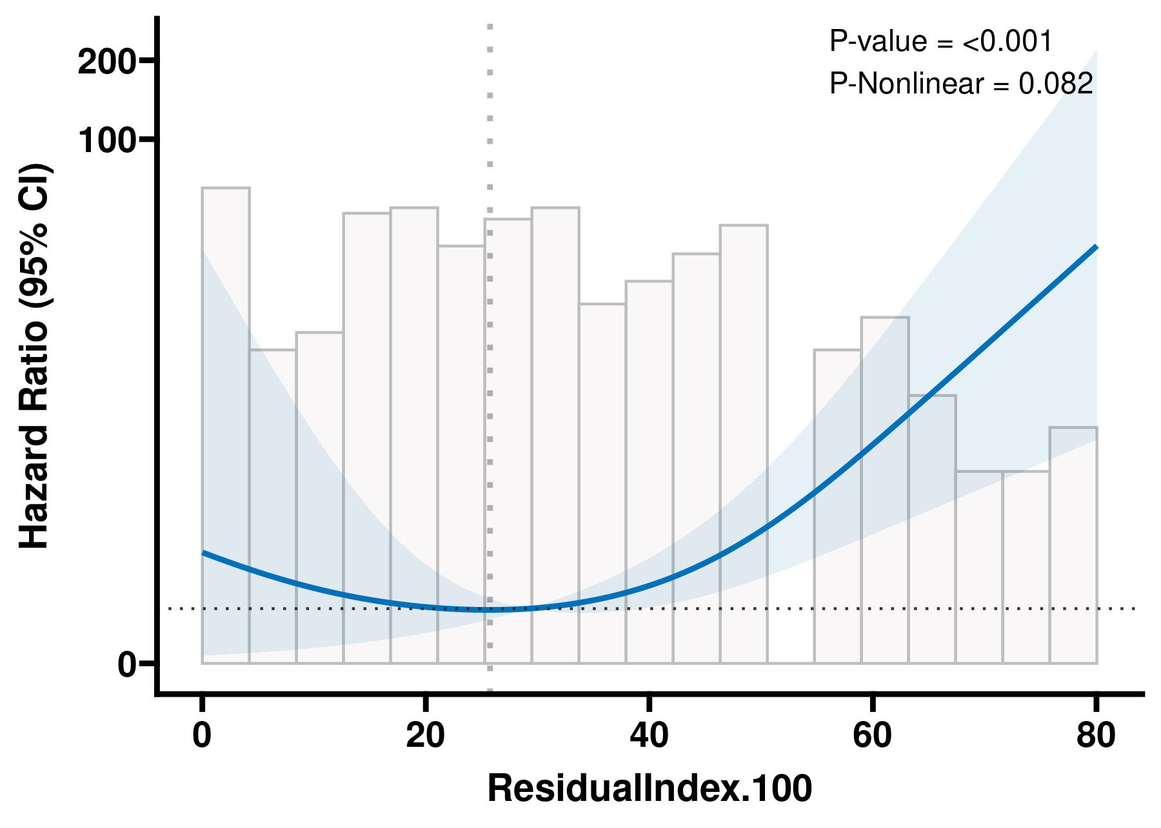
Nonlinear Association Between Residual Thrombotic Obstruction and Mortality After Pulmonary Endarterectomy
Hang Xu¹, Xinhe Xu¹, Sheng Liu¹
¹Department of Cardiovascular Surgery, Fuwai Hospital, National Center for Cardiovascular Diseases, Chinese Academy of Medical Sciences and Peking Union Medical College, Beijing, China
INTRODUCTION
RESULTS
The prognostic value of residual thrombotic burden on early postoperative CT after pulmonary endarterectomy in chronic thromboembolic pulmonary hypertension is unclear.
METHODS
Population: 221 patients who underwent pulmonary endarterectomy and 1-month postoperative contrast-enhanced CT.
Exposure: Residual Thrombotic Obstruction Index.
Outcome: All-cause mortality.
Analysis: Cox regression, restricted cubic spline analysis, and segmented Cox regression.
Adjustment: sex, age, BMI, acute pulmonary embolism, and deep vein thrombosis.
Below 25.74
Above 25.74
Above 25.74
CONCLUSIONS
────────◆────────
────────◆────────
────────◆────────
HR 1.03
p=0.80
Not significant
HR 1.08
p＜0.001
Increased mortality
HR 3.62
p＜0.001
Per SD increase
Residual thrombotic obstruction on early postoperative CT was nonlinearly associated with mortality after pulmonary endarterectomy, and values above 25.74 identified patients at higher risk of death.

