Slide 1
ICC 2026

Slide 2

Myocardial biomarkers in obese patients undergoing pulmonary thromboendarterectomy using hypothermia as the sigle cardioprotective strategy
Orival de Freitas Filho
Thoracic Surgery Department of the Heart Institute
University of São Paulo, São Paulo, São Paulo, Brazil

Slide 3
Introduction
Pulmonary thromboendarterectomy (PTE) is the gold-standard curative surgical treatment for chronic thromboembolic pulmonary hypertension (CTEPH). These patients require cardiopulmonary bypass (CPB) and total circulatory arrest (TCA) during the procedure. Consequently, myocardial injury may occur, although it is generally transient.
This study analyses myocardial biomarker levels in patients undergoing PTE and compares their postoperative progression between groups stratified according to body mass index (BMI).

Slide 4

Methods
Patients were evaluated in a cohort study and stratified according to BMI into two groups:
Non-obese: BMI < 30 kg/m² (n = 63)
Obese: BMI ≥ 30 kg/m² (n = 140)
Myocardial biomarkers were collected during the postoperative period at predefined time intervals: 3–4 hours, 13–15 hours, 37–39 hours, and 62–64 hours.

Slide 5
Results
Among obese patients, myocardial biomarker levels were significantly higher than in non-obese patients during the first 48 postoperative hours
(Troponin: p = 0.021 at 3–4 h, p = 0.018 at 13–15 h, p = 0.07 at 37–39 h).
Secondly, another significant finding was that the obese group presented a higher incidence of acute kidney injury (AKI) stage 3 (p = 0.048).
Furthermore, non-obese patients demonstrated better functional recovery, with a higher proportion achieving World Health Organization Functional Class I (71.7% vs 46.8%, p = 0.003).

Slide 6
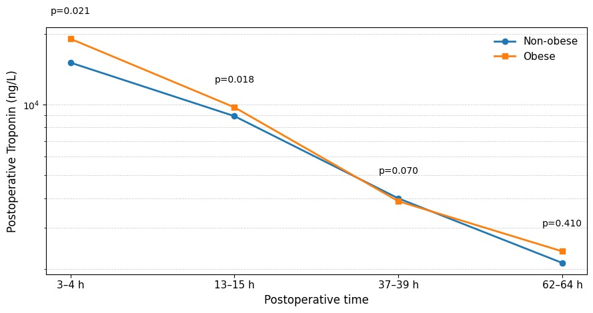
Results
Evolution of troponin in the postoperative period of PEA

Slide 7
Discussion
Procedural factors such as the duration of cardiopulmonary bypass (CPB) and total circulatory arrest (TCA) are frequently associated with increased inflammatory response and elevated myocardial biomarker levels, even in the absence of overt myocardial ischaemia (1).
In the present study, obese patients undergoing pulmonary endarterectomy (PEA) exhibited higher levels of myocardial biomarkers, regardless of baseline disease severity, TCA duration, or CPB time, when compared with non-obese individuals. This finding may be related to the pro-inflammatory state associated with obesity.

Slide 8
Discussion
Inflammation is known to play an important role in the pathogenesis of chronic thromboembolic pulmonary hypertension (CTEPH), and elevated levels of inflammatory cytokines have been reported in previous studies (2).
Despite the higher myocardial biomarker levels observed in obese patients, biomarker clearance was similar between obese and non-obese individuals in this study.

Slide 9
Conclusion
Obesity did not influence baseline disease severity or haemodynamic parameters; however, in this cohort it was associated with higher levels of early myocardial injury biomarkers and a greater incidence of severe acute kidney injury.
Nevertheless, biomarker clearance during the postoperative period was comparable between obese and non-obese patients.
References:
1- Matschke K, et al . Influence of extra corporeal circulation on myocardial oxygen tension: results of an animal model. Clin Hemorheol Microcirc. 2006;35(1-2):105-11. PMID: 16899913.
2-Zabini D, et al. Comprehensive analysis of inflammatory markers in chronic thromboembolic pulmonary hypertension patients. The European Respiratory Journal . 2014;44:951–962.

