Slide 1
ICC 2026
Prognostic Associations and Longitudinal Changes of the Tricuspid Annular Plane Systolic Excursion-to-Systolic Pulmonary Artery Pressure Ratio in Chronic Thromboembolic Pulmonary Hypertension

Slide 2
[Abstract title]
Jing Wen¹, Shuai Zhang², Ruozetuohati Yiminniyaze¹, Wanmu Xie ², Zhenguo Zhai ²
1, National Center for Respiratory Medicine; State Key Laboratory of Respiratory Health and Multimorbidity; National Clinical Research Center for Respiratory Diseases; Institute of Respiratory Medicine, Chinese Academy of Medical Sciences; Department of Pulmonary and Critical Care Medicine, Center of Respiratory Medicine, China-Japan Friendship Hospital; Chinese Academy of Medical Sciences & Peking Union Medical College
2, National Center for Respiratory Medicine; State Key Laboratory of Respiratory Health and Multimorbidity; National Clinical Research Center for Respiratory Diseases; Institute of Respiratory Medicine, Chinese Academy of Medical Sciences; Department of Pulmonary and Critical Care Medicine, Center of Respiratory Medicine, China-Japan Friendship Hospital

Slide 3
Introduction
Chronic thromboembolic pulmonary hypertension (CTEPH) is a severe and potentially curable form of pulmonary hypertension characterized by persistent thromboembolic obstruction and secondary microvascular remodeling, resulting in increased right ventricular afterload and progressive right heart dysfunction.
The echocardiographic tricuspid annular plane systolic excursion-to-systolic pulmonary artery pressure ratio (TAPSE/sPAP) is a noninvasive measure of right ventricular-pulmonary arterial coupling, but its clinical value in CTEPH remains insufficiently defined.

Slide 4
Methods
In this multicenter prospective cohort study, consecutive adults with confirmed CTEPH who underwent baseline transthoracic echocardiography between 2016 and 2023 were screened.
A total of 949 patients met the inclusion criteria, of whom 868 had follow-up data for outcome analyses. Patients were stratified according to baseline TAPSE/sPAP ratio into 3 groups: <0.15, 0.15–0.30, >0.30.
Associations with invasive hemodynamic variables were assessed using Spearman correlation. Kaplan-Meier analysis, Cox proportional hazards models, and restricted cubic splines were used to evaluate the association with clinical worsening. Longitudinal changes in TAPSE/sPAP were assessed using linear mixed-effects models across treatment strategies.

Slide 5
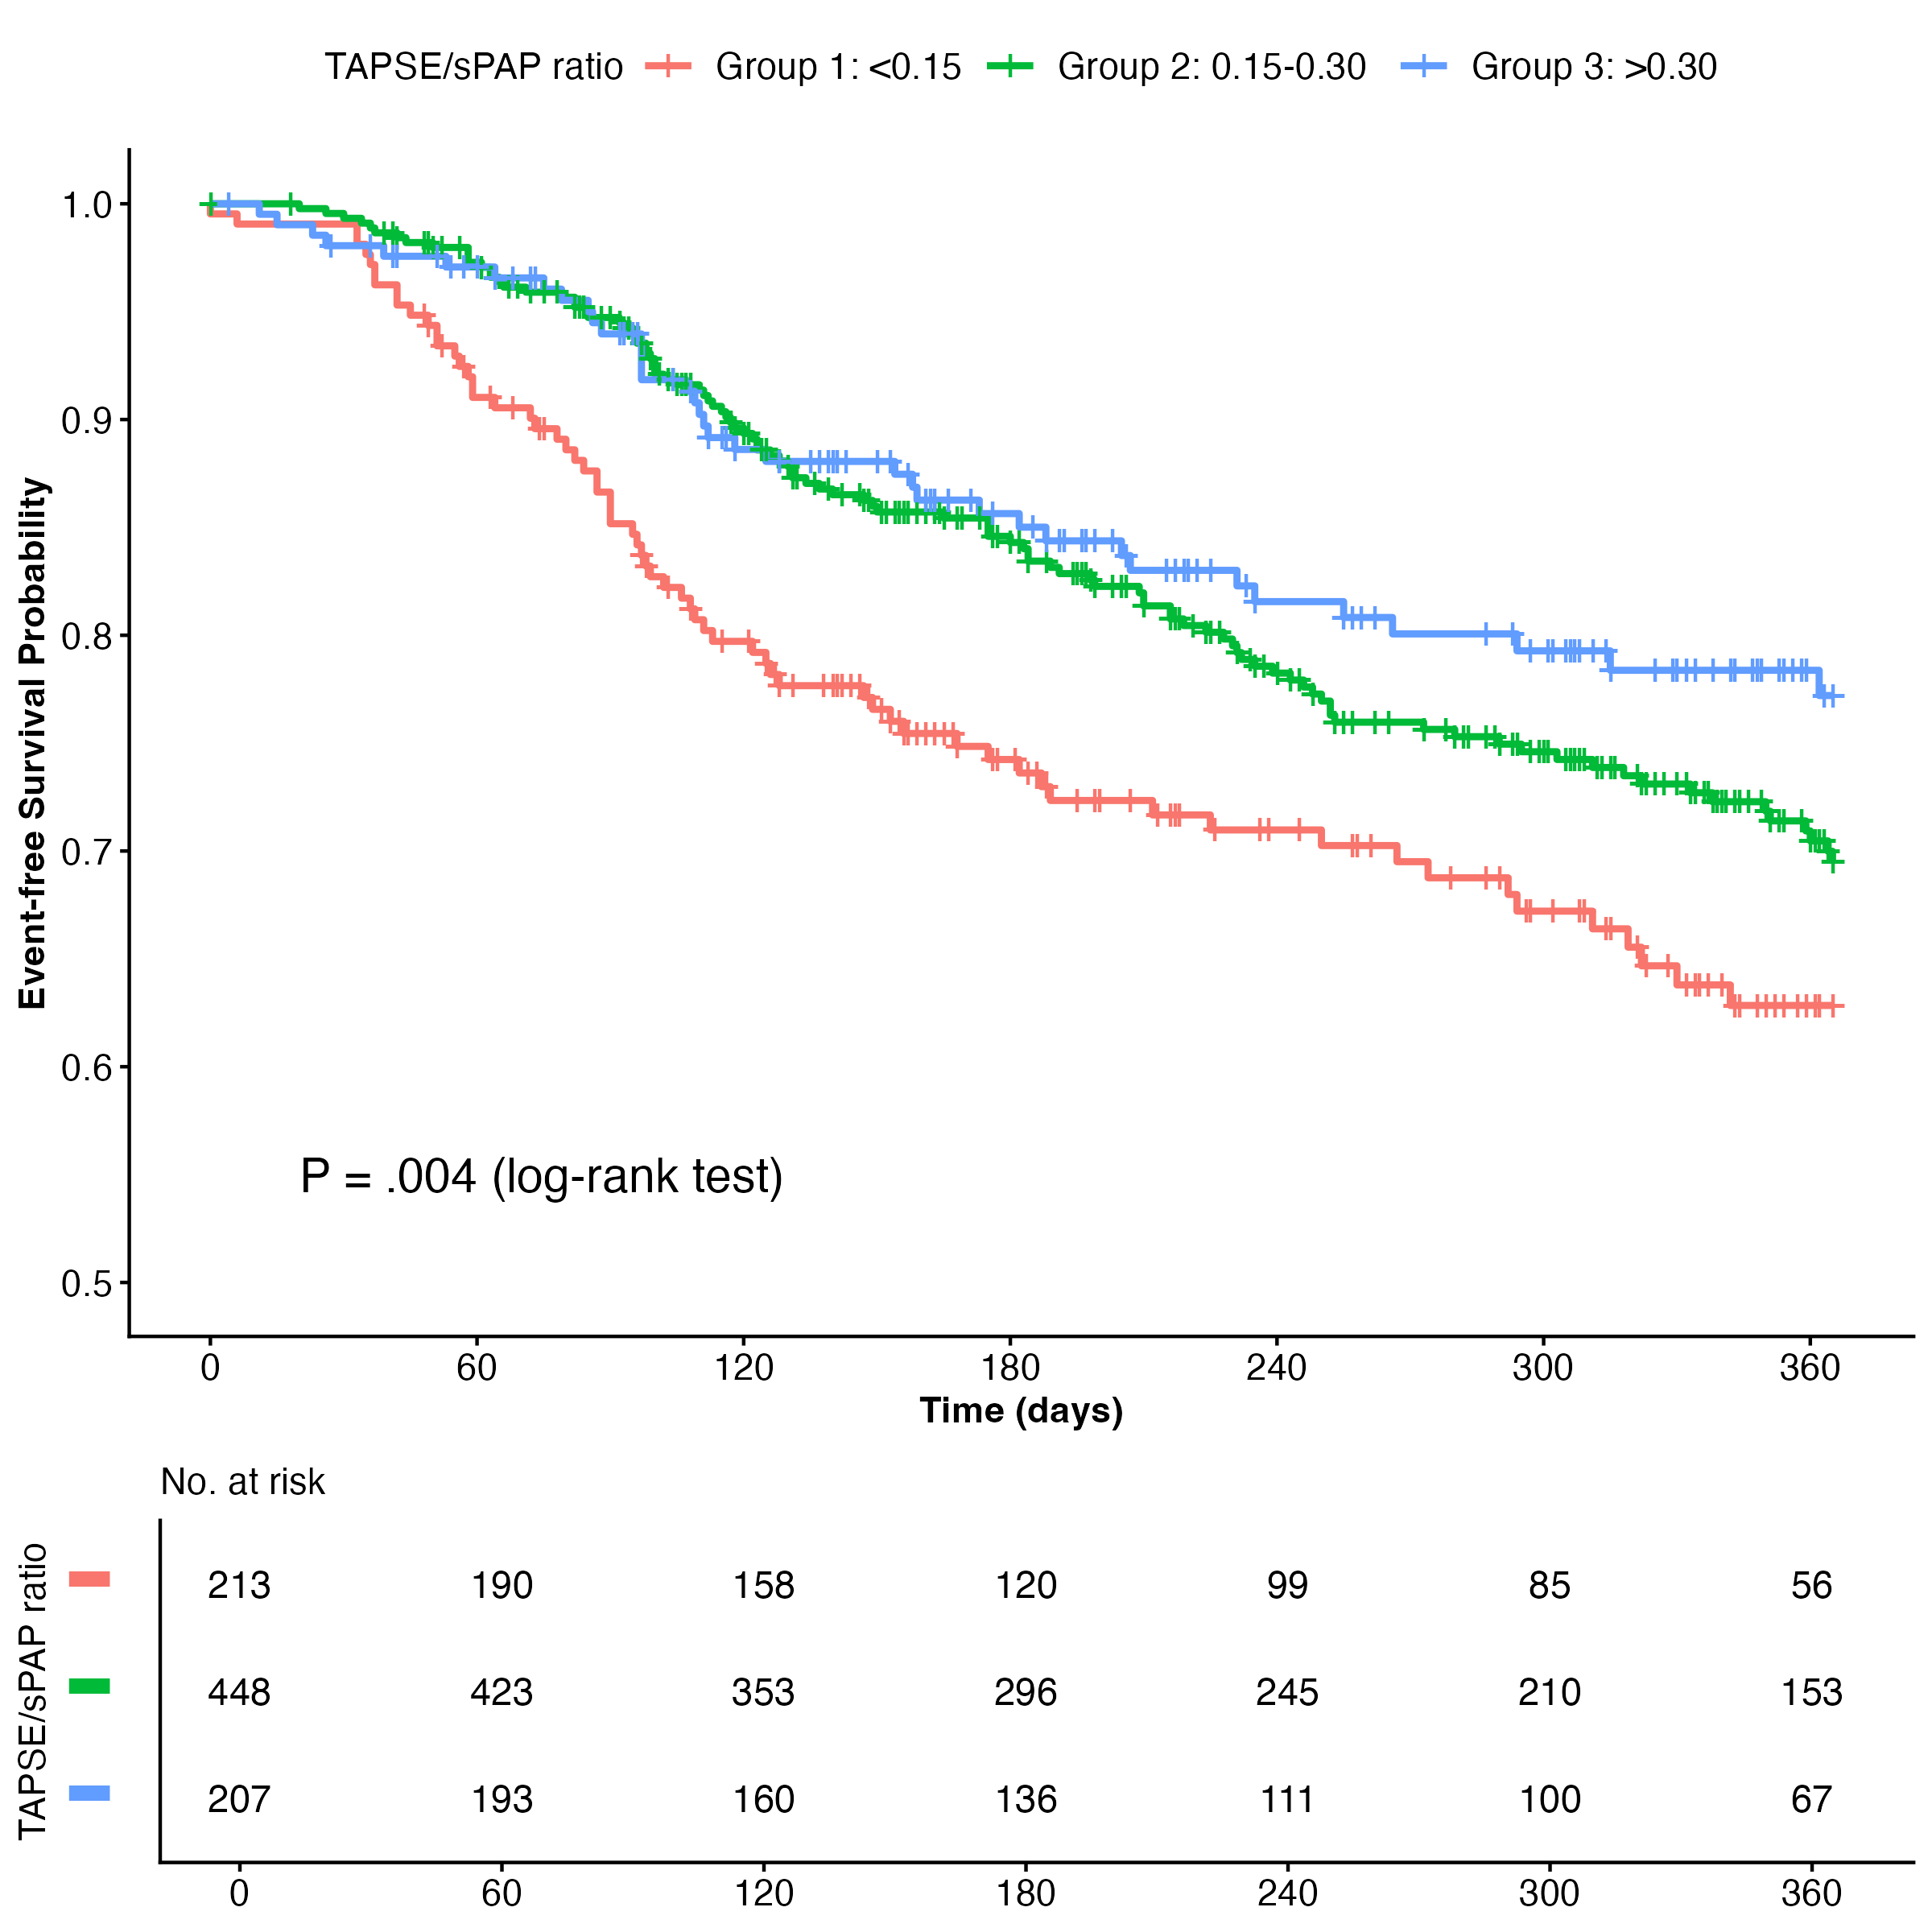
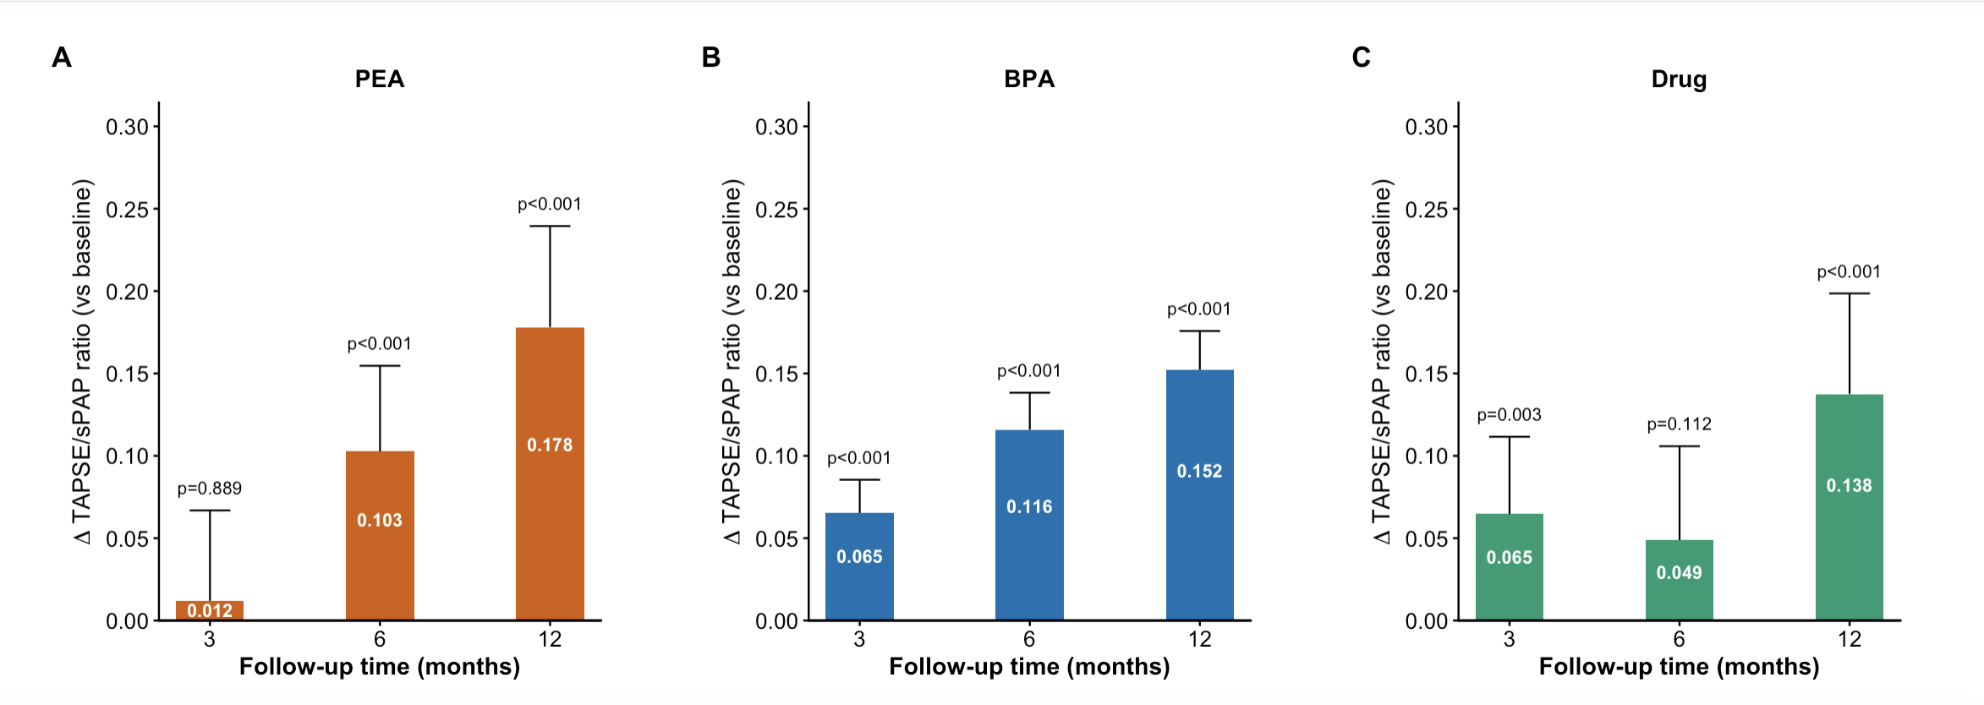
Results
Lower baseline TAPSE/sPAP was associated with more severe hemodynamic abnormalities, including higher pulmonary vascular resistance and lower cardiac index, and worse functional status (all P < 0.001). Over a median follow-up of 10.32 months, 212 CW events (24.4%) and 28 all-cause deaths (3.2%) occurred in the outcome cohort. Higher baseline TAPSE/sPAP independently predicted a lower risk of CW (adjusted hazard ratio per 0.1-unit increase, 0.88; 95% CI, 0.79–0.99; P = 0.039), but was not significantly associated with all-cause mortality. Compared with patients with a baseline ratio < 0.15, those with ratios of 0.15–0.30 and > 0.30 had lower adjusted risks of CW. Longitudinally, TAPSE/sPAP increased progressively, demonstrating distinct temporal recovery patterns dependent on the treatment strategy (P = 0.031).

Slide 6
Discussion
These findings suggest that TAPSE/sPAP is a pragmatic, noninvasive marker reflecting right ventricular-pulmonary arterial uncoupling in CTEPH.
Lower baseline values identified patients with more advanced hemodynamic compromise and a higher short-term risk of clinical worsening, whereas serial improvement over follow-up supports its potential role in longitudinal monitoring after treatment.
The prognostic association was more apparent for clinical worsening than for all-cause mortality, likely reflecting the relatively short follow-up duration and limited number of deaths. Distinct temporal recovery patterns across balloon pulmonary angioplasty, pulmonary endarterectomy, and medical therapy further indicate that TAPSE/sPAP may capture dynamic changes in right ventricular adaptation during contemporary multimodal CTEPH care.

Slide 7
Conclusion
TAPSE/sPAP is a clinically accessible, noninvasive marker of right ventricular-pulmonary arterial coupling that is associated with invasive hemodynamic severity, clinical worsening, and changes over time with treatment in CTEPH. Serial assessment may complement longitudinal follow-up in contemporary CTEPH care.

