Slide 1
ICC 2026
Abstract template

Slide 2
Clinical Outcomes of Invasive Treatment Strategies for Acute-on-Chronic Thromboembolic Pulmonary Hypertension
Jun Yamashita, Ryosuke Ito, Sayo Ikeda, and Kazuhiro Satomi
Department of Cardiology, Tokyo Medical University Hospital
Yusuke Shimahara
Department of Cardiovascular surgery, Tokyo Medical University Hospital

Slide 3
Introduction
Background: Acute-on-chronic thromboembolic pulmonary hypertension (Acute-on-CTEPH) is associated with severe clinical deterioration and worse outcomes than typical CTEPH. However, the clinical impact of invasive interventions such as pulmonary endarterectomy (PEA) or balloon pulmonary angioplasty (BPA) during the acute phase remains unclear.
Objective: To evaluate the feasibility and clinical outcomes of invasive treatment strategies in patients with Acute-on-CTEPH.

Slide 4
Methods
Acute-on-CTEPH was defined as cases presenting with acute worsening of symptoms or hemodynamic deterioration, in which both organized and fresh thrombi were confirmed by pulmonary angiography or in PEA specimens. Among 107 consecutive patients with CTEPH treated at our institution between 2023 and January 2026, those fulfilling this definition were retrospectively identified. Treatment strategies, hemodynamic changes, and clinical outcomes were analyzed.

Slide 5
Results (Patient Characteristics)
Patient Characteristics
Number of patients | 13
Age, years, median (IQR) | 69 (59–78)
Male sex, n (%) | 7 (54%)
WHO functional class I, II, III, IV | 0, 0, 0,13
Use of NPPV, n (%) | 6 (46%)
Mechanical ventilation initiation, n (%) | 7 (54%)
ECMO initiation, n(%) | 7 (54%)

Slide 6
Results (Treatment strategies)
Treatment strategies
Rescue BPA, n (%) | 5 (38%)
Emergency PEA, n (%) | 4 (31%)
Combined PEA and BPA, n (%) | 4 (31%)
Rescue BPA→Staged PEA→Additional BPA, n (%) | 2 (15.5%)
Rescue BPA→Staged PEA, n (%) | 1 (7.7%)
Emergency PEA→Additional BPA, n (%) | 1 (7.7%)

Slide 7
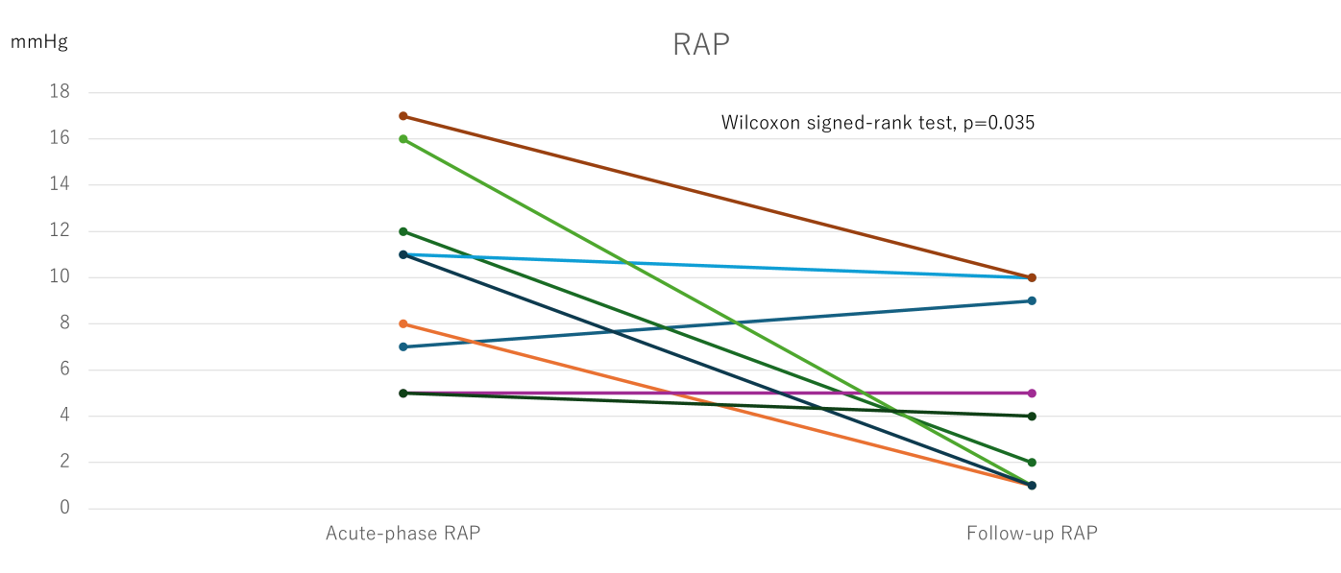
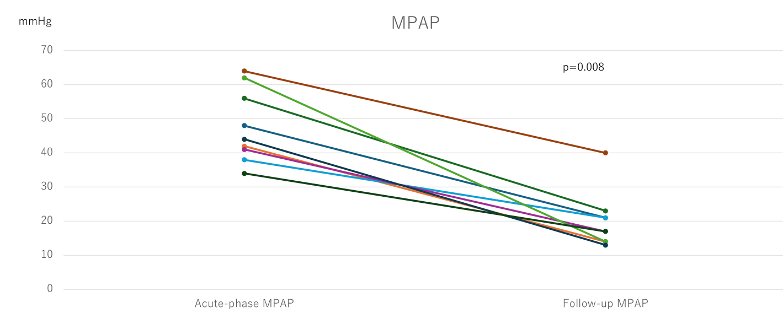
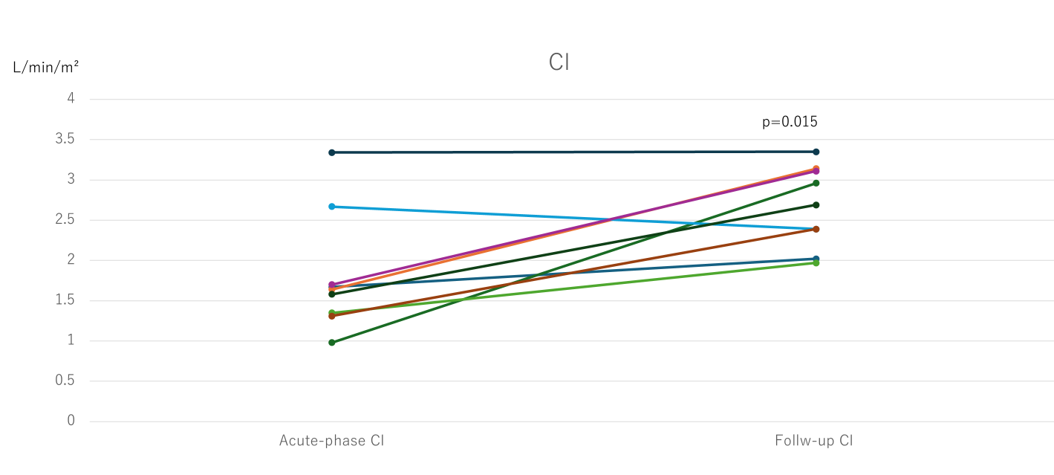
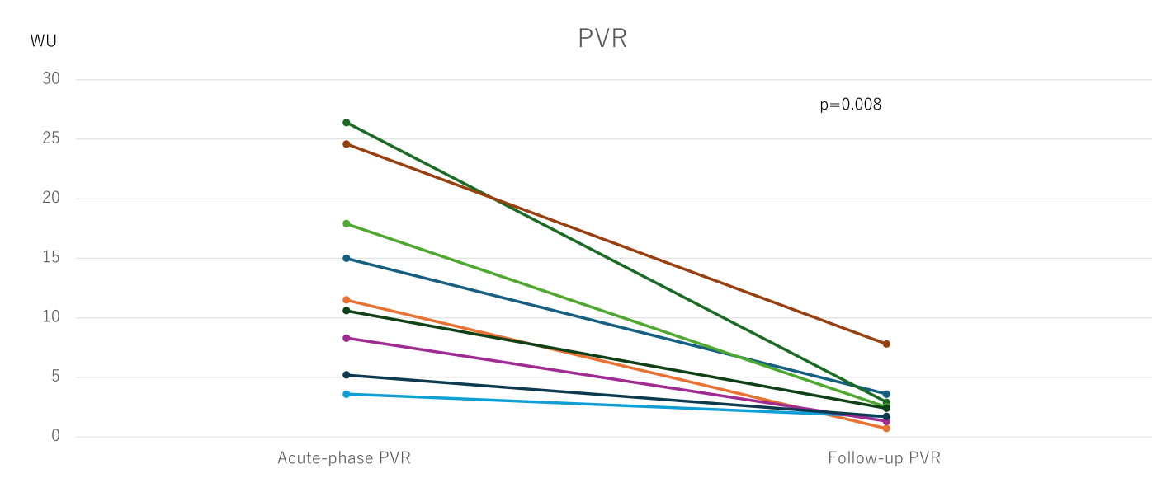
Results (Hemodynamic Changes)
Excluding the fatal cases and those without follow-up right heart catheterization, 9 patients were analyzed.

Slide 8
Results (Clinical outcomes)
Clinical outcomes
Acute-phase mortality, n (%) | 3 (23%)
BPA-related complication | 1 (8%)
Recurrent pulmonary embolism | 1 (8%)
Refractory right heart failure | 1 (8%)
Residual pulmonary hypertension | 1 (8%)
Among the 10 surviving patients, n
Weaning from ECMO | 4
WHO functional class I, II, III, IV | 6*,3,0,1
* Six patients, all of whom improved to WHO functional class I, discontinued home oxygen therapy.

Slide 9
Discussion
Acute-on-CTEPH represents a life-threatening clinical condition characterized by abrupt decompensation on the background of chronic thromboembolic pulmonary disease. In the present series, more than half of the patients required advanced cardiopulmonary support, including ECMO, reflecting the extreme severity of this condition.
Despite this critical presentation, invasive strategies tailored by a multidisciplinary CTEPH team, including rescue BPA, emergency PEA, and combined approaches, resulted in marked hemodynamic improvement and favorable functional recovery among survivors.
These findings suggest that prompt invasive intervention may play an important role in the management of selected patients with Acute-on-CTEPH.
However, the small sample size and retrospective single-center design warrant further investigation.

Slide 10
Conclusion
In selected patients with Acute-on-CTEPH, invasive treatment strategies including PEA and BPA may lead to substantial hemodynamic and clinical improvement when acute complications are successfully managed. Careful multidisciplinary decision-making and meticulous management of procedure-related complications are essential in the management of Acute-on-CTEPH.

