Slide 1
ICC 2026
Abstract template

Slide 2
IVUS-Guided Contrast-Free BPA for CTEPH
With Severe Iodinated Contrast Allergy
Jun Yamashita, Ryosuke Ito, Sayo Ikeda, Kazuhiro Satomi
Department of Cardiology, Tokyo Medical University Hospital
Yusuke Shimahara
Department of Cardiovascular Surgery, Tokyo Medical University Hospital

Slide 3
Introduction
BPA is an established treatment for patients with inoperable or residual lesions in CTEPH.
BPA typically requires repeated pulmonary angiography using iodinated contrast media.
In patients with severe contrast allergy, interventional treatment options are limited.
We evaluated the feasibility of IVUS-guided contrast-free BPA.

Slide 4
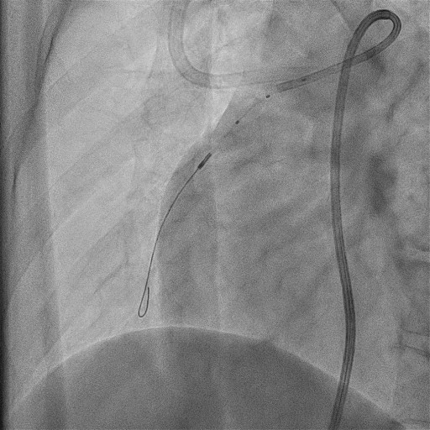
Methods (Procedure for contrast-free BPA)
1. A three-dimensional reconstruction of the pulmonary arteries is created using
previously obtained imaging modalities.
2. Using a standard BPA system, the guiding catheter is engaged into the target
branch of pulmonary artery.
3. After guidewire crossing, IVUS is performed.
The point where the IVUS catheter encounters
resistance is marked.

Slide 5
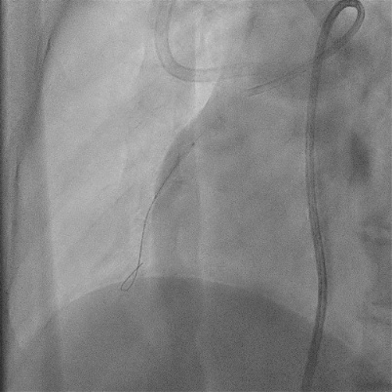
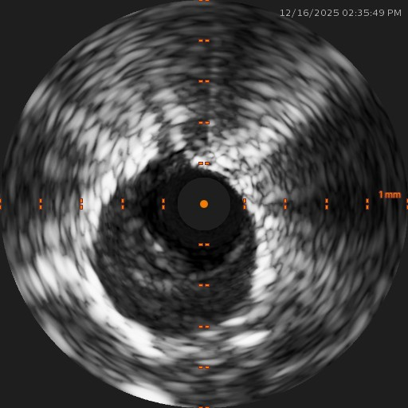
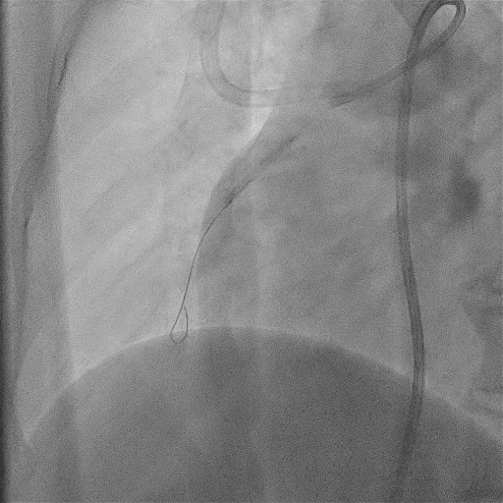
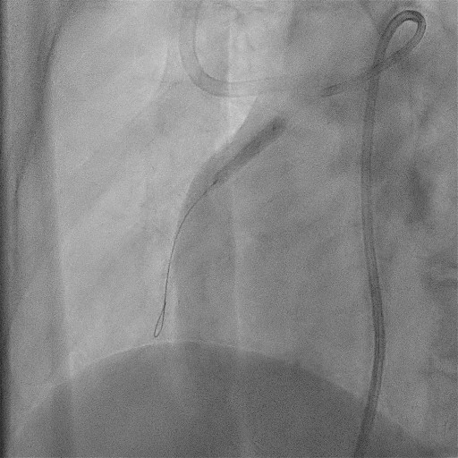
Methods (Procedure for contrast-free BPA)
4. Low-pressure dilation is performed using a 2-mm balloon.
5. IVUS is repeated to reassess the vascular morphology, and additional balloon
dilation with an appropriately upsized balloon is performed if necessary.

Slide 6
Methods (Procedure for contrast-free BPA)
6. After balloon dilation, the vessel is observed for several minutes to confirm the
absence of complications.
7. These steps are repeated for other target lesions.

Slide 7
Case Example 1, 40’s Female
History:
DVT and acute pulmonary embolism
Severe iodinated contrast anaphylaxis during diagnostic imaging
Disease predominantly peripheral → PEA not suitable
Treatment
IVUS-guided contrast-free BPA
3 BPA sessions
Outcome
MPAP: 44 → 23 mmHg
WHO-FC: III → I

Slide 8
Case Example 2, 40’s Female
History:
Severe contrast allergy during contrast-enhanced CT for CTEPH
PEA performed, MPAP: 50 → 34 mmHg, Persistent symptoms (WHO-FC II)
1 year later, MPAP 40 mmHg, WHO-FC III
Treatment
IVUS-guided contrast-free BPA
4 sessions
Outcome
MPAP 40 → 23 mmHg
WHO-FC III → I
Home oxygen therapy discontinued

Slide 9
Discussion
Lesion identification without contrast angiography
Feasibility of IVUS-guided contrast-free BPA
Strategies for complication management
Potential use of carbon dioxide or gadolinium as alternative contrast agents
Potential generalizability and limitations of this technique

Slide 10
Conclusion
These cases suggest that IVUS-guided contrast-free BPA may represent a feasible treatment option for selected CTEPH patients with severe iodinated contrast allergy.

