Slide 1
ICC 2026
Volume-outcome Relationship for Balloon Pulmonary Angioplasty in CTEPH

Slide 2


Volume-outcome Relationship for Balloon Pulmonary Angioplasty in CTEPH
Ryo Takano, Division of Pulmonary Circulation, Department of Cardiovascular Medicine, NCVC
Koshiro Kanaoka, Department of Medical and Health Information Management, NCVC
Yoko Sumita, Department of Medical and Health Information Management, NCVC
Jin Ueda, Division of Pulmonary Circulation, Department of Cardiovascular Medicine, NCVC
Akihiro Tsuji, Division of Pulmonary Circulation, Department of Cardiovascular Medicine, NCVC
Kenichi Tsujita, Department of Cardiovascular Medicine, Kumamoto University
Teruo Noguchi, Department of Cardiovascular Medicine, NCVC
Yoshihiro Miyamoto, Department of Medical and Health Information Management, NCVC
Takeshi Ogo, Division of Pulmonary Circulation, Department of Cardiovascular Medicine, NCVC
NCVC: National Cerebral and Cardiovascular Center, Osaka, Japan

Slide 3
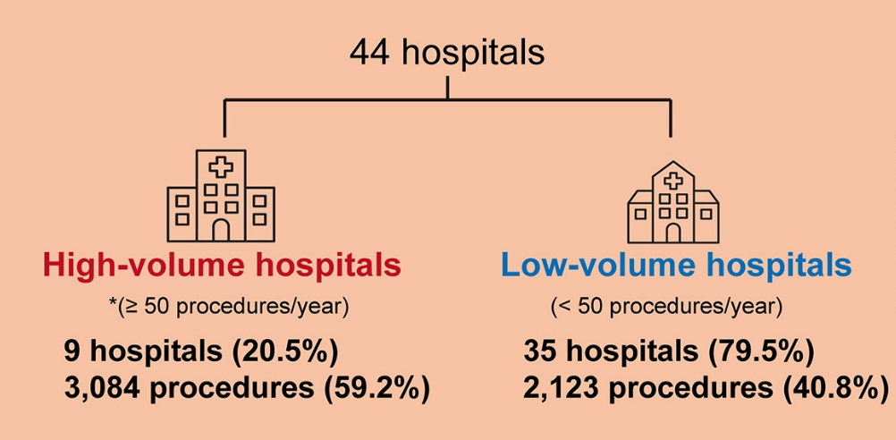

Introduction
Balloon pulmonary angioplasty (BPA) is an established component of multimodal therapy for CTEPH and improves hemodynamics and long-term outcomes¹⁻².
Advances in technique and periprocedural management have improved safety, leading to expanded indications and an increase in centers performing BPA³.
Procedural volume has emerged as an important determinant of safety⁴⁻⁵, and recent report from J-BPA registry suggest that centers performing ≥ 50 procedures/year experience fewer severe complications⁶.
However, data-driven criteria for defining BPA center expertise and volume thresholds remain lacking.
J-BPA registry
1. Delcroix M et al. Circulation. 2024;150(17):1354-1365. 2. Lang IM, et al. J Am Coll Cardiol. 2025;85(23):2270-2284. 3. Takano R, et al. JACC Asia. 2026:S2772-3747(26)00029-3. 4. Humbert M, et al. Eur Respir J. 2023;61:2200879 5. Kim NH, et al. Eur Respir J. 2024;64(4):2401294. 6. Ogo T, et al. Circ Cardiovasc Interv. 2025;18(12):e016172.

Slide 4

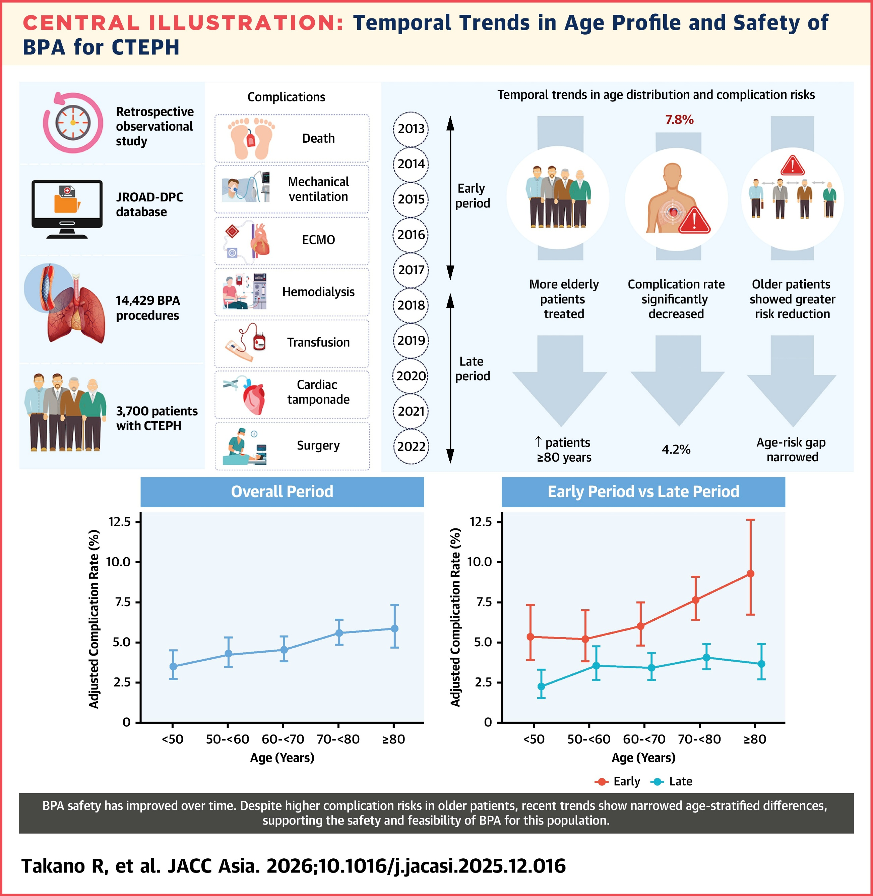
Methods
Aim: To define an expert-center threshold for annual BPA volume using a data-driven approach
Retrospective observational study from JROAD-DPC database (2012-2022)
  14,468 BPA procedures performed in 3,708 patients
Complications¹
Analysis
  Volume group comparison (tertile-based classification)
    Low-volume：1-34 procedures/year
    Intermediate-volume：35-126 procedures/year
    High-volume：≥127 procedures/year
  Restricted cubic spline curve
    Elbow point
    Plateau point
1. Takano R, et al. JACC Asia. 2026:S2772-3747(26)00029-3.

Slide 5
Results
  Volume group comparison
  Restricted cubic spline curve
15
Elbow point: 8 procedures/year
Plateau point: 44 procedures/year
10
Complication Rate (%)
Predicted Complication Rate (%)
5
0
0
50
100
200
300
BPA volume (procedures/year)

Slide 6
Discussion
Complications were primarily driven by initiation of MV (including NPPV). Low-volume centers showed higher rates of death, initiation of MV, and transfusion.
Complication risks declined with increasing annual BPA volume, with a plateau beyond 44 procedures/year, supporting the ≥50 procedures/year threshold proposed in the WSPH 2024 statement and the J-BPA registry¹⁻².
Centers performing ≥127 procedures/year had the lowest complication rates. Together with spline analysis, these results support a stepwise classification of ≥50 procedures/year as BPA centers and >100 procedures/year as BPA expert centers¹⁻³.
Although centralization may improve safety, excessive concentration could restrict patient access and increase the burden on high-volume centers. BPA expansion should balance safety with equitable access.
1. Kim NH, et al. Eur Respir J. 2024;64(4):2401294. 2. Ogo T, et al. Circ Cardiovasc Interv. 2025;18(12):e016172. 3. Humbert M, et al. Eur Respir J. 2023;61:2200879

Slide 7
Conclusion
Higher annual BPA volume was associated with improved safety, and
≥50 procedures/year represents a data-supported benchmark
for defining BPA centers.

