Slide 1

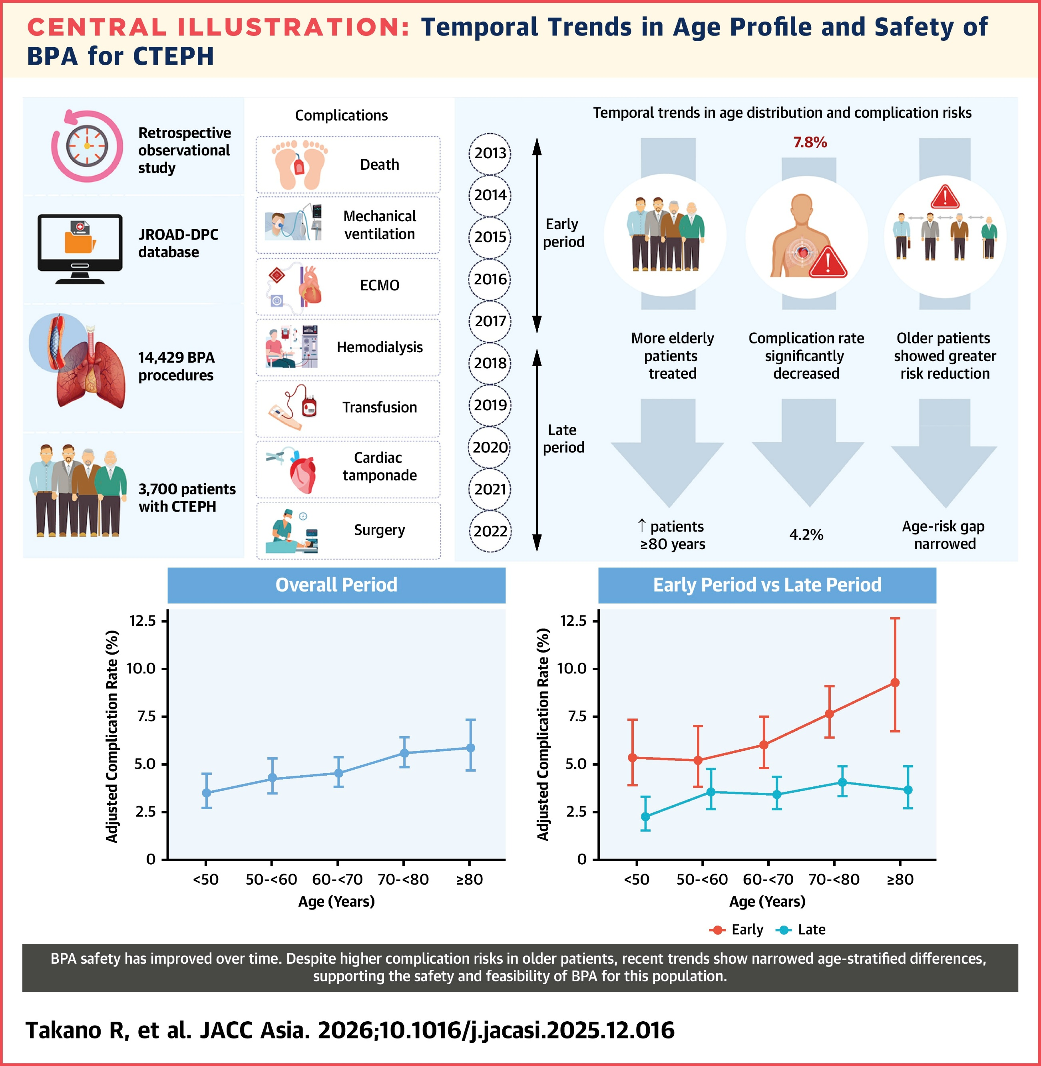
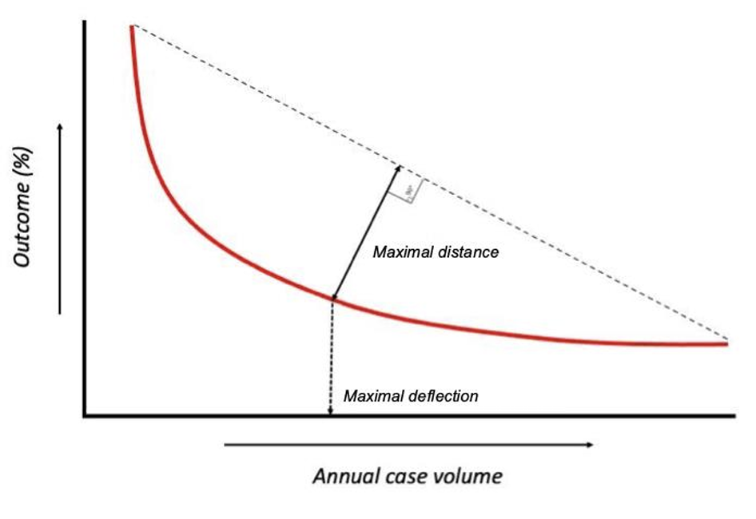








Volume-Outcome Relationship for Balloon Pulmonary Angioplasty for CTEPH
Ryo Takano¹, Koshiro Kanaoka², Yoko Sumita², Jin Ueda¹, Akihiro Tsuji¹, Kenichi Tsujita³, Teruo Noguchi⁴, Yoshihiro Miyamoto⁵, Takeshi Ogo¹
Division of Pulmonary Circulation, Department of Cardiovascular Medicine, National Cerebral and Cardiovascular Center (NCVC) 2. Department of Medical and Health Information Management, NCVC
3. Department of Cardiovascular Medicine, Kumamoto University 4. Department of Cardiovascular Medicine, NCVC 5. Department of Medical and Health Information Management, NCVC
Introduction
Balloon pulmonary angioplasty (BPA) is an established component of multimodal therapy for CTEPH and improves hemodynamics and long-term outcomes¹⁻².
Advances in technique and periprocedural management have improved safety, leading to expanded indications and broader dissemination of BPA to centers with limited procedural experience³.
Annual procedural volume has emerged as an important determinant of safety⁴⁻⁵, and a recent report from J-BPA registry suggests that centers performing ≥50 procedures/year experience fewer severe complications⁶.
However, data-driven criteria for defining BPA center volume thresholds remain lacking.
Results
Figure 1. Complication rates according to tertiles of annual procedural volume
Table 1. Baseline patient characteristics
The overall complication rate decreased significantly with increasing annual procedural volume (trend P < 0.001). The most common complication was MV initiation, which also decreased significantly with increasing annual procedural volume (trend P < 0.001). In-hospital mortality and transfusion rates were also lower in high-volume centers (trend P = 0.001 and 0.006, respectively).
Patients treated at high-volume centers were older, had a lower NYHA functional class, and were less frequently treated with pulmonary vasodilators.
 | Overall (n = 14,468) | Low volume (n = 4,900) | Intermediate volume (n = 4,856) | High volume (n = 4,712) | P-value
Age, years | 68 (56–75) | 69 (57–76) | 68 (56–75) | 68 (56–75) | 0.011
Sex, female | 10,750 (74.3) | 3,659 (74.7) | 3,532 (72.7) | 3,559 (75.5) | 0.005
NYHA (I/II/III/IV) |  |  |  |  | <0.001
Class Ⅰ | 1,934 (14.4) | 602 (13.0) | 689 (14.8) | 643 (15.4)
Class Ⅱ | 7,520 (55.8) | 2,228 (48.0) | 2,653 (57.0) | 2,639 (63.2)
Class Ⅲ | 3,213 (23.8) | 1,326 (28.6) | 1,110 (23.9) | 777 (18.6)
Class Ⅳ | 365 (2.7) | 198 (4.3) | 83 (1.8) | 84 (2.0)
Oral anticoagulant
Warfarin | 7,167 (49.5) | 2,103 (42.9) | 2,142 (44.1) | 2,922 (62.0) | <0.001
DOAC | 5,624 (38.9) | 2,045 (41.7) | 2,224 (45.8) | 1,355 (28.8) | <0.001
Pulmonary vasodilators
Any | 7,958 (55.0) | 3,056 (62.4) | 2,779 (57.2) | 2,123 (45.1) | <0.001
sGC stimulator | 5,994 (41.4) | 2,410 (49.2) | 2,306 (47.5) | 1,278 (27.1) | <0.001
Selexipag | 1,203 (8.3) | 398 (8.1) | 456 (9.4) | 349 (7.4) | 0.002
ERA | 1,940 (13.4) | 822 (16.8) | 418 (8.6) | 700 (14.9) | <0.001
PDE5i | 1,202 (8.3) | 394 (8.0) | 239 (4.9) | 569 (12.1) | <0.001
IV epoprostenol | 177 (1.2) | 93 (1.9) | 45 (0.9) | 39 (0.8) | <0.001
SC treprostinil | 4 (0.0) | 3 (0.1) | 1 (0.0) | 0 (0.0) | 0.033
Complication Rate (%)
Figure 2. Restricted cubic spline curve showing the association between annual procedural volume and predicted complication rate
15
Methods
Nationwide retrospective analysis of the JROAD-DPC database including 14,468 BPA procedures in 3,708 patients with CTEPH at 149 hospitals (2012–2023).
The outcome was procedure-related in-hospital
complications within 30 days after BPA,
assessed on a per-procedure basis.
Annual procedural volume was categorized
into tertiles.
    Low-volume: 1-34 procedures/year
    Intermediate-volume: 35-126 procedures/year
    High-volume: ≥127 procedures/year
    Restricted cubic spline analyses adjusted
    for age, sex, NYHA functional class, and procedure year were used to evaluate the volume–outcome relationship, with 95% CIs estimated using institution-level cluster- robust standard errors.
    The elbow point analysis was performed to identify the annual procedural volume at which further reductions in complication risk became marginal.
Restricted cubic spline analysis demonstrated that the predicted complication rate plateaued at approximately 52 procedures per year, corresponding to the identified elbow point.
10
Predicted Complication Rate (%)
Complication³
5
Abbreviations
CHDF, continuous hemodiafiltration; ECMO, extracorporeal membrane oxygenation; JROAD-DPC, Japanese Registry of All Cardiac and Vascular Diseases–Diagnosis Procedure Combination; MV, mechanical ventilation; NPPV, non-invasive positive pressure ventilation; NYHA, New York Heart Association; WSPH, World Symposium on Pulmonary Hypertension.
0
0
50
100
200
300
BPA volume (procedures/year)
Discussion
Complications were primarily driven by initiation of MV (including NPPV). Low-volume centers showed higher rates of death, initiation of MV, and transfusion.
Complication risk declined with increasing annual BPA volume, with a plateau beyond 52 procedures/year, supporting the ≥50 procedures/year threshold proposed in the WSPH 2024 statement and the J-BPA registry⁵⁻⁶.
Centers performing ≥127 procedures/year had the lowest complication rates. Together with spline analysis, these results support a stepwise classification of ≥50 procedures/year as BPA centers and >100 procedures/year as BPA expert centers⁴⁻⁶.
Although centralization may improve safety, excessive concentration could restrict patient access and increase the burden on high-volume centers. Balancing procedural safety with equitable access to BPA remains an important challenge for future research.
Elbow point
The elbow point was defined as the maximal perpendicular distance between the spline curve and the straight line connecting both ends of the curve, indicating the point where risk reduction began to plateau⁷⁻⁸.
Conclusions
Higher annual BPA volume was associated with improved safety, and ≥50 procedures/year represents a data-supported benchmark for defining BPA centers.
Contact
Ryo Takano, MD
Division of Pulmonary Circulation, Department of Cardiovascular Medicine, NCVC
E-mail: takano.ryo@ncvc.go.jp
Delcroix M et al. Circulation. 2024;150(17):1354-1365. 2. Lang IM, et al. J Am Coll Cardiol. 2025;85(23):2270-2284. 3. Takano R, et al. JACC Asia. 2026;6(4):543-555. 4. Humbert M, et al. Eur Respir J. 2023;61:2200879 5. Kim NH, et al. Eur Respir J. 2024;64(4):2401294. 6. Ogo T, et al. Circ Cardiovasc Interv. 2025;18(12):e016172.
7. Kawczynski MJ, et al. Eur Heart J. 2023;44:4357-4372. 8. Heuts S, et al. Eur Respir J. 2025;65:2401865.

