Slide 1
ICC 2026
Abstract template

Slide 2
Incidence and hemodynamic data of Latvian CTEPH patients diagnosed in 2024-2025
Matiss Zicans, Riga Stradins University;
Assoc. prof. Ainars Rudzitis, Riga Stradins University, Pauls Stradins Clinical University hospital;
Ricards Kaulins, Riga Stradins University;
Dana Kigitovica, Riga Stradins University, Pauls Stradins Clinical University hospital
Haralds Cesnieks, University of Latvia;
Martins Bode, Riga Stradins University;
Assoc. prof. Andris Skride, Riga Stradins University, Pauls Stradins Clinical University hospital;
Latvian Pulmonary Hypertension centre

Slide 3
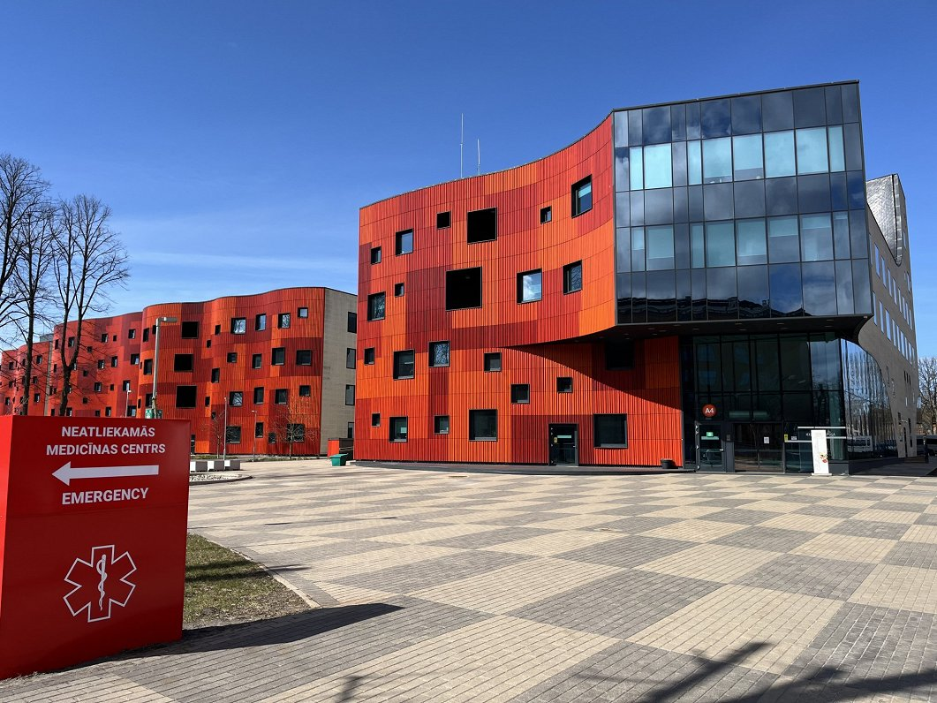
Introduction
CTEPH incidence is widely variable throughout the world;
  Registries: 4-7 cases per million^{1,2};
  Calculations: 3-30 cases per million³;
    Based on epidemiology of pulmonary embolism (PE);
Diagnostic delay is associated with higher mortality;
  14 month delay → Life expectancy reduced by 3 years⁴;
Latvian pulmonary hypertension centre;
  Registries since 2007;
  The only pulmonary hypertension centre in Latvia;
  Present nationwide epidemiological data;
Pauls Stradins Clinical University hospital
1. Gall H, Hoeper MM, Richter MJ, et al. An epidemiological analysis of the burden of chronic thromboembolic pulmonary hypertension in the USA, Europe and Japan. European Respiratory Review [Internet]. 2017 Mar 29 [cited 2021 Oct 6];26(143):160121. Available from: https://err.ersjournals.com/content/errev/26/143/160121.full.pdf
2. Kramm T, Wilkens H, Fuge J, et al. Incidence and characteristics of chronic thromboembolic pulmonary hypertension in Germany. Clinical Research in Cardiology. 2018 Feb 15;107(7):548–53.
3. Lang IM, Pesavento R, Bonderman D, et al. Risk factors and basic mechanisms of chronic thromboembolic pulmonary hypertension: a current understanding. European Respiratory Journal. 2012 Jun 14;41(2):462–8.
4. Boon GJAM, van den Hout WB, Barco S, et al. A model for estimating the health economic impact of earlier diagnosis of chronic thromboembolic pulmonary hypertension. ERJ Open Research. 2021 Jul;7(3):00719-2020.

Slide 4
Methods
Study population:
  All CTEPH patients diagnosed via RHC + conventional PA in Latvia 01.01.2024. – 31.12.2025.
  Diagnosis – in accordance with ESC PH (2022) guidelines⁵;
Patients with suspected CTEPH - referred to our centre;
  Medical history → Probability of CTEPH;
  Clinical interview → Risk factors, onset of symptoms, questionnaires;
  Additional investigation;
    Echocardiography;
    V/Q scintigraphy;
If needed
Epidemiological data & Statistics
RHC + PA
Diagnosis & Inclusion in the registry
5. Humbert M, Kovacs G, Hoeper MM, et al. 2022 ESC/ERS Guidelines for the diagnosis and treatment of pulmonary hypertension. European Heart Journal. 2022 Aug 26;43(38).

Slide 5
Results
Table 1. Patients’ road to diagnosis
 | All patients (n=20) Median (IQR) | Diagnosed earlier (n=9) Median (IQR) | Diagnosed later (n=11) Median (IQR)
Age, years | 67 (18) | 60 (18) | 71 (13.5)
Male sex, % | 65 | 68 | 62
Time till diagnosis, months | 24 (20) | 14 (6) | 30 (18)
Doctors visited before referral to PH centre | 3 (2) | 2 (2) | 4 (2)
Examinations where signs of CTEPH are missed | 1 (3) | 1 (3) | 2 (3)
Incidence
RHC + PA performed for 27 patients;
20 patients diagnosed during 2 years;
  In 2024 – 15;
  In 2025 – 5;
Incidence: 5.46 cases/million;
2 groups compared:
  «Diagnosed earlier» - in less than 2 years;
  «Diagnosed later» - more than 2 years;
    Since the onset of symptoms.

Slide 6
Results
Table 2. Patients’ clinical data
Hemodynamic data
«Later diagnosed group» - worse!
  Higher mPAP and PVR;
  Worse in 6MWT;
NT-proBNP – not significant differences;
Functional class:
  «Earlier diagnosed»
    6/9 WHO FC II;
    3/9 WHO FC III;
  «Later diagnosed»
    5/11 WHO FC II;
    6/11 WHO FC III
 | All patients (n=20) Median (IQR) | Diagnosed earlier (n=9) Median (IQR) | Diagnosed later (n=11) Median (IQR)
mPAP, mmHg* | 43.0 ±7.1 | 39.6 ±7.7 | 45.9 ±8.0
PAWP, mmHg | 10 (9) | 11 (9) | 9 (10)
PVR, WU* | 9.18 ±3.99 | 7.49 ±3.96 | 10.62 ±4.05
6MWD, m | 360 (366) | 390 (280) | 343 (385)
NT-proBNP, pg/mL | 901 (1221) | 806 (2318) | 956 (1023)
Worse functional capabilities
* Calculated using mean (±SD)

Slide 7
Discussion
CTEPH is underrecognized and underestimated;
  Our median time from symptom onset to diagnosis – 24 months;
  Many patients remain undiagnosed due to comorbidities mimicking CTEPH;
CTEPH is usually not in the differential;
  Median physician visits required for referral to PH centre – 3!
  Often CTEPH is missed when it is visible;
    in echocardiography;
    In CTPA;
Delay in diagnosis leads to significant worsening;
  Worsening heart failure;
  More severe pulmonary hypertension;

Slide 8
Conclusion
Our reported incidence of 5.46 cases/million is in line with data of other registries^{1,2};
Earlier recognition and referral to a PH centre correlate with milder pulmonary hypertension and heart failure;
Nationwide registries serve an educational purpose to assess differences in the complicated diagnostic pathways of CTEPH patients;
Physician educational activities like seminars, conferences are needed to increase awareness;
  Twice a year in Latvia – «Rare disease conference»
Patients with suspicions of CTEPH must be referred to a specialized PH centre to confirm the diagnosis and provide the treatment.

