Slide 1
ICC 2026

Slide 2
Regaining Work Ability One year after PEA in Patients with CTEPH
N. Kolac¹
P. Tsimpoura,¹ MD
D. Kuschka,¹ MD
N. Ganceva,¹ MD
S. Guth,² MD
E. Mayer,² MD
R. Huhn,^{1,3} MD, PhD
C. Torregroza,¹ MD, PhD
C.B. Wiedenroth,² MD
¹Department of Anesthesiology, Kerckhoff-Clinic, Justus-Liebig-University Giessen, Bad Nauheim, Germany, ²Department of Thoracic Surgery, Kerckhoff-Clinic, Justus-Liebig-University Giessen, Bad Nauheim, Germany, ³Department of Anesthesiology, Amsterdam University Medical Center (AUMC), The Netherlands

Slide 3
Introduction
Chronic thromboembolic pulmonary hypertension (CTEPH) is a rare disease affecting patients of all age groups (median age 60; range 18-84 years).¹
Pulmonary Endarterectomy (PEA) is the treatment of choice.²
PEA has been shown to improve Quality of life.³
Participation in working life is an important part of society and social life.
The question of whether the operation will enable patients to return to work is of great importance.
Impact of CTEPH on work ability before and after PEA surgery is yet to be investigated.
¹Mayer et al. J Thorac Cardiovasc Surg. 2011; 141(3):702-10, ² Delcroix et al. Circulation 2024; 150(17):1354-1365, ³McKenna et al. Qual Life Res. 2006; 15(1):103-15

Slide 4
Methods
Study design: Prospective, single-centre, observational cohort study
Study period: February 2022 – January 2026
Study centre: Kerckhoff Clinic, Bad Nauheim, Germany
Study population: CTEPH patients > 18 years but within working age, undergoing PEA
Primary endpoint: Ability to resume work 1 year after PEA
Fischer’s exact test and one-way-ANOVA with Bonferroni post-hoc test to compare work capacity before onset of symptoms, at the time of surgery and postoperatively
Univariate and multivariable regression analysis to identify influencing factors on primary endpoint

Slide 5
Results
145 patients included into analysis (54 % male, mean age 51±12 years)
Preoperative work participation: 46 %
70 % returned to working life 1 year after PEA surgery
Mean weekly working time significantly increased 1 year after PEA (24 hours vs. 15 hours preoperative, p< 0.001)
*p<0.001 before onset of symptoms vs. 1-year post PEA; #p<0.001 before onset of symptoms vs. at time of PEA; §p<0.001 at time of PEA vs. 1-year post PEA

Slide 6
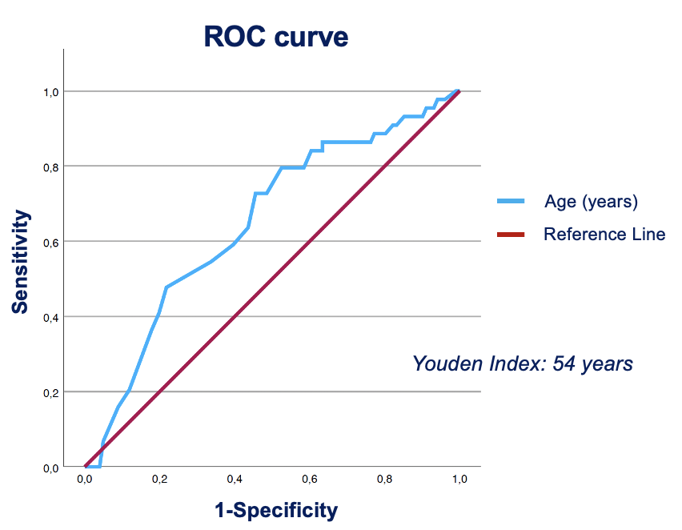
Results
Age [OR: 0.956, 95% CI: 0.920-0.993, p = 0.021] and diabetes [OR: 0.321, 95% CI: 0.108-0.953, p = 0.041] independent limiting factors on working ability
WHO-FC II before surgery favourable factor on working ability [OR: 3.773, 95% CI: 1.020-13.958, p = 0.047]
Patients older than 54 years more unlikely to return to work life after PEA [AUC age: 0.650 95% CI 0.553-0.746, p=0.002]

Slide 7
Discussion
CTEPH patients experience an increase in their ability to work after PEA.
A significant amount (70%) of patients return to working life post surgery.
Age (> 54 years) and Diabetes mellitus are independent limiting factors on work ability after PEA.
Patients with lower WHO functional class are more likely to regain working ability after PEA.
³McKenna et al. Qual Life Res. 2006; 15(1):103-15

Slide 8
Conclusion
PEA enables CTEPH patients to return to work as part of social life, hence improving quality of life in this patient cohort.
Results support the relevance of surgical treatment in CTEPH patients.
The study is of great importance not only for each individual patient but for society.

