Slide 1
ICC 2026
Pulmonary Endarterectomy: Post-operative Extubation, Analgesia and Mobilisation

Slide 2
Pulmonary Endarterectomy: Post-operative Extubation, Analgesia and Mobilisation
Kesavan Sivanesan, Royal Papworth Hospital, Cambridge, UK
Sophia Thomas, Royal Papworth Hospital, Cambridge, UK
Judee Lopez, Royal Papworth Hospital, Cambridge, UK
David Jenkins, Royal Papworth Hospital, Cambridge, UK
John Taghavi, Royal Papworth Hospital, Cambridge, UK
Steven Tsui, Royal Papworth Hospital, Cambridge, UK
Choo Yen Ng, Royal Papworth Hospital, Cambridge, UK
Florencia Ares, Royal Papworth Hospital, Cambridge, UK
Andrew Klein, Royal Papworth Hospital, Cambridge, UK
Nicola Jones, Royal Papworth Hospital, Cambridge, UK

Slide 3
Introduction
Pulmonary endarterectomy (PEA) is a complex cardiothoracic procedure requiring structured post-operative critical care. Optimising sedation, ventilation, and analgesia may influence early recovery milestones, including extubation and mobilisation. We evaluated early post-operative pain and recovery metrics in a national PEA centre where care was delivered according to protocol in a Cardiac Nurse Specialist-led ‘Enhanced Recovery Unit’.

Slide 4
Methods
A retrospective review was conducted of consecutive patients undergoing isolated PEA at Royal Papworth Hospital between 1 March and 30 August 2025. Cases involving concomitant procedures or pre-existing complex analgesic requirements were excluded.
Post-operative sedation was propofol-based infusion without routine opioid co-administration. Intravenous paracetamol formed the standard first-line analgesic strategy. Escalation to oral codeine was the defined second-line approach. Intraoperative analgesia consists of 1000mcg of IV fentanyl administered at the time of induction.
Outcome measures included time to sedation break, extubation, analgesic escalation, mobilisation, and discharge from the critical care area (CCA). Pain was assessed using maximal recorded numerical rating scores.

Slide 5
Results
Sixty-four patients were included (median age 61 years [range 21–84]; 59% male).
Median time to first sedation break was 9.9 [IQR 7.2-15.9] hours, and median time to extubation was 17.4 [IQR 11.1-22.3] hours. Twenty-one patients (33%) required re-sedation following the initial sedation break. The most frequent causes were inadequate gas exchange (n=15) and cardiovascular instability (n=13), with agitation less commonly responsible (Table 1).

Slide 6
Results
Intravenous paracetamol was administered early (median 2.6 [IQR 2-4.1 hours). Escalation of analgesia, most commonly to codeine, was required in 87.5% of patients and occurred at a median of 20 [IQR 16.7-29.3] hours, predominantly after extubation. The median maximal numerical pain score, using a 0–10 scale (0 = lowest, 10 = highest), was 4.5 [IQR 3-7].
Median time to mobilisation was 25.7 [IQR 19.7-40.2] hours, and median time to discharge from CCA was 45.2 [IQR 41.4-67] hours.

Slide 7
Results
Table 1: Reasons for delay of first sedation break
Reason for delay | Cases (n)
Abnormal neurology while sedated | 1
Agitation | 5
Medical/Surgical Plan | 3
CV instability alone | 13
CV instability and Inadequate Gas Exchange | 2
Excessive bleeding alone | 1
Excessive bleeding and Haemodynamic Instability | 1
Excessive bleeding and Inadequate Gas Exchange | 1
Inadequate Gas Exchange alone | 15
No delay | 21
Hypothermia and Inadequate Gas Exchange | 1

Slide 8
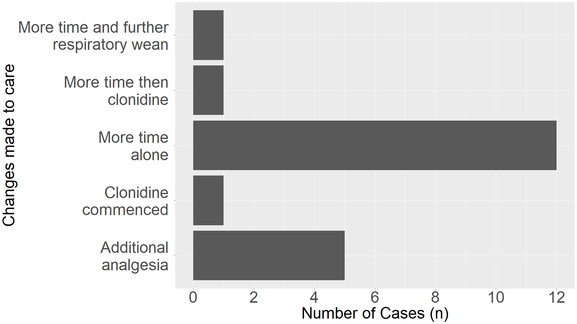
Results
Figure 1: Changes made after failed first sedation break

Slide 9
Discussion
Patients undergoing PEA have severe haemodynamic compromised secondary to chronic severe pulmonary hypertension. Post-operatively, they are particularly at risk of reperfusion cerebral and pulmonary oedema. Close monitoring and avoidance of routine opioid administration enables earlier neurological assessment and tracheal extubation.
This cohort demonstrates a clear temporal relationship between extubation and escalation of analgesia. Despite early paracetamol administration and the absence of routine opioid infusion during sedation, the majority of patients required codeine following restoration of consciousness and spontaneous ventilation.

Slide 10
Discussion
The average interval between extubation and analgesic escalation was approximately 3–4 hours, suggesting that clinically significant pain emerges in the early post-extubation phase rather than during deep sedation.
Re-sedation was predominantly driven by physiological instability rather than uncontrolled pain, indicating that delayed extubation was not primarily analgesia-related.
These findings suggest that anticipatory optimisation of post-extubation analgesia may represent a rational target for pathway refinement in PEA recovery.

Slide 11
Conclusion
Patients undergoing PEA experience moderate post-operative pain that most commonly emerges after extubation. Escalation to codeine frequently follows restoration of spontaneous ventilation. Structured evaluation of early post-extubation analgesic strategies may further enhance recovery while maintaining early extubation goals.

