Slide 1
Pulmonary Angiography as a Quantifiable Measure of Successful Pulmonary Thromboendarterectomy in the Era of Expanding Indications
Stephen Chiu, MD [Cardiac Surgery, Northwestern University, Chicago, IL, USA]
Daniel Romary, MD, MS [Cardiac Surgery, Northwestern University, Chicago, IL, USA]
Charles Logan, MD, MS [Cardiac Surgery, Northwestern University, Chicago, IL, USA]
Ruben Mylvaganam, MD [Pulmonary Critical Care, Northwestern University, Chicago, IL, USA]
Yasmin Raza, MD [Cardiology, Northwestern University, Chicago, IL, USA]
Maanasi Samant, MD [Pulmonary Critical Care, Northwestern University, Chicago, IL, USA]
Daniel Schimmel, MD, MS [Cardiology, Northwestern University, Chicago, IL, USA]
Michael Cuttica, MD [Pulmonary Critical Care, Northwestern University, Chicago, IL, USA]
S. Chris Malaisrie, MD [Cardiac Surgery, Northwestern University, Chicago, IL, USA]

Slide 2
Introduction
Pulmonary thromboendarterectomy (PTE) is the guideline-recommended treatment for chronic thromboembolic pulmonary hypertension (CTEPH).¹
As disease recognition and surgical safety have improved, patients with a lower burden of disease are being offered PTE,² making it difficult to quantify treatment success using traditional parameters such as pulmonary vascular resistance (PVR).
Here, we describe our experience using pulmonary angiography (PAg) as a quality indicator for PTE across disease severity.
Humbert M, Kovacs G, Hoeper MM, et al. 2022 ESC/ERS Guidelines for the diagnosis and treatment of pulmonary hypertension. Eur Respir J. Jan 2023;61(1)
Jenkins DP, Tsui SS, Taghavi J, et al. Pulmonary thromboendarterectomy-the Royal Papworth experience. Ann Cardiothorac Surg. 2022;11(2):128-132.

Slide 3
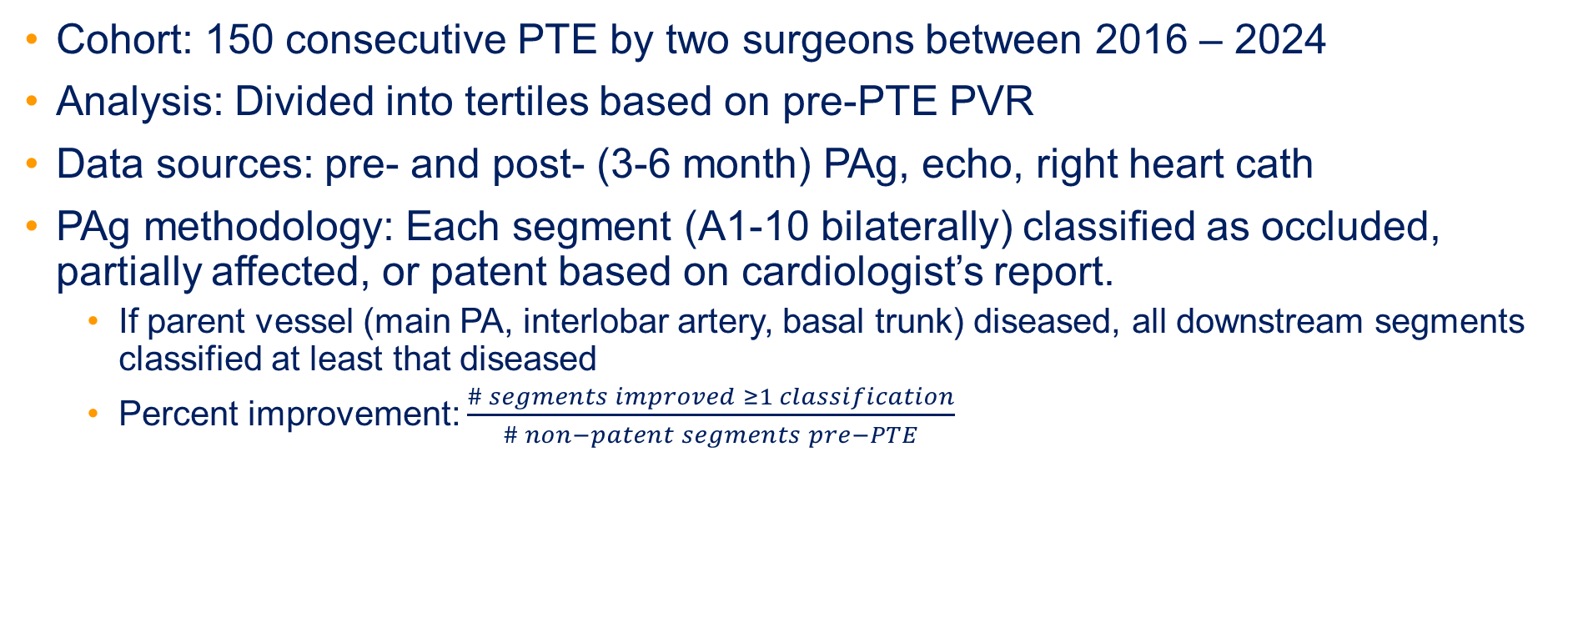
Methods
Cohort: 150 consecutive PTE by two surgeons between 2016 – 2024
Analysis: Divided into tertiles based on pre-PTE PVR
Data sources: pre- and post- (3-6 month) PAg, echo, right heart cath
PAg methodology: Each segment (A1-10 bilaterally) classified as occluded, partially affected, or patent based on cardiologist’s report.
  If parent vessel (main PA, interlobar artery, basal trunk) diseased, all downstream segments classified at least that diseased
  Percent improvement: $\frac{\# segments improved ≥1 classification}{\# non−patent segments pre−PTE}$

Slide 4
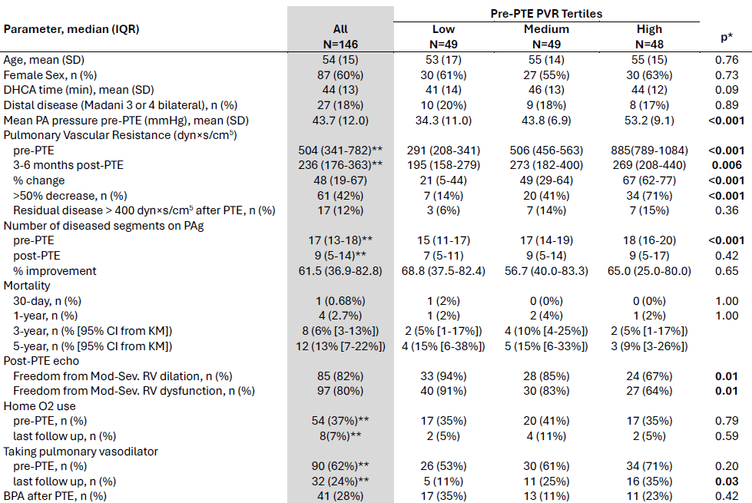
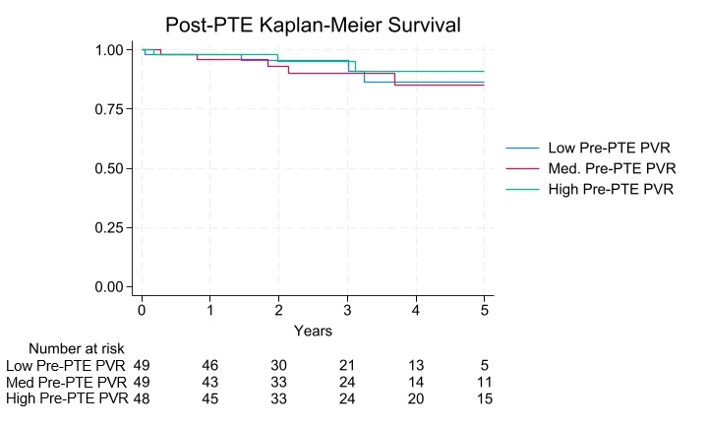
Results
146 of 150 cases had pre-operative pulmonary vascular resistance.
Patients with usable PAg: 135 pre-PTE, 122 post-PTE, 116 both
*Comparison across first, second, and third cohorts with one-way ANOVA, Kruskall-Wallis, chi-squared, or Fisher’s exact test as appropriate.
** Pairwise comparisons were performed by Wilcoxon matched-pairs signed-rank test or McNemar’s test as appropriate. Denotes statistical significance at p<0.001 based on pairwise tests.

Slide 5
Discussion
The number of diseased segments identified on pre-PTE PAg increased with the pre-PTE PVR tertile.
There were no differences in mortality at 30-days or 1-year across groups.
The low starting PVR cohort had greater freedom from mod-severe RV dilation and dysfunction than the high starting PVR group 3-6 months after PTE (p=0.01).
Those with a higher pre-PTE PVR were more likely to be on pulmonary vasodilators at last follow up (p=0.03).
While percentage decrease in PVR and number of patients achieving >50% reduction in PVR significantly differed across the groups (p<0.01), the number of diseased segments on post-PTE PAg (p=0.4) and percentage improvement in diseased segments (p=0.7) were not affected by pre-PTE PVR.

Slide 6
Conclusion
Traditional quantifiable metrics of PTE success, such as percent and absolute reduction in PVR, are affected by the starting hemodynamic severity of disease.
Alternatively, post-PTE pulmonary angiography can be evaluated separately as a quality indicator for success, independent of patients' baseline hemodynamics.

