Slide 1
ICC 2026
Abstract template

Slide 2
ERACS for CTEPD without PH
Tom Verbelen, Department of Cardiac Surgery, University Hospitals Leuven, Belgium
Danny F. Hoogma, Department of Anaesthesiology, University Hospitals Leuven, Belgium
Laurent Godinas, Department of Pneumology, University Hospitals Leuven, Belgium
Emanuele Muscogiuri, Department of Radiology, University Hospitals Leuven, Belgium
Kenny Van Zwam, Department of Perfusion, University Hospitals Leuven, Belgium
Marion Delcroix, Department of Pneumology, University Hospitals Leuven, Belgium
Steffen Rex, Department of Anesthesiology, University Hospitals Leuven, Belgium

Slide 3
Introduction
Enhanced Recovery After Cardiac Surgery (ERACS) is a multidisciplinary, evidence-based approach designed to reduce the body's stress response to surgery, minimize complications, and expedite a patient's return to normal functional status.
Pulmonary hypertension (PH) increases the risk of perioperative mortality and morbidity - such as right heart failure, delayed extubation, and longer ICU stays – and therefore requires a tailored management rather than a standardized ERACS pathway.
Patients with Chronic Thromboembolic Pulmonary Disease (CTEPD) without PH may have a more predictable postoperative course after pulmonary endarterectomy (PEA) compared to patients with Chronic Thromboembolic Pulmonary Hypertension (CTEPH) undergoing PEA.
Minimally invasive PEA has recently been described by a few groups.

Slide 4
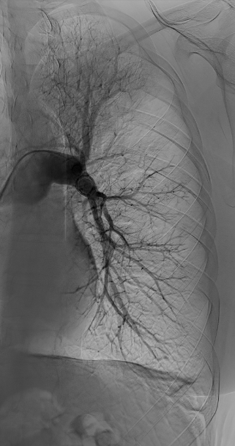
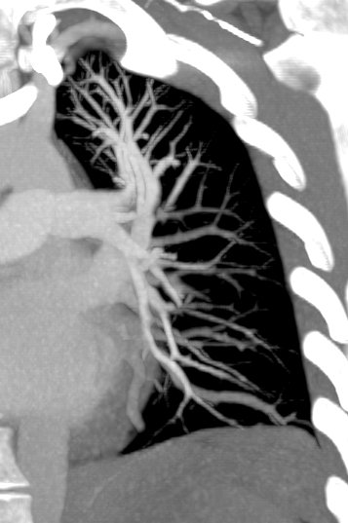
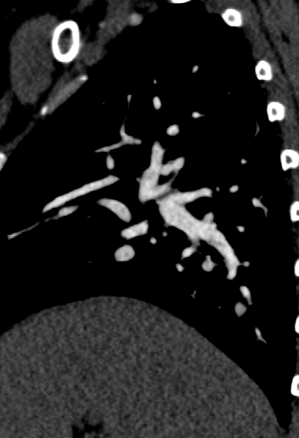
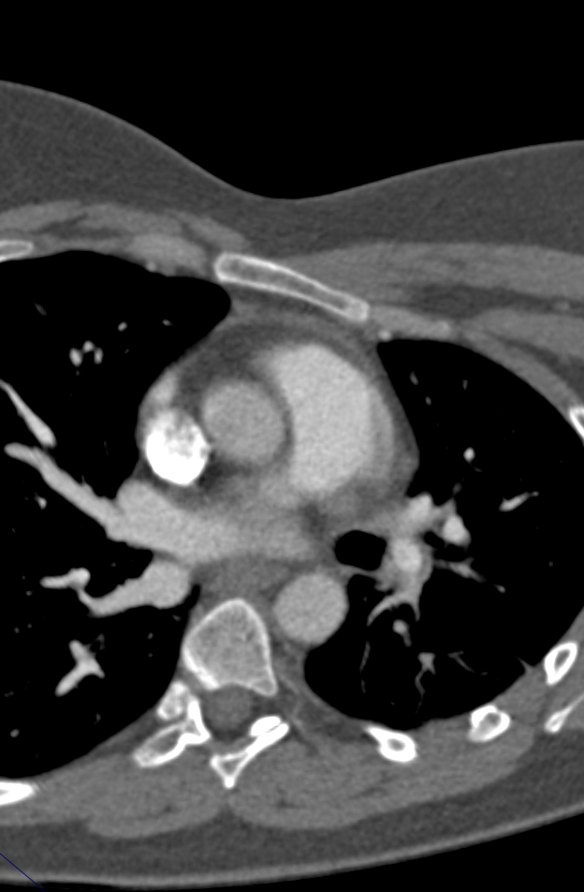
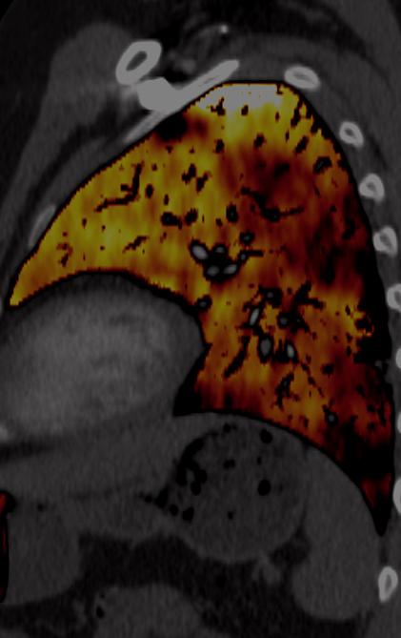
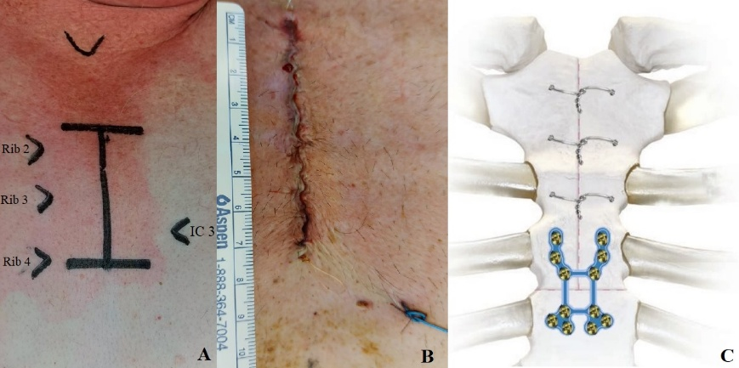
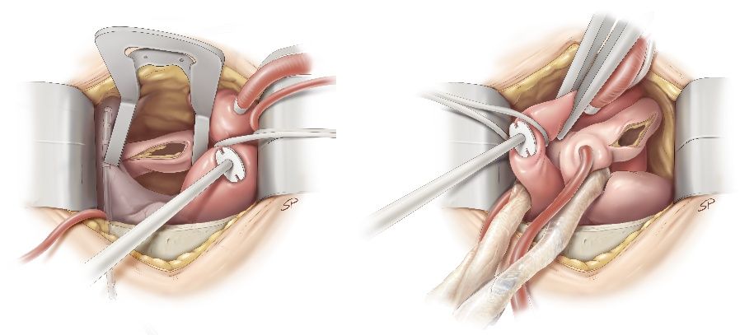
Methods
32-year old female symptomatic patient
BMI: 32.5 kg/m²
mPAP: 19 mmHg
CI: 2.39 L/min/m²
PVR: 1.44 WU
6MWD: 575 m
NYHA II
NT-pro BNP: 5 ng/L
TAPSE: 22.49 mm
VO_{2max}: 20 mL/kg/min
VE/VCO2: 44
PEA by inverted-T upper hemisternotomy¹
*
1. De Vos M, Meyns B, Quarck RA, Belge C, Godinas L, Rex S, Vlasselaers D, Delcroix M, Verbelen T. Pulmonary endarterectomy through inverted-T upper hemisternotomy. JTCVS Tech. 2024 Oct 18;28:65-72. doi: 10.1016/j.xjtc.2024.09.021

Slide 5
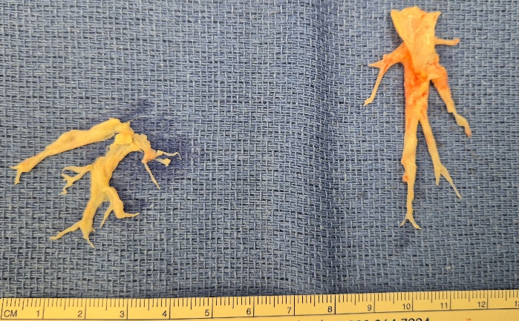
Results
Deep Hypothermic Circulatory Arrest: 23 minutes
Cross clamp time: 91 minutes
Cardiopulmonary bypass time: 222 minutes
Extubation in operating room
Postoperative Anaesthesia Care Unit (PACU)
Postoperative day (POD)1: morning mobilisation
POD1 14:30h: transfer to the ward
POD2: drain removal and starts physical rehabilitation
↓
Goal: climbing 1 floor of stairs
Intensive care unit-stay: 0 days
PACU-stay: 1 day
Hospital stay: 4 days
6 months postop evaluation:
  Normal V/Q-scan
  NYHA I
  6MWD: 579 m
  TAPSE: 19.6 mm
  NT-pro BNP: 47 ng/L

Slide 6
Discussion
PEA for CTEPD without PH only in expert centres and if patients are symptomatic¹
PEA for CTEPD without PH → significant improvement in symptoms and quality of life²
Minimally invasive cardiac surgery (MICS) might improve postoperative outcomes³
The full benefit of MICS can only be achieved by also utilizing an ERACS platform³
Verbelen T, Fadel E, Wiedenroth CB, Jenkins DP, Madani MM. Pulmonary endarterectomy for chronic thromboembolic pulmonary hypertension: Technical challenges and controversies. JHLT Open. 2025 Jul 30;10:100357. doi: 10.1016/j.jhlto.2025.100357
Taboada D, Pepke-Zaba J, Jenkins DP, Berman M, Treacy CM, Cannon JE, Toshner M, Dunning JJ, Ng C, Tsui SS, Sheares KK. Outcome of pulmonary endarterectomy in symptomatic chronic thromboembolic disease. Eur Respir J. 2014 Dec;44(6):1635-45. doi: 10.1183/09031936.00050114.
Salenger R, Ad N, Grant MC, Bakaeen F, Balkhy HH, Mick SL, Sardari Nia P, Kempfert J, Bonaros N, Bapat V, Wyler von Ballmoos MC, Gerdisch M, Johnston DR, Engelman DT. Maximizing Minimally Invasive Cardiac Surgery With Enhanced Recovery (ERAS). Innovations (Phila). 2024 Jul-Aug;19(4):371-379. doi: 10.1177/15569845241264565.

Slide 7
Conclusion
ERACS after PEA for CTEPD without PH
  is feasible and safe
  only in centres with expertise in both PEA surgery and ERACS standard of care procedures
The full benefit of minimally invasive PEA can only be achieved by ERACS

