Slide 1
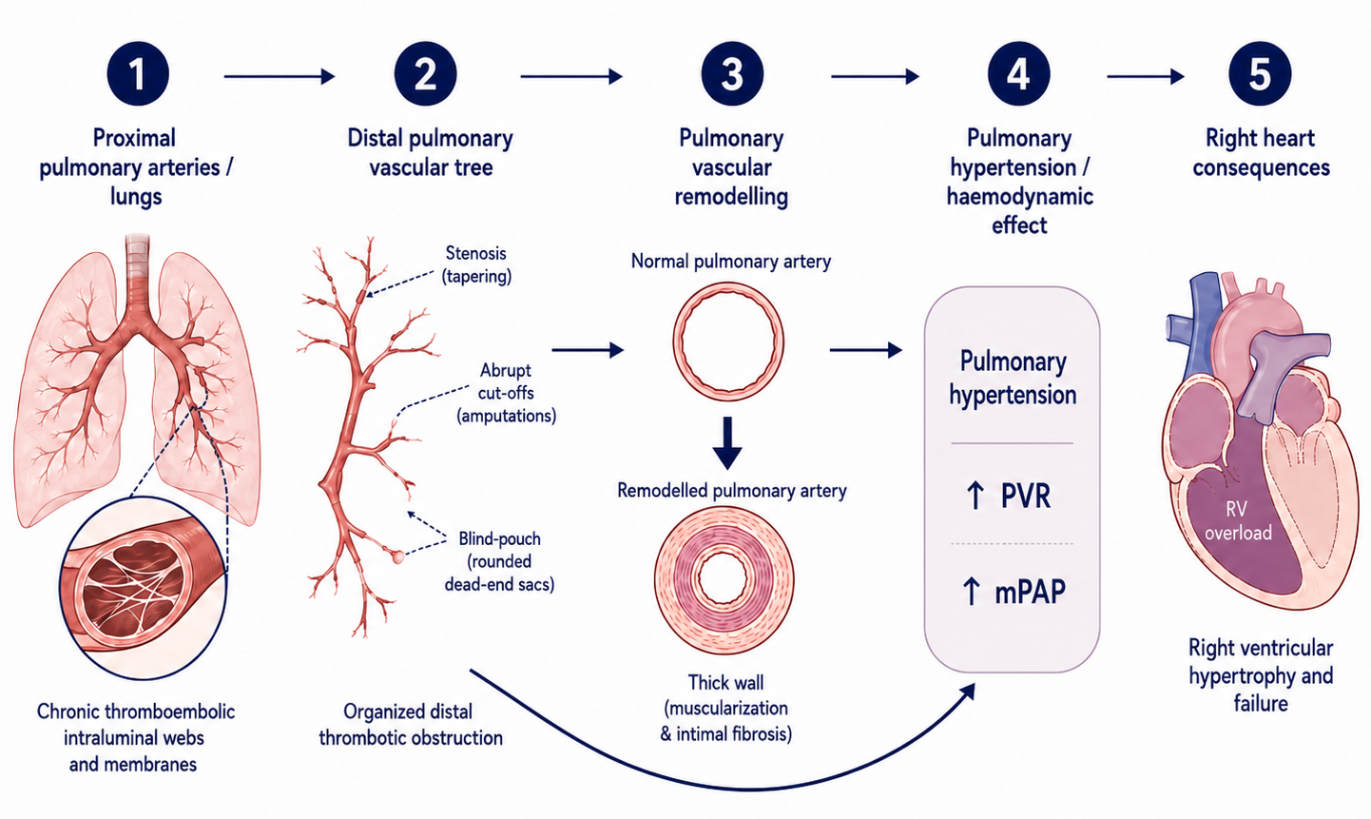
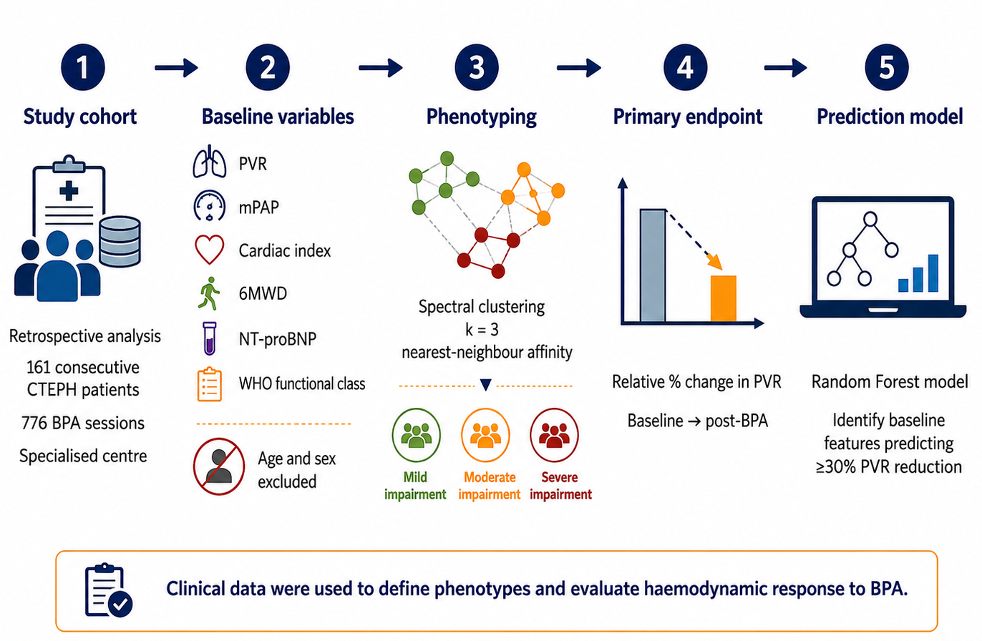
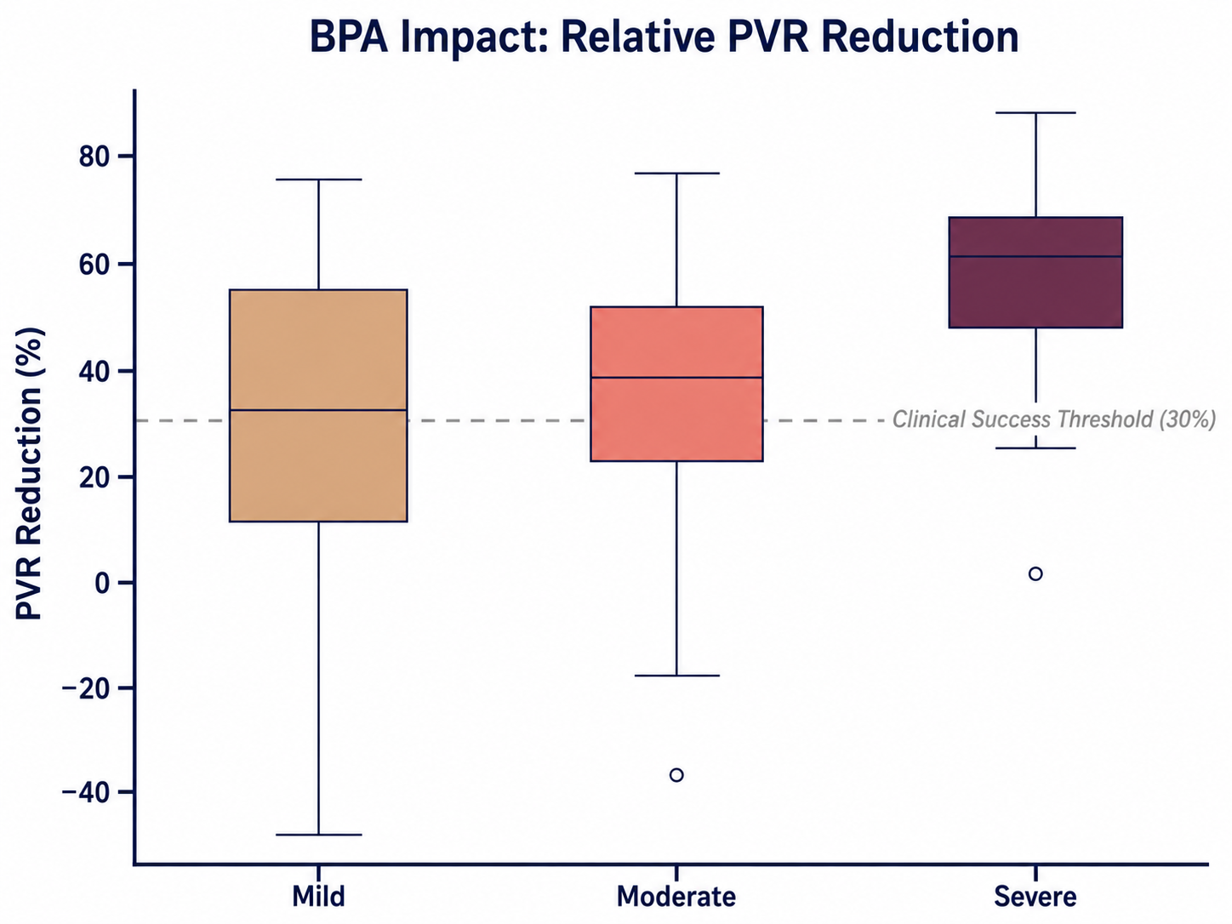
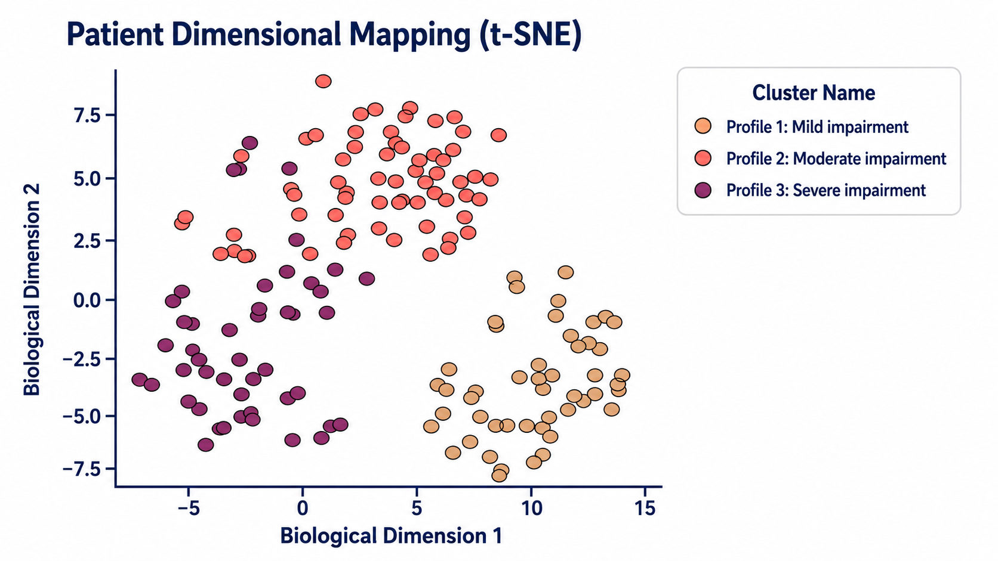
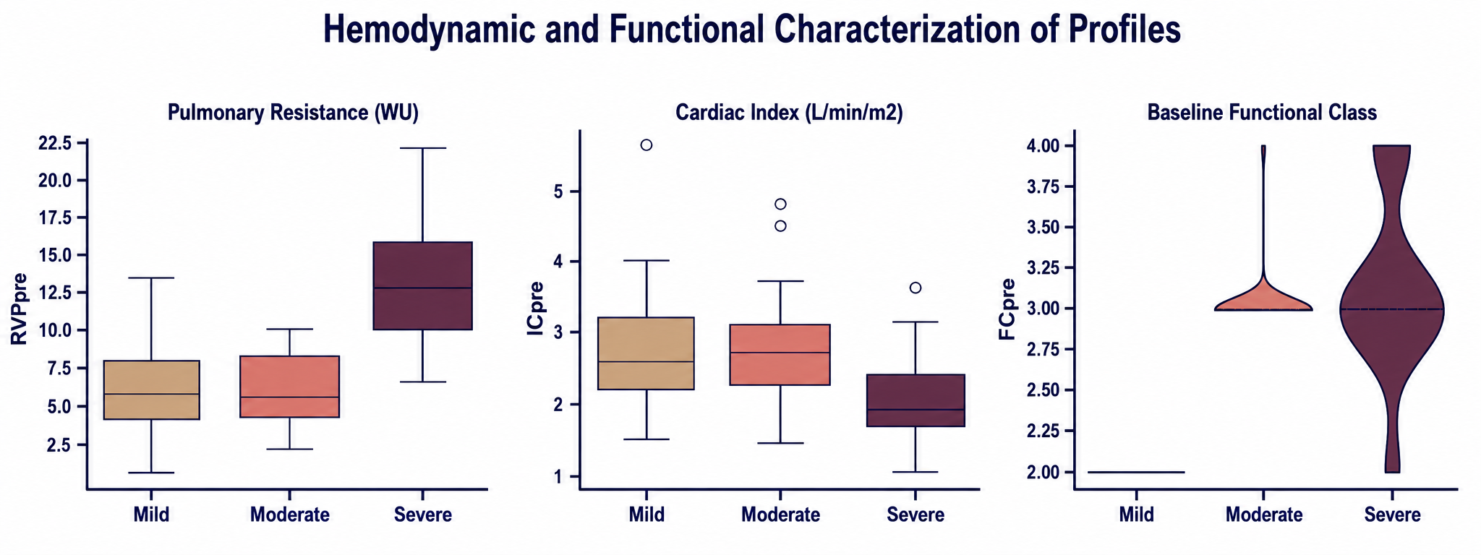
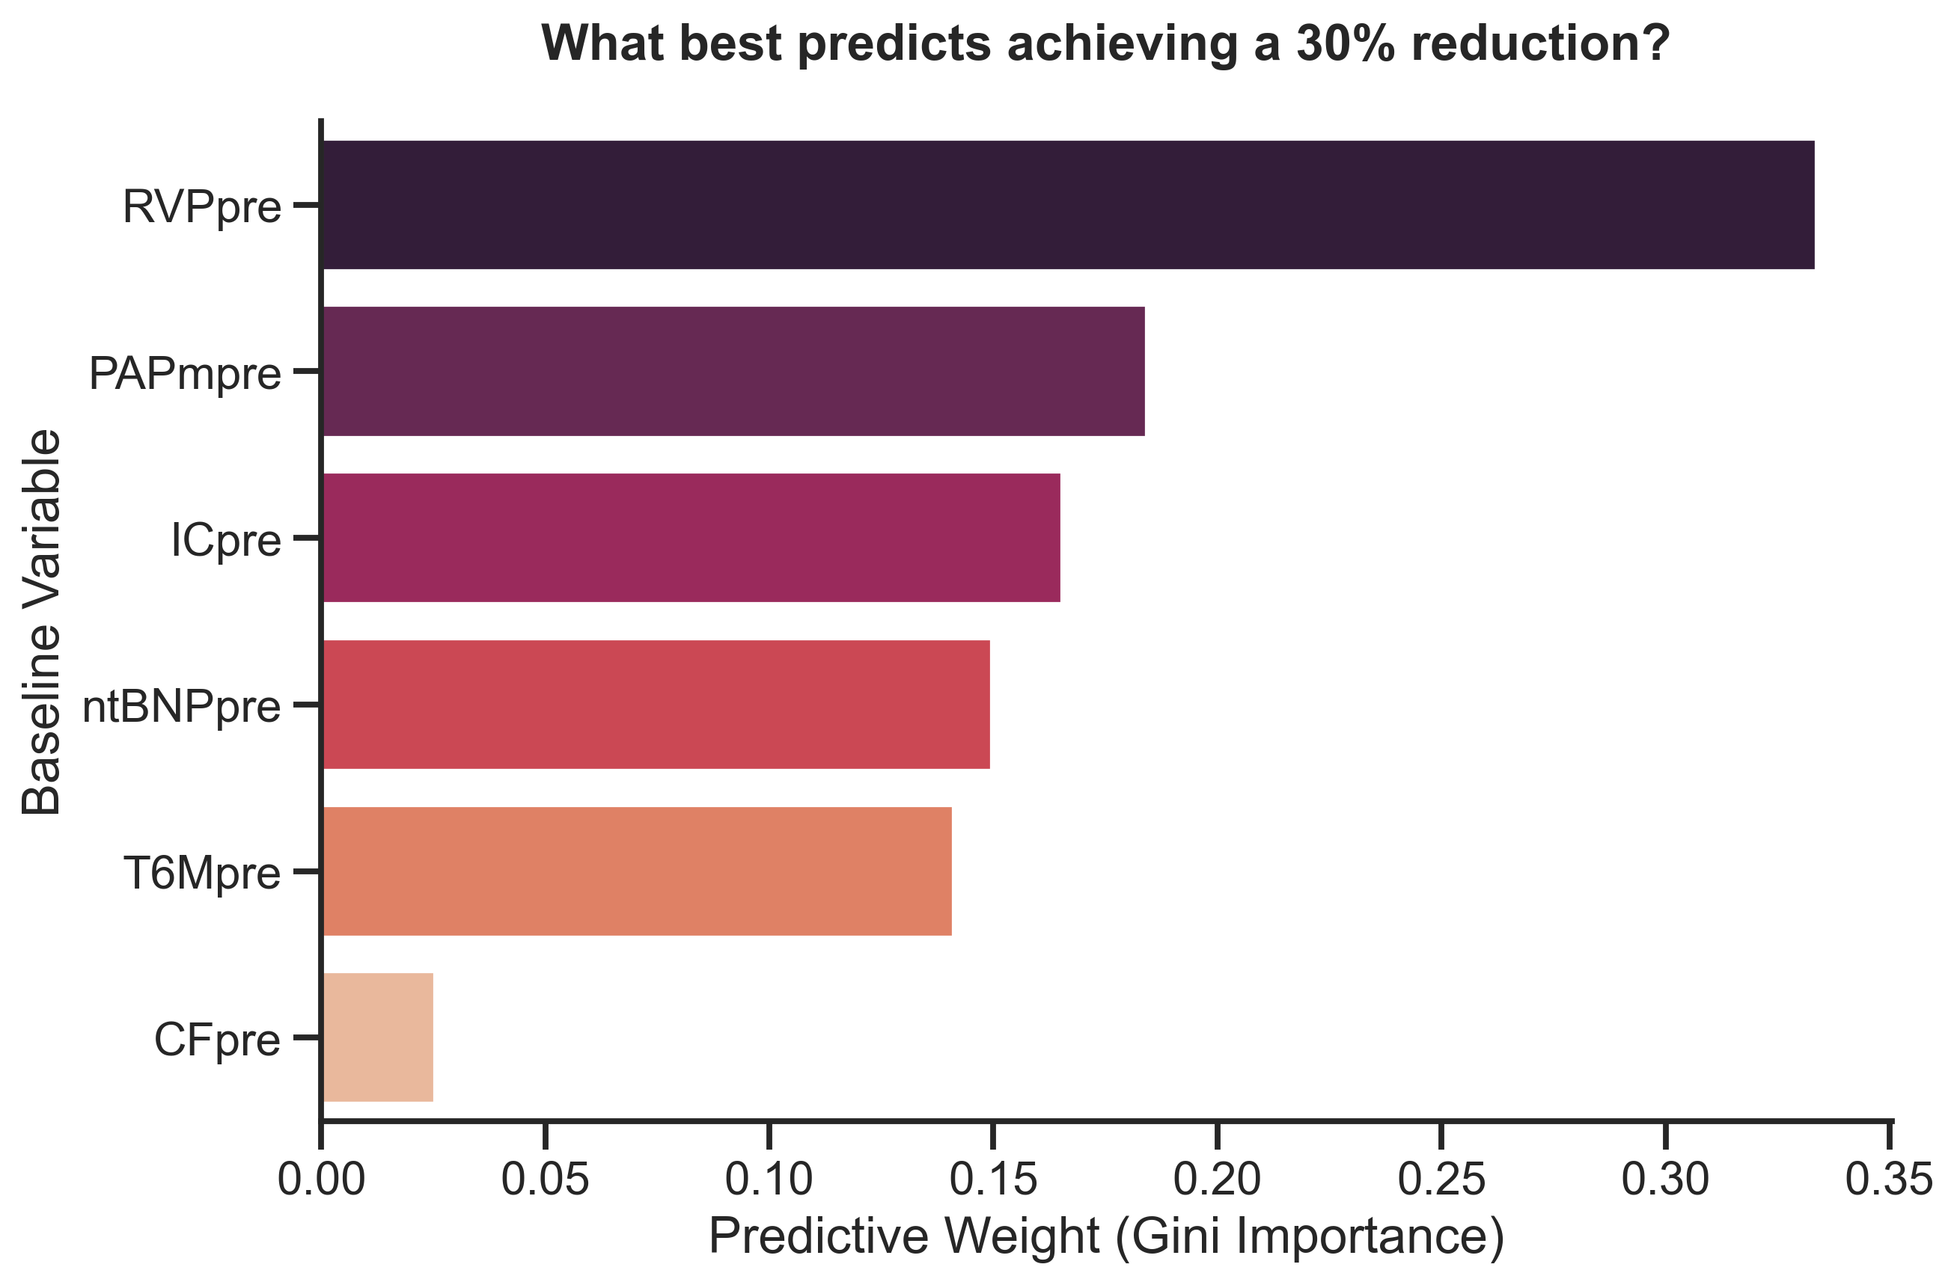
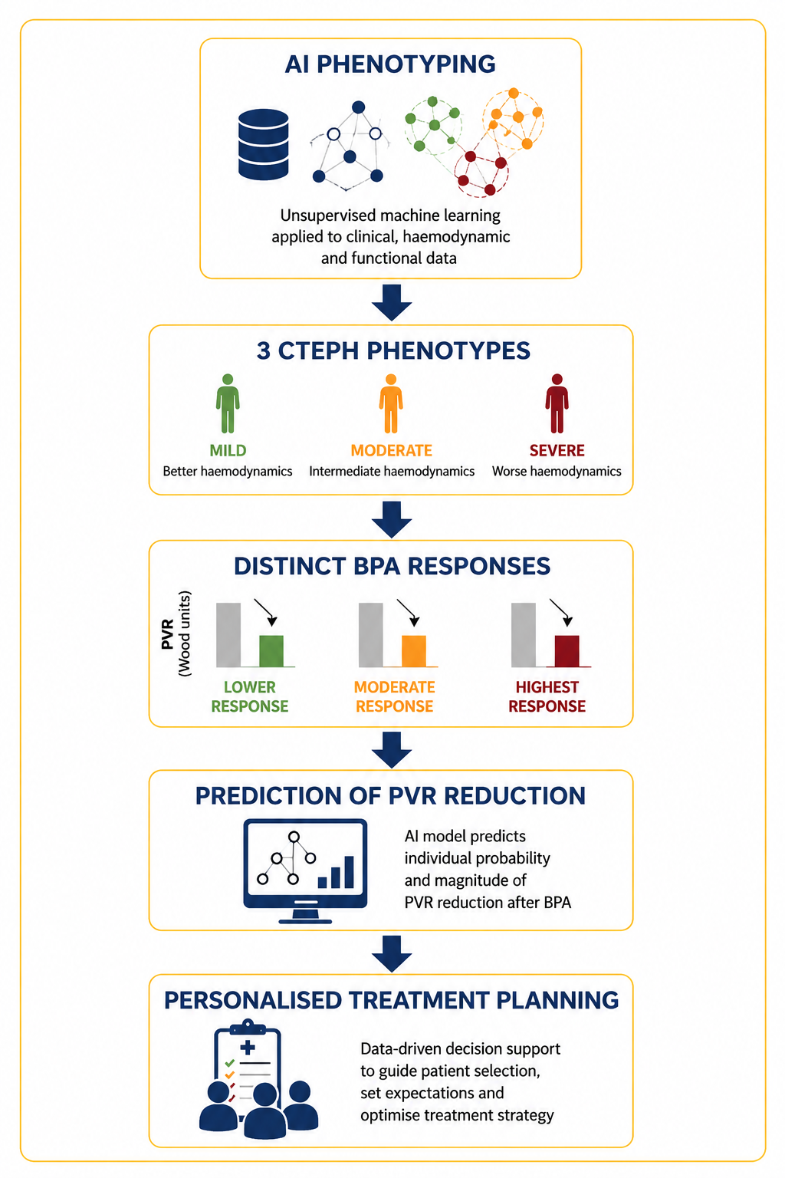
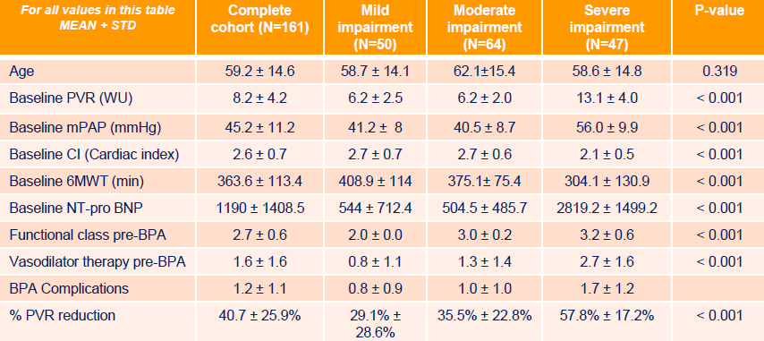











Precision medicine in CTEPH: Spectral‑clustering phenotypes predict haemodynamic benefit of balloon pulmonary angioplasty
Carlos Blanco^{1,2}, María Teresa Velázquez^{3,4,5,6}, Nicolás Maneiro⁵, Julio Mayol^{2,7}, Pilar Escribano‑Subías^{3,4,5,6*}
¹ Unidad de Innovación, IdISSC, Madrid, Spain; ² IdISSC, Madrid, Spain; ³ Imas12, Madrid, Spain; ⁴ Pulmonary Hypertension Unit, Dept. of Cardiology, Hospital Universitario 12 de Octubre, Madrid, Spain; ⁵ Dept. of Cardiology, Hospital Universitario 12 de Octubre, Madrid, Spain; ⁶ CIBERCV, Madrid, Spain; ⁷ Facultad de Medicina, Universidad Complutense de Madrid, Madrid, Spain.
Introduction
Methods
Results
Spectral clustering identified three baseline phenotypes: mild, moderate and severe impairment.
The severe impairment phenotype showed the greatest relative PVR reduction after BPA.
This phenotype was characterized by higher baseline PVR and lower cardiac index.
Baseline PVR was the strongest predictor of achieving a ≥30% PVR reduction.
Results
Discussion
Three reproducible phenotypes identified.
Baseline haemodynamic severity drives BPA response.
Severe disease shows greatest relative benefit.
AI phenotyping enables precision medicine in CTEPH.
Conclusions
Clustering identified three clinically meaningful CTEPH phenotypes with distinct haemodynamic profiles.
The severe impairment phenotype showed the greatest PVR reduction after BPA, suggesting a subgroup of high-benefit responders.
Baseline haemodynamic severity, particularly PVR, was the strongest predictor of achieving a ≥30% PVR reduction.
AI-driven phenotyping may support precision medicine in CTEPH by improving patient stratification and treatment planning.
Contact / QR
Carlos Blanco – carlos.blanco.externo@salud.madrid.org
Unidad de Innovación, IdISSC, Madrid, Spain

