Slide 1

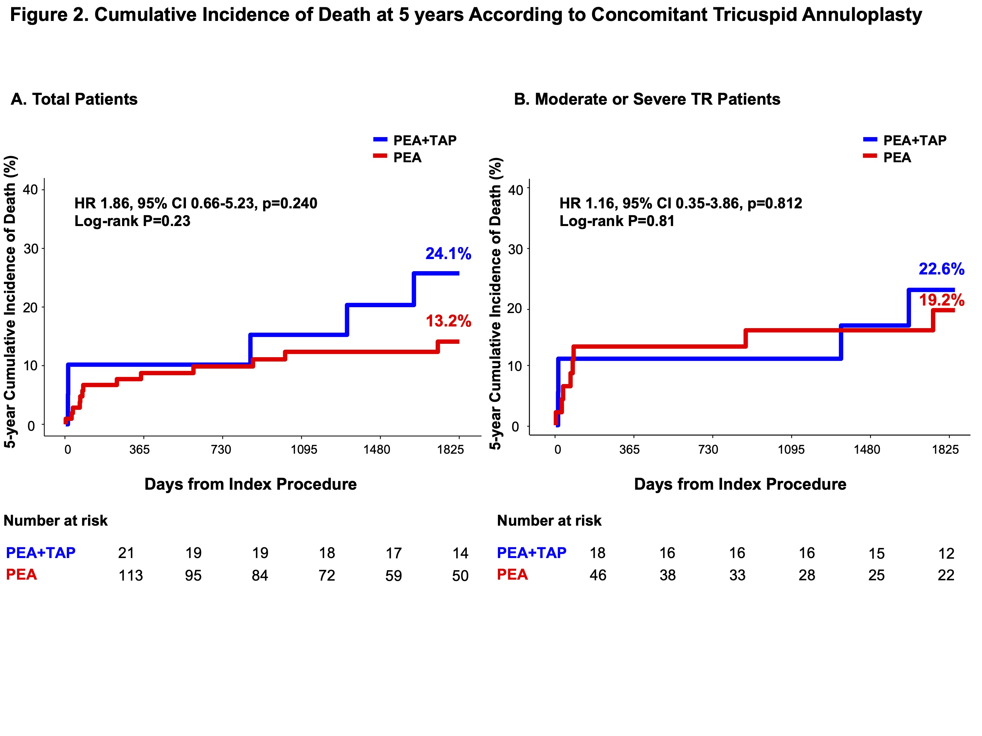

Tricuspid Annuloplasty in Chronic Thromboembolic Pulmonary Hypertension: Impact on Clinical Outcomes and Tricuspid Regurgitation after Pulmonary Endarterectomy
Residual TR was independently associated with follow-up TR peak velocity (adjusted OR 6.16, 95% CI: 2.19–21.32, P=0.002).
CONCLUSIONS
S. Chang¹ , Y. Kim¹ , D. Jeong²
¹Division of Cardiology, Department of Internal Medicine, Heart Vascular Stroke Institute, Samsung Medical Center, Seoul, Korea
²Department of Thoracic and Cardiovascular Surgery, Cardiac and Vascular Center, Samsung Medical Center, Seoul, Korea
Significant TR reduction was observed in PEA alone group comparable to PEA+TAP group with no significant difference in 5-year survival.
Concomitant TAP should be carefully considered in selected patients, with emphasis on controlling persistent pulmonary hypertension.
BACKGROUND
The benefit of concomitant TAP during PEA remains unclear in CTEPH.
This study aimed to evaluate the impact of concomitant TAP on clinical outcomes and TR severity in CTEPH patients undergoing PEA.
METHODS
Patients diagnosed with CTEPH undergoing PEA were retrospectively evaluated.
The primary outcome was 5-year mortality.
RESULTS
We analyzed 134 CTEPH patients (21 PEA+TAP, 113 PEA alone). The mean age was 51.8 ± 15.5 years, and 56.0% were male.
Within 3 months postoperatively, 100% in PEA+TAP group and 82.6% in PEA alone group had none or trace TR.
Concomitant TAP was associated with increased composite risk of in-hospital mortality and ECMO insertion (23.8% vs. 8.0%; RR 2.99, 95% CI: 1.00–8.92, P=0.050), higher risk of pneumonia (28.6% vs. 5.3%; RR 5.38, 95% CI: 1.74–16.68, P=0.004) and extended duration of mechanical ventilation (6.5 ± 7.0 days vs. 1.9 ± 2.3 days, P=0.008).
5-year mortality for overall population was 15.5%, with no significant difference between the groups (Total: 24.1% vs. 13.2%; HR 1.86, 95% CI: 0.66–5.23, P=0.240; moderate or severe TR: 22.6% vs. 19.2%; HR 1.16, 95% CI: 0.35–3.86, P=0.812).

