Slide 1
ICC 2026
Abstract template

Slide 2
Surgical management of chronic thromboembolic pulmonary hypertension with systemic and suprasystemic pulmonary artery pressure
L. Kulyk, Lviv National Medical University, Ukraine
Y. Sirenko, P.Shupik National University of the Healthcare of Ukraine, Kyiv, Ukraine
G. Radchenko - The State Institution "National Scientific Center named after Acad. M.D. Strazhesko of NAMS of Ukraine“, Kyiv, Ukraine
L. Solovey – Lviv University Hospital, Lviv, Ukraine
L.Vasilieva – State Institution ‘Dnipropetrovsk Medical Academy of the Ministry of Health of Ukraine, Dnipro, Ukraine
A. Shnaydruk – Lviv University Hospital, Lviv, Ukraine
V. Pryshlyak – Lviv University Hospital, Lviv, Ukraine
P. Bodak – Lviv University Hospital, Lviv, Ukraine
D. Beshley – Lviv University Hospital, Lviv, Ukraine
Y. Botsiuk – The State Institution "National Scientific Center named after Acad. M.D. Strazhesko of NAMS of Ukraine“, Kyiv, Ukraine

Slide 3
Introduction
PEA is the treatment of choice for CTEPH
BPA and medical therapy (Riociguat) is an established treatment for inoperable CTEPH or persistent/recurrent PH after PEA
No large study has evaluated whether pts with severely elevated PAP
derive benefit from PEA with acceptable mortality.
Do high and very high PAP or PVR preclude the use of PEA ?
Humbert M, Kovacs G, Hoeper M, et al. 2022 ESC/ERS Guidelines for the diagnosis and treatment of pulmonary hypertension. Eur Respir J. 2023;61(1):2200879.
P. Thistlethwaite, A. Kemp, L. Du, M. Madani, S. Jamieson. Outcomes of pulmonary endarterectomy for treatment of extreme thromboembolic pulmonary hypertension JTCS V. 131, N. 2, p. 307-31, 2006

Slide 4
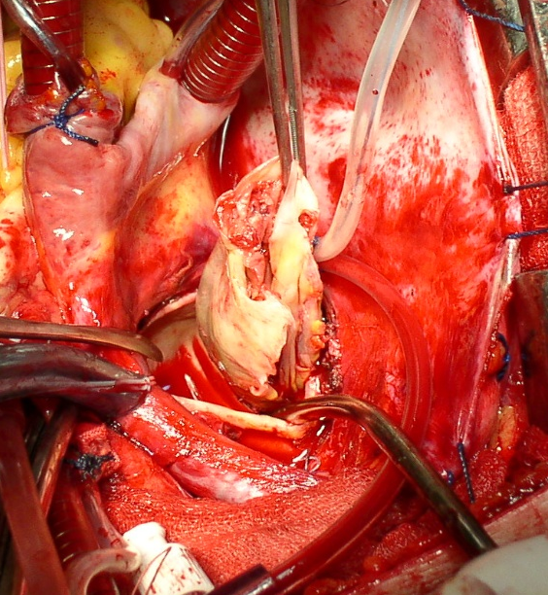
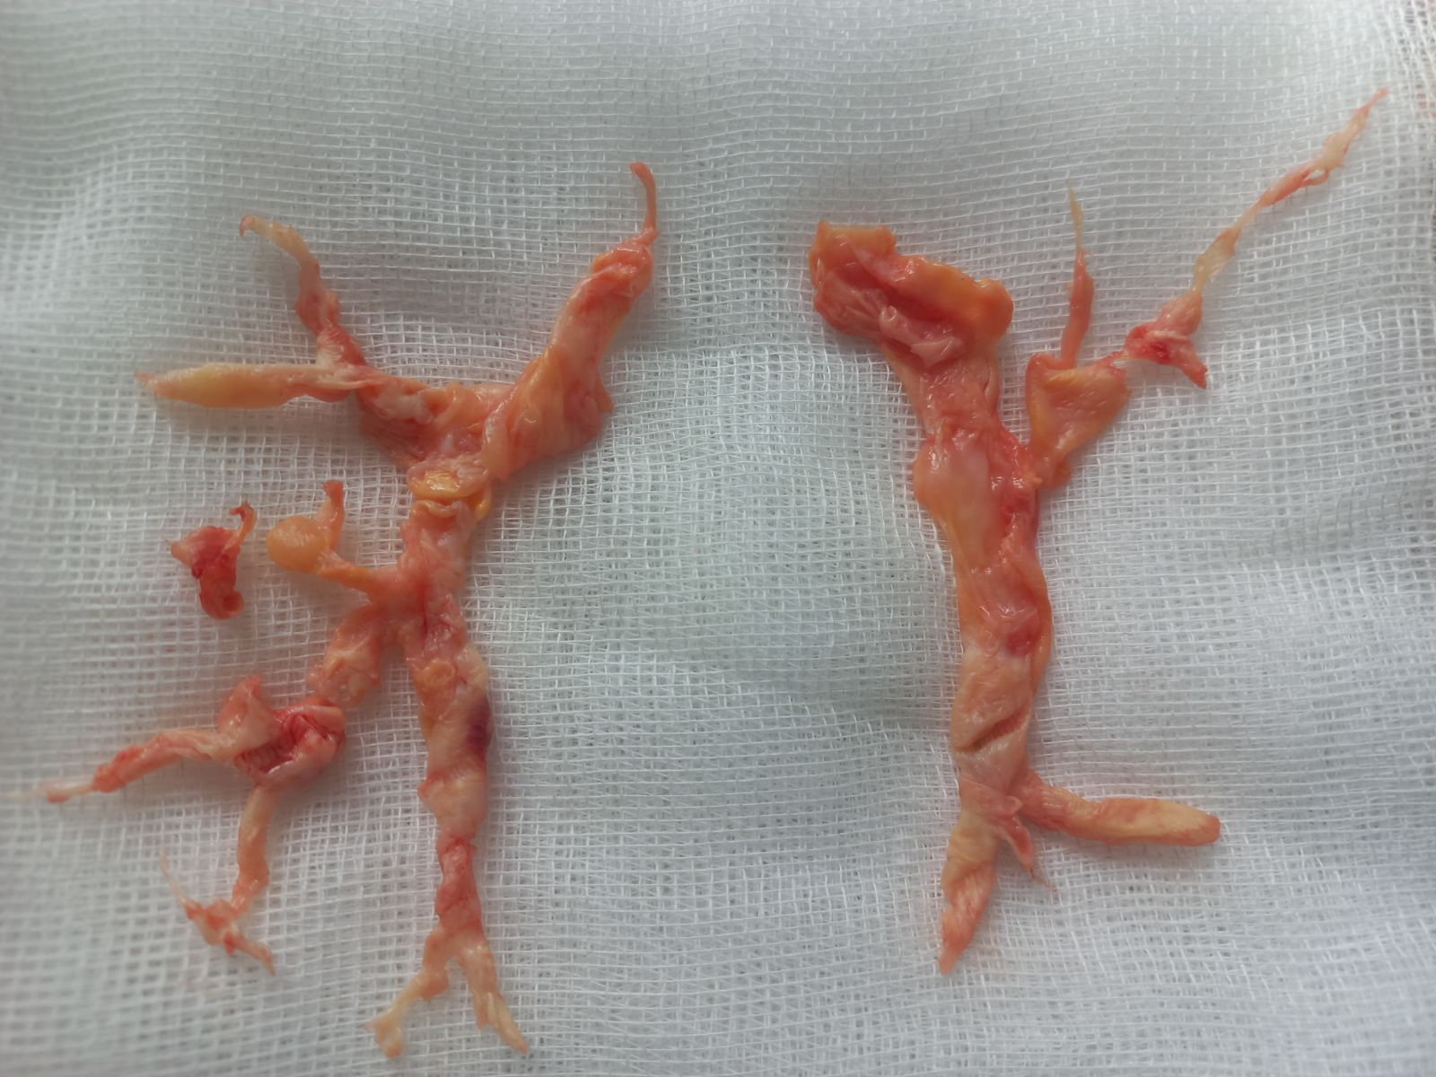
Methods
Characteristics | systemic & suprasystemic PAP n - 21 | total group (1996 - March 2026) n - 211
age, yrs | 22- 65 | 22 - 80
History of PE | 16 (76%) | 74 ( 81%)
Repeat PEA | 1 | 3
Syst. PAP, mm Hg | 118 ± 22 | 65-140
PVR, dynes ∙ sec ∙ cm–5 | 1705 ± 845 | 320 - 2550
Aortic cross clamp (min) | 115±19 | 84 - 145
Total circulatory arrest ( min) | 45-92 | 15-92
ECMO | 6 | 6
San Diego surgical classification Level I, Level II, Level III | 9, 7, 5 | 132 , 48, 31
Bilateral PEA , profound hypothermia, intermittent TCA
b- Level -II
surgical specimen
M. M. Madani Pulmonary endarterectomy for chronic thromboembolic pulmonary hypertension: state-of-the-art 2020
Cardiovascular and Thoracic Surgery, University of California San Diego, La Pulmonary Circulation 2021; 11(2) 1–6

Slide 5
Results
PEA - overall perioperative mortality 5.2% (5/211)
- in pts with systemic & suprasystemic PAP 19 % (4/21 )
- in pts with systemic PAP 15.3% (2/13)
- in pts with suprasystemic PAP 25% ( 2/8 )
ECMO
- moderate-severe PAP none
- systemic & suprasystemic PAP 6 – survive 3
- central veno-arterial ECMO 3 – survive 1
- peripheral veno-arterial ECMO 3 – survive 2
Chia AXF, Valchanov K, Ng C, Tsui S, Taghavi J, Vuylsteke A, Fowles JA, Jenkins DP. Perioperative extracorporeal membrane oxygenation support for pulmonary endarterectomy: A 17-year experience from the UK national cohort. J Heart Lung Transplant. 2024 Feb;43(2):241-250.

Slide 6
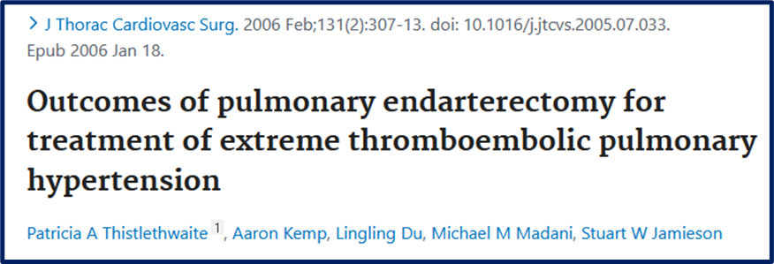
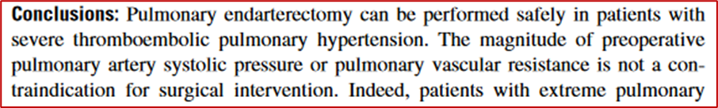
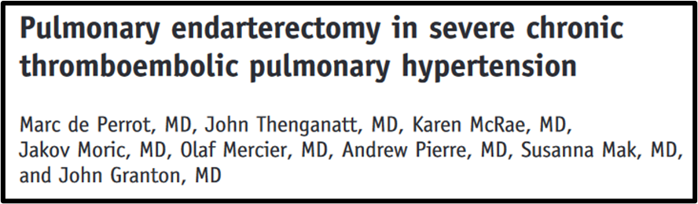
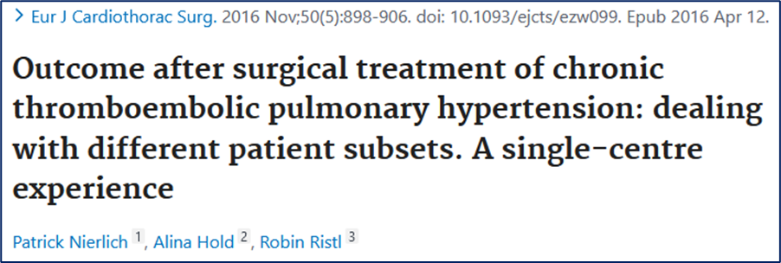
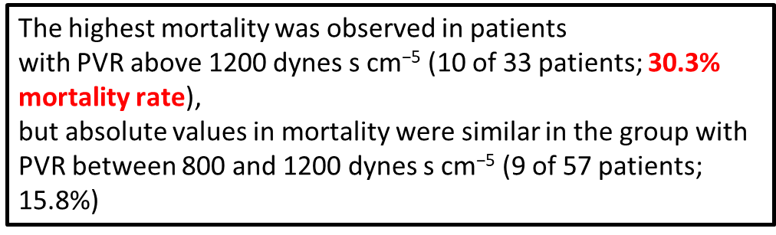
Discussion
743 pts operated 1999 - 2004
65 pts Systolic PAP > 100 mm Hg
- 678 pts Systolic PAP < 100 mm Hg
The overall in-hospital mortality after PEA was 4% (n -5) All deaths occurred in patients with TPR > 1,200 dynes sec cm–5 and decompensated right heart failure.
M. de Perrot , K. McRae , L. Donahoe , et al.; the Canadian CTEPH Working Group Pulmonary endarterectomy in severe chronic thromboembolic pulmonary hypertension: the Toronto experience Ann Cardiothorac Surg . 2022 Mar;11(2):133–142.

Slide 7
Conclusion
PEA should not be denied to patients with high and extremely high PAP when it is evidence of adequate surgical removal of thromboembolic material
PEA in very sick patients with severe PAP and right heart failure remains a great surgical challenge

