Slide 1
ICC 2026
Abstract template

Slide 2
Beyond Chronological Age: The Prognostic Value of the Age-Adjusted Charlson Comorbidity Index in Balloon Pulmonary Angioplasty
Piotr Szwed, MD, Dept. of Pulmonary Circulation, Thromboembolic Diseases and Cardiology, Center of Postgraduate Medical Education, European Health Center, Otwock, Poland
Paweł Kurzyna, MD, Dept. of Pulmonary Circulation, Thromboembolic Diseases and Cardiology, Center of Postgraduate Medical Education, European Health Center, Otwock, Poland
Marta Banaszkiewicz, MD, PhD, Dept. of Pulmonary Circulation, Thromboembolic Diseases and Cardiology, Center of Postgraduate Medical Education, European Health Center, Otwock, Poland
Michał Florczyk, MD, Dept. of Pulmonary Circulation, Thromboembolic Diseases and Cardiology, Center of Postgraduate Medical Education, European Health Center, Otwock, Poland
Michał Piłka, MD, PhD, Dept. of Pulmonary Circulation, Thromboembolic Diseases and Cardiology, Center of Postgraduate Medical Education, European Health Center, Otwock, Poland
Rafał Mańczak, MD, PhD, Dept. of Pulmonary Circulation, Thromboembolic Diseases and Cardiology, Center of Postgraduate Medical Education, European Health Center, Otwock, Poland
Maria Wieteska-Miłek, MD, PhD, Dept. of Pulmonary Circulation, Thromboembolic Diseases and Cardiology, Center of Postgraduate Medical Education, European Health Center, Otwock, Poland
Prof. Adam Torbicki, MD, PhD, Dept. of Pulmonary Circulation, Thromboembolic Diseases and Cardiology, Center of Postgraduate Medical Education, European Health Center, Otwock, Poland
Prof. Marcin Kurzyna, MD, PhD, Dept. of Pulmonary Circulation, Thromboembolic Diseases and Cardiology, Center of Postgraduate Medical Education, European Health Center, Otwock, Poland
Presenting author: Szymon Darocha, MD, PhD, Dept. of Pulmonary Circulation, Thromboembolic Diseases and Cardiology, Center of Postgraduate Medical Education, European Health Center, Otwock, Poland

Slide 3
Introduction
While balloon pulmonary angioplasty (BPA) is established as an effective treatment in elderly patients with chronic thromboembolic pulmonary hypertension (CTEPH), chronological age may not adequately stratify individual clinical risk [1]. This study compared the prognostic utility of chronological age versus both raw and Age-adjusted Charlson Comorbidity Indices (CCI and ACCI) in predicting hemodynamic response, safety, and survival [2].
[1] Shinya, Yoshiki et al. “Efficacy and Long-term Mortality After Balloon Pulmonary Angioplasty in Older Patients With Chronic Thromboembolic Pulmonary Hypertension.” The Canadian journal of cardiology vol. 41,8 (2025): 1469-1476. doi:10.1016/j.cjca.2025.04.029
[2] Charlson, M et al. “Validation of a combined comorbidity index.” Journal of clinical epidemiology vol. 47,11 (1994): 1245-51. doi:10.1016/0895-4356(94)90129-5

Slide 4
Methods
This retrospective single-center study included 190 patients with CTEPH undergoing balloon pulmonary angioplasty (BPA). Patients were stratified by chronological age (≥70 vs <70 years), Charlson Comorbidity Index (CCI ≥3 vs <3), and age-adjusted CCI (ACCI ≥4 vs <4). Therapeutic success was defined as mean pulmonary arterial pressure (mPAP) <30 mmHg or pulmonary vascular resistance (PVR) <3 Wood Units at final follow-up. Percentage changes in hemodynamic and biomarker parameters were analyzed using Wilcoxon tests. Procedural complications were assessed using odds ratios, and survival was evaluated with Kaplan–Meier analysis.

Slide 5
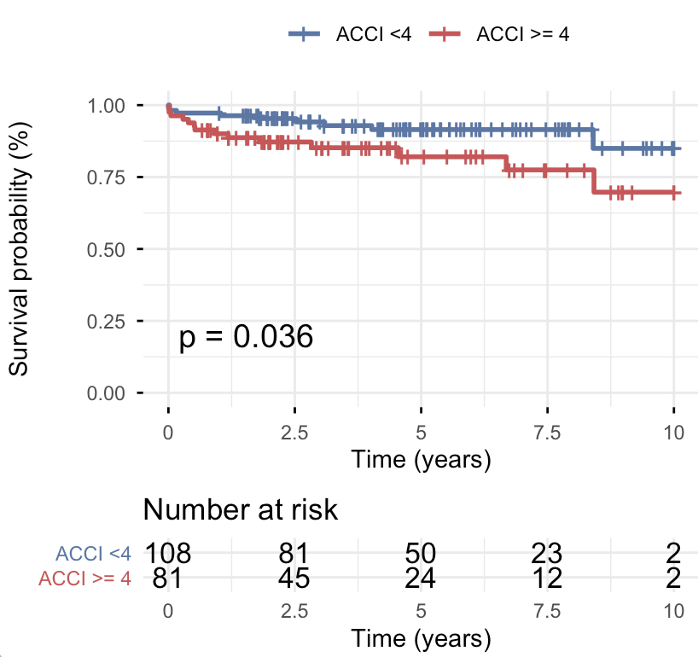
Results
Patients aged ≥70 years presented with a more compromised baseline profile, including lower exercise capacity (6MWD), reduced cardiac output, and higher NT-proBNP, troponin, and creatinine levels. Similarly, high-comorbidity groups (CCI ≥3 and ACCI ≥4) demonstrated higher BMI, elevated PCWP, and more advanced WHO functional class. Although BPA improved hemodynamic parameters overall, the magnitude of improvement was attenuated in elderly and multimorbid patients. Patients ≥70 years showed smaller percentage reductions in mPAP, mRAP, and PVR, while high CCI and ACCI groups failed to demonstrate significant improvements in CI, SVI, and 6MWD. Therapeutic success was less frequent in multimorbid patients (CCI ≥3, p=0.019; ACCI ≥4, p=0.021), whereas chronological age alone was not predictive. Procedural safety was comparable between groups, although contrast-induced nephropathy was more frequent in patients ≥70 years. In survival analysis, ACCI ≥4 emerged as the only predictor of reduced long-term survival (p=0.036).
Fig. 1 Kaplan-Meier survival analysis according to age-adjusted Charlson Comorbidity Index (ACCI) group.

Slide 6
Discussion
Our findings corroborate previous reports indicating that balloon pulmonary angioplasty (BPA) is a safe and effective therapeutic option for elderly patients[1,3]. However, our data add important nuance by showing that, despite meaningful clinical benefit, the magnitude of hemodynamic and functional improvement is attenuated in older patients compared with younger individuals. Although the age-adjusted Charlson Comorbidity Index (ACCI) is widely recognized as a robust prognostic tool in surgical and interventional populations, its role in patients with chronic thromboembolic pulmonary hypertension (CTEPH) undergoing BPA has not been previously examined [2, 4]. To our knowledge, this study represents the first evaluation of a comorbidity-based risk stratification approach in a BPA-treated CTEPH cohort. Our findings suggest that age-adjusted comorbidity burden, rather than chronological age alone, is a key determinant of therapeutic response and long-term survival in this population.
[3] Velázquez Martín, Maite et al. “Balloon pulmonary angioplasty can be an effective and safe therapeutic option in non-surgical elderly patients.” Frontiers in cardiovascular medicine vol. 9 1001518. 25 Oct. 2022, doi:10.3389/fcvm.2022.1001518
[4] Yurkovich M, Avina-Zubieta JA, Thomas J, Gorenchtein M, Lacaille D. A systematic review identifies valid comorbidity indices derived from administrative health data. J Clin Epidemiol. 2015 Jan;68(1):3-14. doi: 10.1016/j.jclinepi.2014.09.010. Epub 2014 Oct 31. PMID: 25441702.

Slide 7
Conclusion
BPA remains safe and effective across age groups. Although advanced age is associated with an attenuated hemodynamic response, chronological age alone provides limited prognostic discrimination with respect to long-term outcomes. The age-adjusted Charlson Comorbidity Index (ACCI) provides more robust risk stratification, identifying patients at increased risk of reduced therapeutic success and higher long-term mortality.

